Slide 1
Northern Ireland Statistics and Research Agency
Dr David Marshall

Slide 2
NISRA: Statistics & Research Agency
Agency within Dept Finance & Personnel
Produce official statistics & social research
e.g. Labour Force Survey, House Price Index, hospital waiting lists, deprivation measures etc…
General Register Office (civil registration)
Statistics - statutory Code of Practice

Slide 3
Air Passenger Statistics – Sources / Key Points
Joanne Henderson

Slide 4
Air Passenger Flow

Slide 5
Air Passenger Statistics Sources
UK Civil Aviation Authority & Irish Aviation Authority
Continuous Household Survey
Northern Ireland Passenger Survey
Country of Residence Survey (CSO, Ireland)

Slide 6
Headline Aviation Authority Data

Slide 7
Total Air Passenger Flow (millions)
Showing up to Q3 2015 – (CAA more up-to-date available)
 | 2005 | 2008 | 2010 | 2013 | Q4 2014 to Q3 2015
UK Airports | 231.7 | 239.5 | 214.3 | 231.7 | 251.9
Northern Ireland Airports | 7.3 | 8.3 | 7.1 | 6.9 | 7.2
Republic of Ireland Airports | 25.7 | 31.0 | 23.5 | 24.6 | 28.8

Slide 8
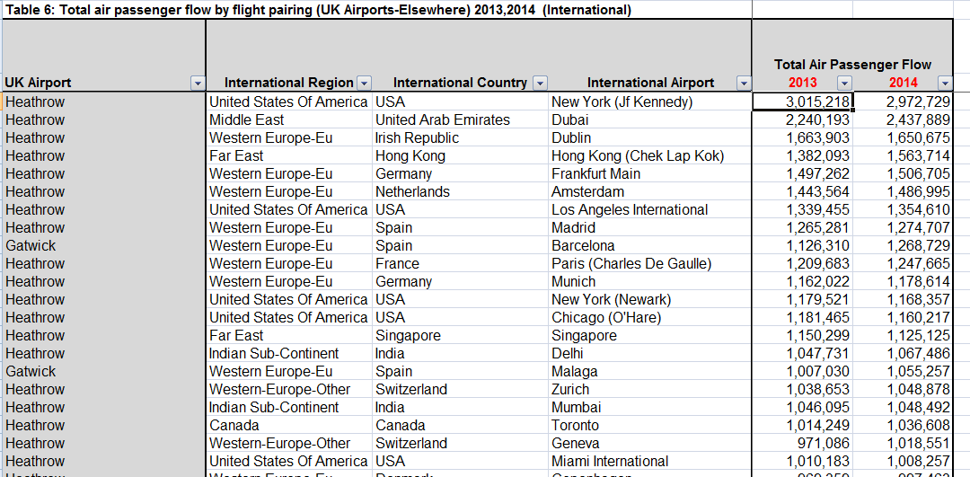
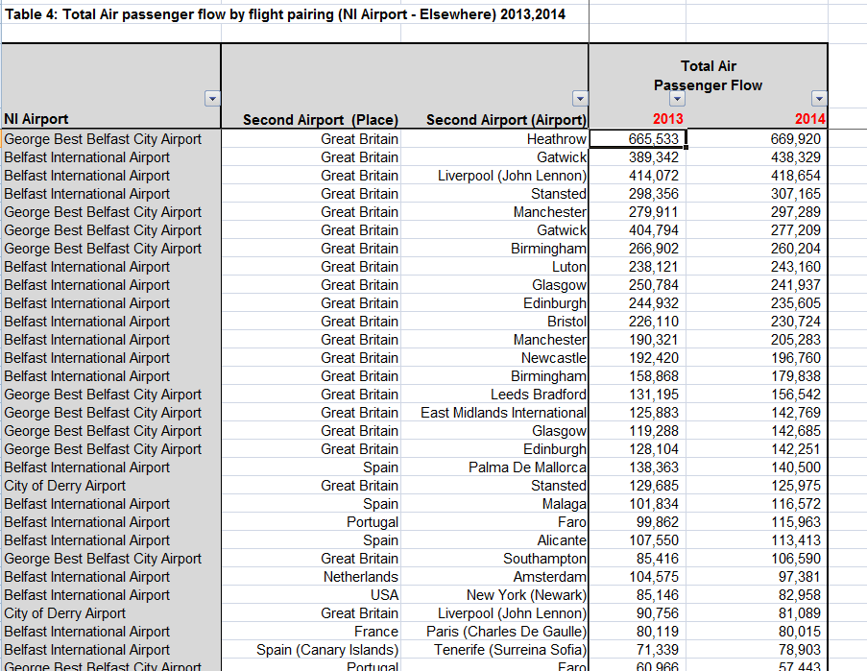
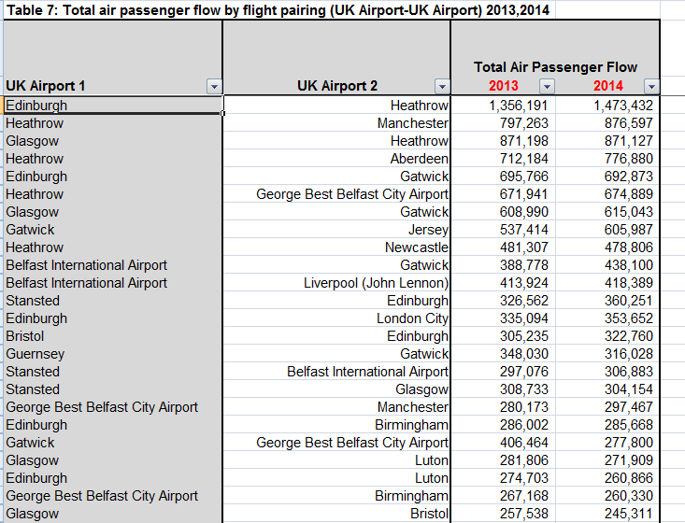
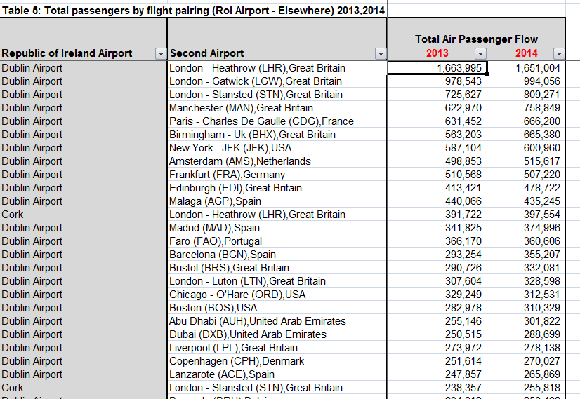
Air Passenger flow by flight pairing
Showing up to 2014
Notes:
CAREFUL RE FLIGHTS WITHIN IRELAND AND DOUBLE COUNTING UK
We plan to update these tables annually

Slide 9
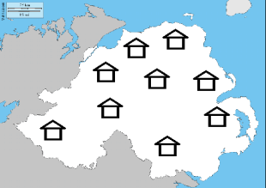
Continuous Household Survey (NISRA)
Methodology
random sample of 4,500 NI addresses
each adult in household invited to participate
face-face interviews / 65% response rate
Questions
In the last 12 months, how many times have you flown (by airplane) where you departed from an airport in NI or RoI?
Which airport did you depart from?
Why did you depart from X airport on this occasion?
What was the country of your final destination?
What was the main purpose for this trip?
Notes:
Points to note
Children (under 16) not included
2014/15 – limited no of flight responses to 10 per person
Potential recall issue (currently asked about flights in last 12 months)
Departure airport – we assume someone flies in and out of same airport
Flights are over a 12 month period so no seasonal effects or knowledge of when flights taken
STILL experimental (only 1 year of information on a sample survey)

Slide 10
Air Passenger Flow – Port Survey
Northern Ireland Passenger Survey
Country of Residence Survey (RoI)
Methodology
What is your Country of Residence?
grossed to CAA/IAA totals
sample NIPS: 55k, CRS: 388k
Notes:
Points to note
-definition of Country of Residence
NI – only asked of those departing so assumption that arrive and depart from same port

Slide 11
Northern Ireland Airports - Residency of Passengers

Slide 12
Northern Ireland Airports – Passenger Residency
(Q4 2014 to Q3 2015)
Northern Ireland residents 7.23m air passenger flow
NI residents 58%
GB residents 33%
RoI residents 3%
Outside UK & Ireland
residents 5%

Slide 13
Northern Ireland Airports Passenger Flow
(Q4 2014 to Q3 2015) – by country of residence
Passenger flow resident in: | Q4 2014 to Q3 2015 | Perc.
Northern Ireland | 4.17 | 57.7%
Great Britain | 2.42 | 33.5%
Republic of Ireland | 0.25 | 3.5%
Other Europe | 0.18 | 2.5%
North America (USA & Canada) | 0.11 | 1.5%
Other | 0.10 | 1.4%
Northern Ireland Airports | 7.23 | 100%

Slide 14
Northern Ireland Residents - Airport Used

Slide 15
Northern Ireland Resident Air Passenger Flow
by Airport (Q4 2014 – Q3 2015)
Northern Ireland residents 5.02m air passenger flow
NI Airports 4.17m
RoI Airports 0.85m
Belfast International 52%
George Best Belfast City 29%
City of Derry 2%
Dublin 16%
5.02 million
NI residents air
passenger flow

Slide 16
Other Data Published
Sub-Northern Ireland breakdown
e.g. Newry, Mourne & Down LGD residents more likely to use Dublin Airport
Reason for flight
e.g. Importance of business to George Best, Belfast City Airport

Slide 17
Further Data to be published
Plan to publish data on visitors to NI by airport used

Slide 18
Air Passenger Statistics – Sources / Key Points
Joanne Henderson

