Slide 1
Labour Market Statistics
User Group
21 October 2020

Slide 2
Aim of today’s meeting
Update users on
1) publication cycle
2) impact of COVID-19 on data collection
2) new data and analysis to understand COVID-19 impacts
Obtain feedback from users on
1) proposed changes
2) information needs

Slide 3
Agenda
Overall Publication Cycle for Labour Market Stats
Unemployment, Employment, Inactivity Experimental Claimant Count Earnings Q&A
Business Register and Employment Survey Quarterly Employment Survey Furlough data and Redundancies Q&A
Notes:
Publication cycle
Plus women in NI – every 18months to 2 years
Draw attention to additional pieces published – work quality, self employment topic paper
COVID impact on publications to some extent – delayed publication of annual report until September, originally planned for June….but other outputs maintained on schedule
COVID impact on data collection. LFS

Slide 4
Publication Cycle

Slide 5
NEETs, Households, Quarterly tables, Vacancies
Quarterly Employment Survey
NEETs, Households, Quarterly tables, Vacancies
Quarterly Employment Survey
NEETs, Households, Quarterly tables, Vacancies
Quarterly Employment Survey
NEETs, Households, Quarterly tables, Vacancies
Quarterly Employment Survey
LMR
LMR
LMR
LMR
LMR
LMR
LMR
LMR
LMR
LMR
LMR
LMR
Publication Cycle
ASHE Pensions
LFS Annual Report Summary
BRES
Work Quality
LFS Annual Report
ASHE
Women in NI
Topic Papers

Slide 6
Labour Force Survey
Economic and Labour Market
Statistics, Carly Gordon

Slide 7
Progress - Summary
 | Actions
Survey and data:
Impact of covid-19 | Monitoring of impacts to data collection, weighting of data, additional/new outputs
Response rates | Sample boost, survey materials, incentives etc.
Compliance Check | LMR incorporated more detail on uncertainty around estimates, all related documents updated and website reorganised. Very positive feedback from OSR
Publications:
LMR | Additional analysis, Stats Disclosure Control Policy
Annual Report | Summary in April 2020 and new look full report in October 2020
Women in NI | Published in June 2020 with focus on LFS only and links to other data sources.
Self-employment Topic Paper | Topic paper examining trends in and the profile of self-employed
Hours Worked Topic Paper | Topic paper examining the change in the number of hours worked
Work quality | 2019 update of work quality tables published in September 2020
NEW
NEW

Slide 8
Data collection
Outputs
Impact of Covid-19
Data processing
Sample size

Slide 9

Impact on Data Collection
Hold on face-to-face interviews since March
Telephone Interviewing
Initial contact/engagement
Encouraging engagement of the public

Slide 10
Impact on sample size
72%
47%
October-December 2019
April-June 2020

Slide 11
Impact to Precision
 | Confidence Intervals
 | October-December 2019 | April-June 2020
Employed (number) | +19,000 | + 21,000
Unemployed (number) | +5,000 | +6,000
Economically Inactive (number) | +18,000 | +21,000
Employment Rate | +1.5 | +1.7
Unemployment Rate | +0.6 | +0.6
Economic Inactivity Rate | +1.5 | +1.6

Slide 12
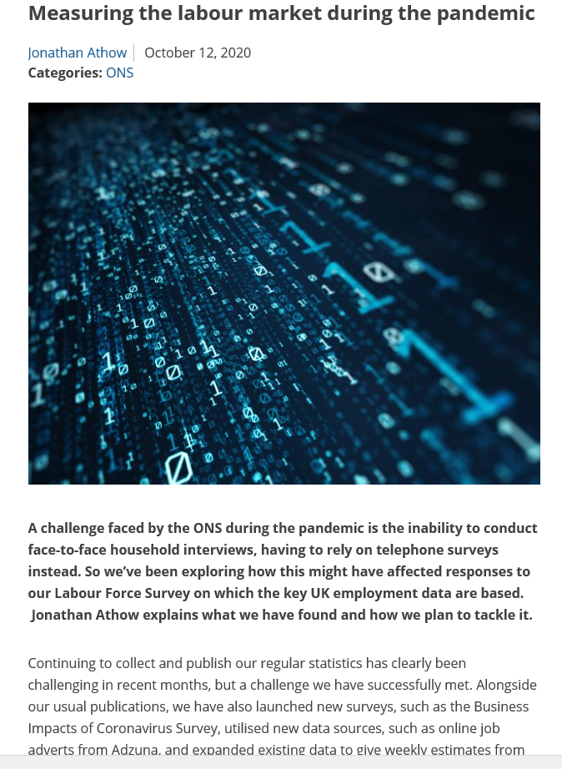
Impact on Data Processing
https://blog.ons.gov.uk/2020/10/12/measuring-the-labour-market-during-the-pandemic

Slide 13
NI Employment Rates (16-64), Previously Published and Revised Estimates (non-zero axis)
NI Economic Inactivity Rates (16-64), Previously Published and Revised Estimates (non-zero axis)
NI Unemployment Rates (16+), Previously Published and Revised Estimates (non-zero axis)

Slide 14
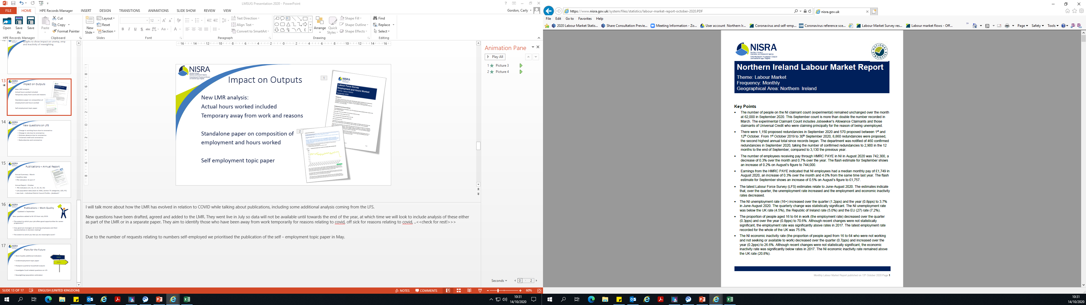
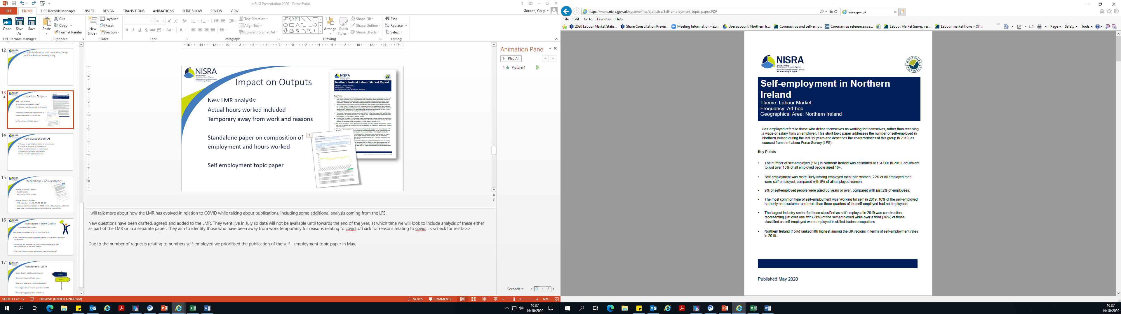
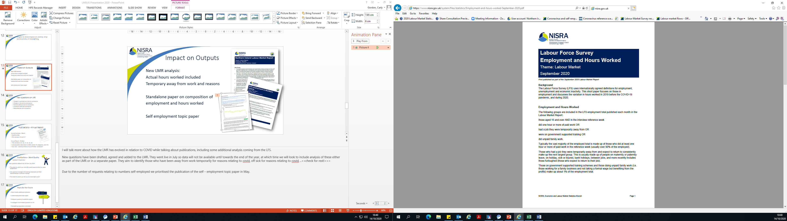
Impact on Outputs
New LMR analysis:
Actual hours worked included
Temporary away from work and reasons
Standalone paper on composition of
employment and hours worked
Self employment topic paper

Slide 15

New questions on LFS
  Change in working hours due to coronavirus
  Change in role due to coronavirus
  Sickness absence due to coronavirus
  Universal credit and coronavirus
  Redundancies and coronavirus

Slide 16
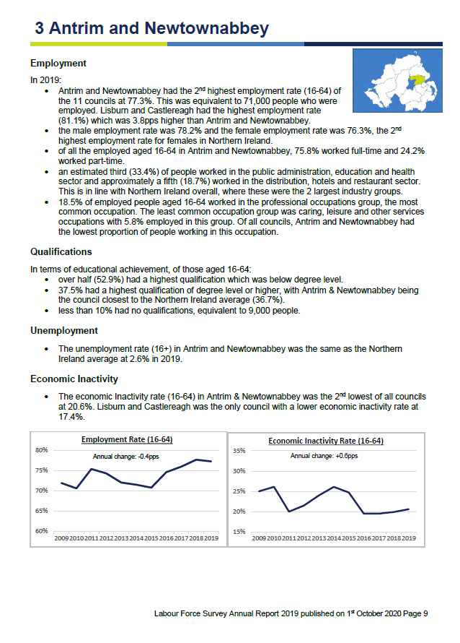
Publications – Annual Report
Annual Summary - March
headline data
PfG indicators 16 and 17
Annual Report - October
PfG indicators (14, 16, 17, 32, 33, 34)
sub-population data (back to 2006, section 75 categories, LGD, PC)
new look – individual District Council Profile

Slide 17

Publications – Work Quality
Updated in September
New questions added to NI LFS from July 2019:
The extent to which your job offers good opportunities for career progression?
How good are managers at involving employees and their representatives in decision making?
The extent to which you feel you do meaningful work?

Slide 18

Plans for the Future
Work Quality additional indicators
Underemployment topic paper
Postpone quarterly household outputs
Investigate Covid related questions on LFS
Women in NI
Reweighting (population estimates)
2019/20
2020/21

Slide 19
Experimental Claimant Count
Economic and Labour Market
Statistics, Cathryn Blair

Slide 20
Claimant Count- Overview
        Measure of the number of people claiming unemployment related benefits
        Data is derived from Jobs and Benefits Offices systems
        Counts relate to second Thursday in each month
        Published a month after count date
        Timely economic indicator

Slide 21

Claimant Count- Overview
        Universal Credit was rolled out for new claimants on a phased basis between September 2017 and December 2018
        Jobseeker’s Allowance Claimants and those in the searching for work conditionality of Universal Credit – since March 2018
        Steady decline in the proportion of JSA claimants in the Claimant Count
          March 2019 broadly 50/50
          March 2020 JSA -36%, UC 64%
        Removed the CC from LMR due to a period of revisions

Slide 22

Seasonally adjusted claimant count (experimental) monthly rates
September 2005 - September 2020
Note: there was an undercount between December 2018 and November 2019
See correction note in Labour Market Report for more details
Data published – 13th October 2020

Slide 23
Seasonally adjusted claimant count and LFS Unemployment
September 2005 - September 2020
LFS Unemployment
Note: there was an undercount in claimant count between December 2018 and November 2019
See correction note in Labour Market Report for more details
Data published – 13th October 2020

Slide 24
Difference between
LFS Unemployment and Claimant Count
        Claimant Count
        … includes JSA claimants plus out-of-work Universal Credit (UC) claimants who were claiming it principally for the reason of being unemployed (those in the “searching for work” conditionality regime).
        Those claiming such benefits may be wholly unemployed and seeking work, or may be employed but with low income and/or low hours, that make them eligible for unemployment-related benefit support.
        LFS Unemployment
        …includes those without a job who were able to start work in the two weeks following their LFS interview and had either looked for work in the four weeks prior to interview or were waiting to start a job they had already obtained.

Slide 25
Increase in Claimant Count
The recent increases in claimant count can largely be attributed to the increase in the numbers of people becoming unemployed,
or having their hours reduced, resulting in very low earnings below the administrative earnings threshold.
There may be some persons, previously not eligible for UC due to partner earnings, now eligible as a result of work allowance increases who would now be included within the count.

Slide 26
Claimants who are Employed – GB
DWP released information on the employment status of UC claimants in GB
In March 2020, 15% of those claiming under the searching for work conditionality were employed
By April this had increased to 20%
In August it had fallen to 12%

Slide 27
Earnings
Annual Survey of Hours and Earnings and HMRC RTI PAYE
Economic and Labour Market
Statistics

Slide 28
Annual Survey of Hours and Earnings 2020

Slide 29

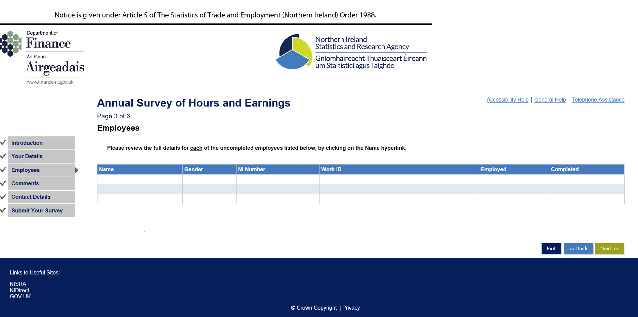
ASHE Data Collection 2020
Extra guidance for completing the form, particularly for furloughed employees
New eForm
Response rate
80%

Slide 30
ASHE 2020
New furlough variable – linked across from HMRC Coronavirus Job Retention Scheme information
Usually employees who’s earnings were reduced by absence are excluded from the ASHE estimates
To remove furloughed staff, who were more likely to be lower earners, would over inflate the estimates
Created an adapted version of the loss of pay variable which identifies those employees with a loss of pay but were not furloughed. This group will be excluded from 2020 estimates.
Similar to previous years, this group accounts for around 5% of the UK sample

Slide 31
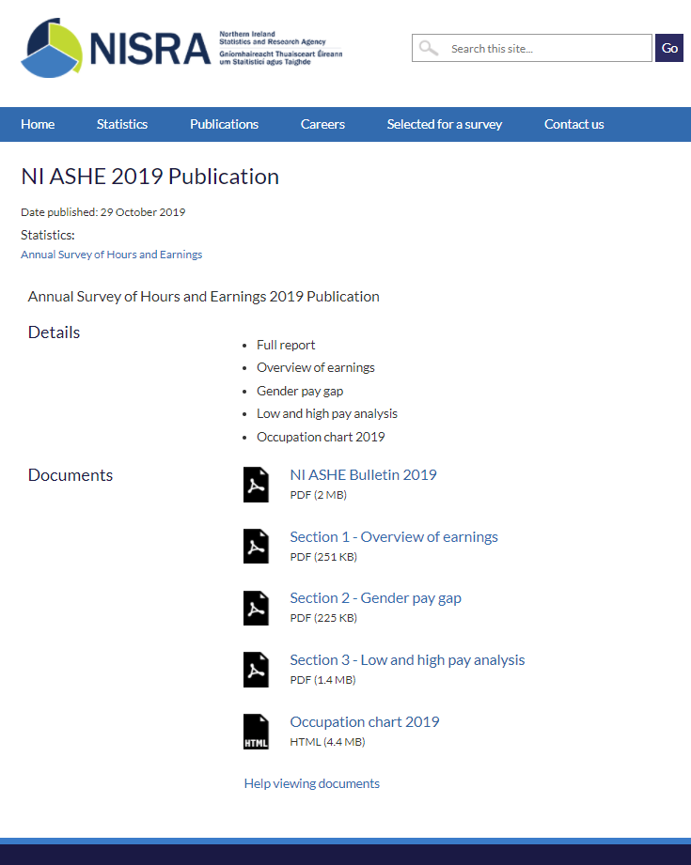
ASHE 2020
Publication date – 3rd November
3 sections as last year, but adapted to reflect the unusual situation in the labour market this year
Hope to publish all data tables on the publications date or quickly thereafter

Slide 32
HMRC’s RTI PAYE Data
EXPERIMENTAL
Real Time Information Pay As You Earn system
Monthly data on earnings and pay-rolled employees
Now included in the Labour Market Report
Since October, median earnings and employee counts are available for individual months (t+6 weeks)
Flash estimates (t+2 weeks)

Slide 33
Median Monthly Employee Pay

Slide 34
Number of Paid Employees
Seasonally Adjusted

Slide 35
Business Register and Employment Survey
(BRES)
Arlene Connolly
Notes:
BRES collects employee job data at a local unit level so can provide a geography split of the data as well as an industry split.
BRES as the title suggests is also the main survey within ELMS that updates the business register – ie information taken from BRES is used for SIC codes, addresses, contact details, number of local units, activity transfers

Slide 36


Meet the team: BRES and IDBR
Clare Kennedy
BRES
Neil Mulhern
IDBR
arlene.connolly@nisra.gov.uk
neil.Mulhern@nisra.gov.uk
clare.kennedy@nisra.gov.uk
Arlene Connolly

Slide 37
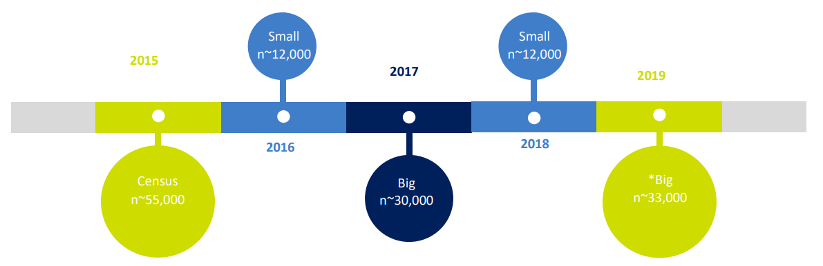
BRES Survey Cycle
BRES 2019 should have been a Census BRES
Notes:
To refresh your memories we have a 4-year survey cycle.
A full census and a big BRES allow disaggregation of the data to all geographies and industry levels.
A small bres produces results at DCA and headline only – but we will keep the small BRES as that is what you have told us to do.
BRES 2019 should have been a census year but the decision was taken within the branch that it would be a big BRES as we were undergoing a data transformation and the resources were not available to process 55K forms
Also we are continually trying to reduce burden on business so from a users perspective the output would be the same but we would have reduced our survey burden.
Errors around big BRES data are in the region of <1% at DCA and Section Level and remain relatively low at other disaggregations <2% so still an extremely accurate dataset

Slide 38
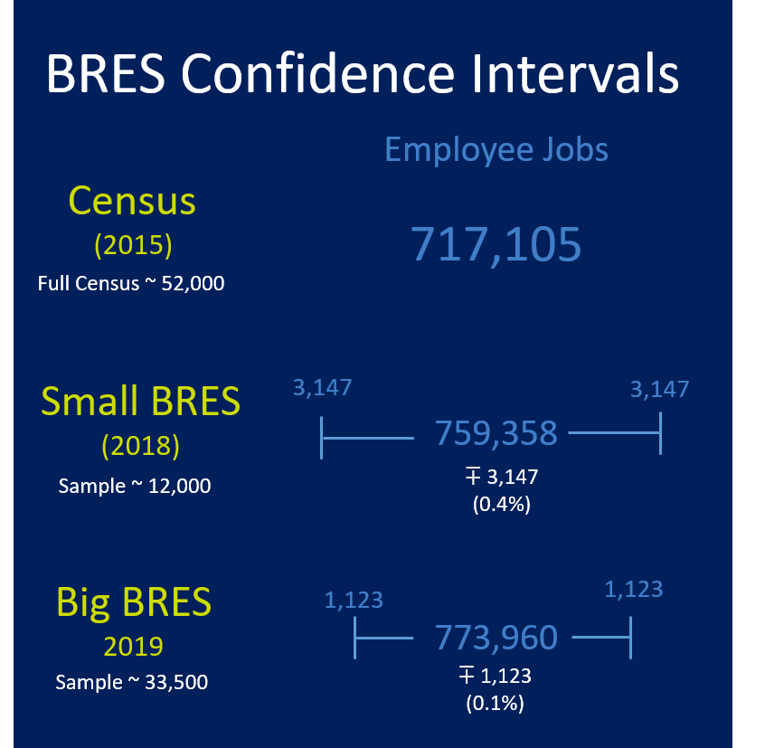

Slide 39

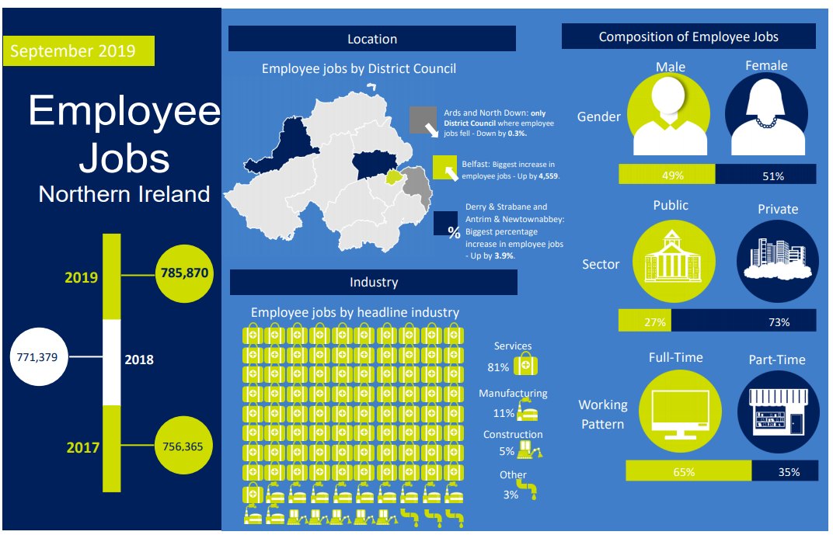
BRES 2019
No impact from COVID-19 lockdown
Publication Date: 30th June 2020
Big BRES (Sample size ≈ 33,000)
72% response rate (45% EDC)
Outputs:
- Statistical report with charts and commentary
Infographics
Data tables
Lots of ad-hoc queries
Summary Infographic

Slide 40
Earlier publication date
We looked at coverage and not response rate
Targeted businesses needed to reach our coverage limits
We SAS coded an outlier methodology
Introduced PowerBI to help analyse the data identifying reasons for change
Balance
Timeliness Accuracy

Slide 41
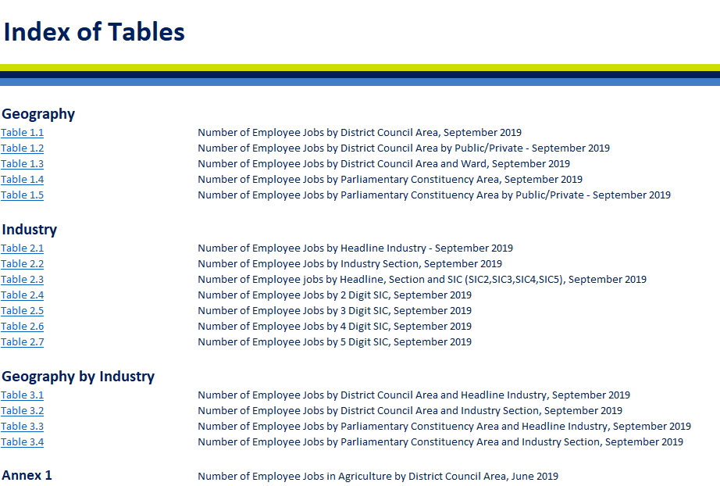
BRES 2019 output

Slide 42
BRES 2020
Survey date: 7th September 2020
Small BRES (Sample size ≈ 16,000)
New webforms
Outputs June 2021:
Geography – DCA only;
Industry – Headline only, and
Geography by Industry – DCA by Headline.
Notes:
Another push to increase the number of businesses using webforms which have replaced our eForms
800 from proving
2,200 a boost in anticipation of a reduced sample size

Slide 43
BRES 2020
Not included a furlough question
All staff on furlough are to be included in BRES counts
Employees working from home will be placed in their normal office (local unit) even if the office has been closed – methodology agreed by ONS BRES and ONS IDBR
We will be involved with ONS IDBR discussions on increased wfh and geographical placement of employee jobs
To date the BRES 2020 response rate is commensurate with previous years ~45% with survey closing end of Jan 2021

Slide 44


Update on migrant and vacancy data collected via BRES 2018, 2019
We have 2 years worth of data (1 small and 1 big)
Questions are retained on the BRES 2020 form
Initial results are due soon – analysis delayed as a result of COVID-19
Migrant Question
Vacancy Question

Slide 45
Links to our most recent publications
BRES 2019
https://www.nisra.gov.uk/publications/bres-publications-and-tables-2019
IDBR: Northern Ireland Business; activity, size, location and ownership, 2020
https://www.nisra.gov.uk/publications/current-publication-and-idbr-tables-1
IDBR: Business Demography NI 2018 (births and deaths)
https://www.nisra.gov.uk/publications/business-demography-ni

Slide 46
Useful Links
ONS quarterly release of IDBR birth and death statistics (experimental)
https://www.ons.gov.uk/businessindustryandtrade/business/activitysizeandlocation/bulletins/businessdemographyquarterlyexperimentalstatisticsuk/apriltojune2020
Agricultural Census in Northern Ireland
https://www.daera-ni.gov.uk/articles/agricultural-census-northern-ireland
BEIS report providing estimates for self-employed in NI
https://assets.publishing.service.gov.uk/government/uploads/system/uploads/attachment_data/file/922793/BPE__2020_detailed_tables.xlsx

Slide 47
Quarterly Employment Survey (QES)
Lynda Kennedy

Slide 48
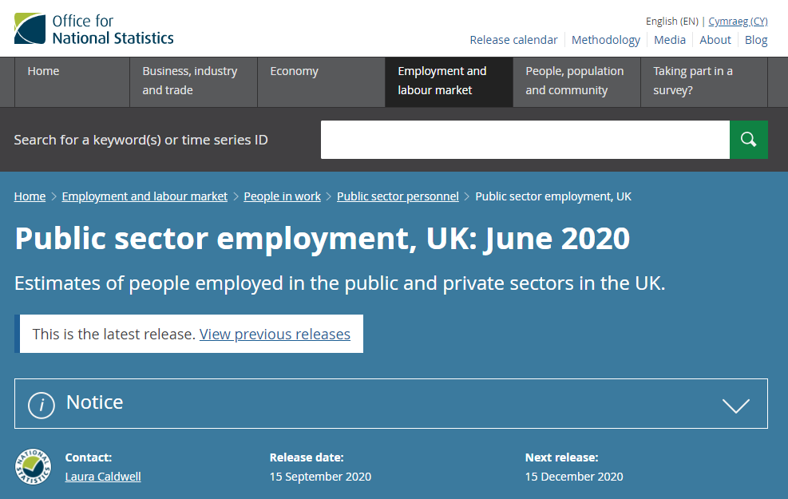
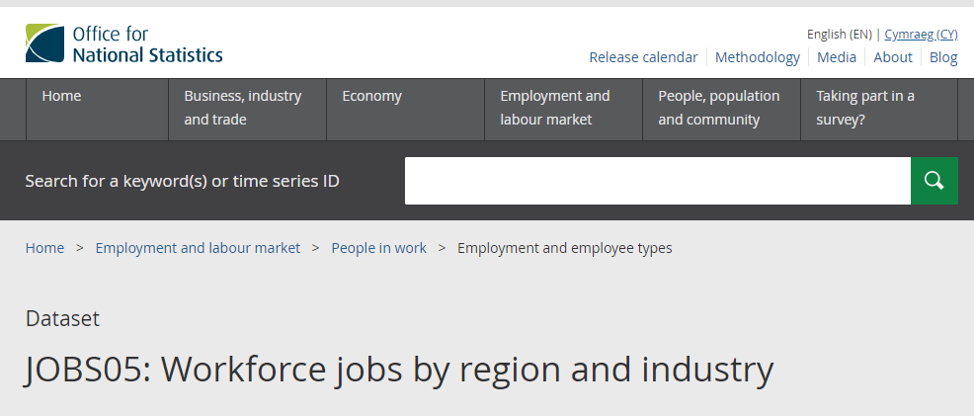
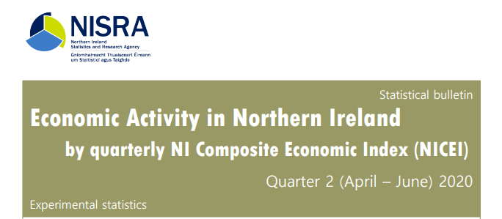
Quarterly Employment Survey (QES)
Overview
Provides short term estimates of employee jobs in Northern Ireland through a quarterly sample survey of approx. 6,000 businesses.
Only includes Pay As You Earn (PAYE) jobs – the self employed are not included.
QES estimates are used in the calculation of:
  ONS UK Workforce Jobs
  ONS UK Public Sector Employment estimates
  NICEI calculations

Slide 49
Quarterly Employment Survey (QES)
Latest Results
Published on 15th September 2020 at 7.00am for Q2 2020.
The survey date for Q2 was 1st June 2020. This was following the introduction of the Coronavirus Job Retention Scheme (CJRS) in April 2020.
Those who are furloughed under the CJRS are included in QES employee jobs estimates.
Latest HMRC furlough data (next release 22nd October 2020): www.gov.uk/government/statistics/coronavirus-job-retention-scheme-statistics-september-2020
Data source reference
periods and key dates

Slide 50

Quarterly Employment Survey (QES)
COVID-19 impacted on the data collection and validation of employee jobs data.
  Business closures – fewer responses and reduced business contact for validating data.
*median value achieved at QES database closure of quarter 1, quarter 2, quarter 3 and quarter 4 2019.
As a result:
  estimates for Q1 and Q2 2020 are likely to be subject to higher revisions than normal over the coming quarters (late returns, mop up exercise).
  estimates at lower industry levels (e.g. 2 digit Standard Industrial Classification level), should be treated with caution.
 | Quarter 2 2020 | 2019 (median*)
Coverage response rate (returned employees) | 62% | 77%
Form response rate (returned forms) | 54% | 74%

Slide 51
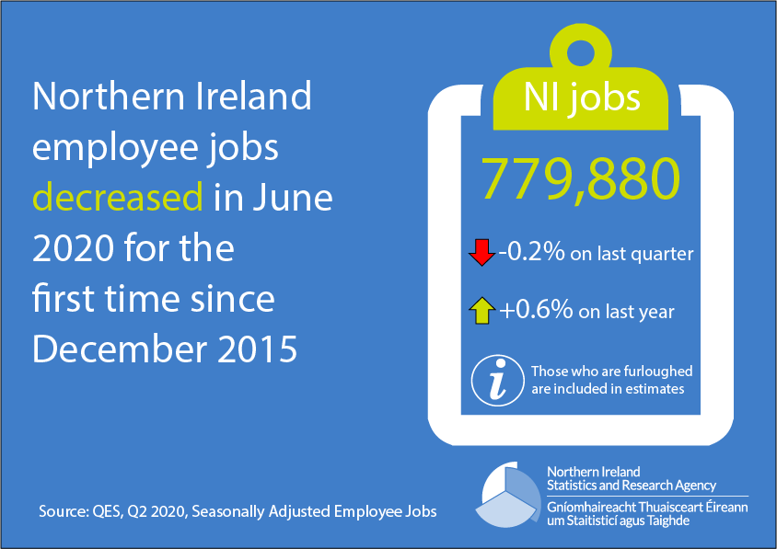
Quarterly Employment Survey (QES)
Key results from Q2 2020

Slide 52
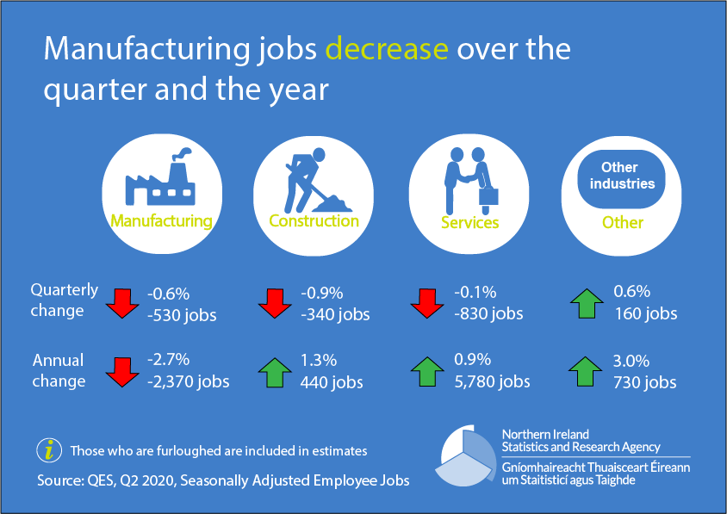
Quarterly Employment Survey (QES)
Key results from Q2 2020

Slide 53
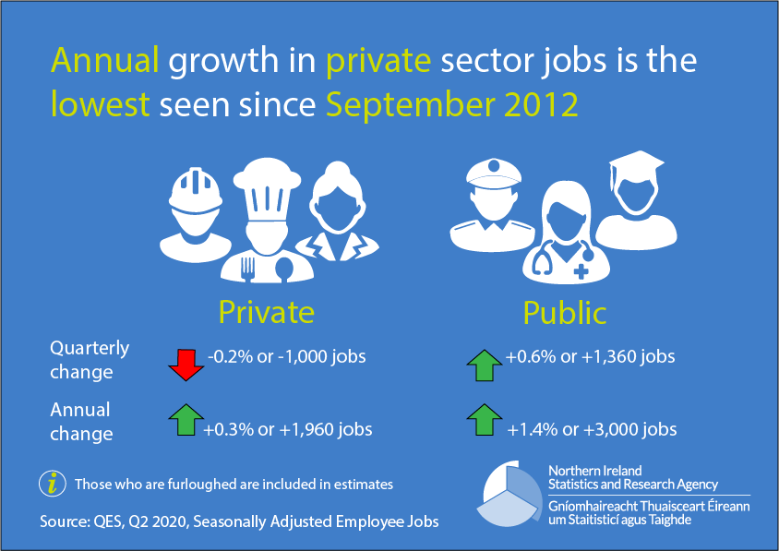
Quarterly Employment Survey (QES)
Key results from Q2 2020

Slide 54
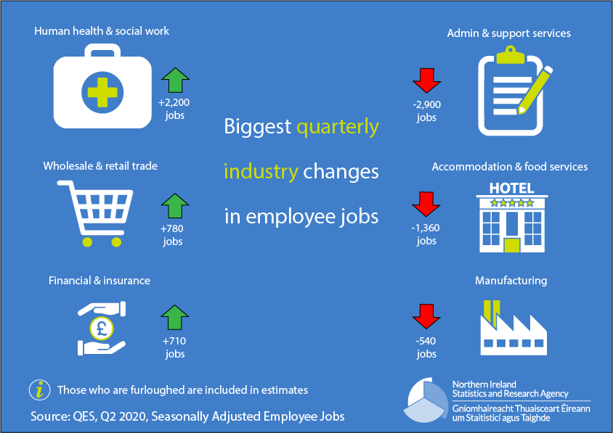
Quarterly Employment Survey (QES)
Key results from Q2 2020

Slide 55
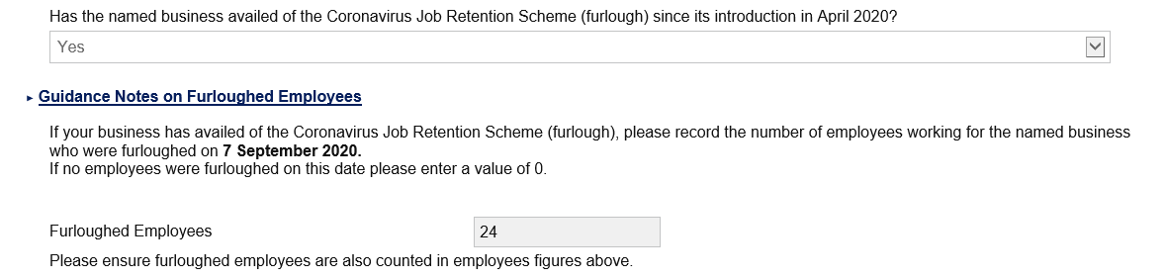
Quarterly Employment Survey (QES)
Upcoming work
Furloughed Employees Question
In response to the COVID-19 pandemic and the introduction of the Coronavirus Job Retention Scheme (CJRS), from Q2 2020 QES added an additional question to the survey to ask businesses to provide the number of furloughed employees on the survey date.
We have been able to use this information to help in validating our survey data, however further work is needed before we could publish any new analysis. These data could potentially provide additional breakdowns to the Northern Ireland CJRS data provided by HMRC, such as estimates by Public/Private sector and further industry breakdowns.

Slide 56
Quarterly Employment Survey (QES)
Upcoming work
Improving Accessibility
Work is underway to make the QES publication document and tables as accessible as possible for users. A review of all QES publication outputs is currently being undertaken with regards to ensuring correct document metadata; meaningful hyperlink text; sufficient colour contrast; and table formats that are easy to understand and manipulate by users for their own outputs.
Various improvements will be made to the next publication documents (to be published in December 2020), however some of the improvements will take longer to implement and it is recognised that some users may use the web tables to produce their own outputs and therefore further consultation with key stakeholders will be required before making radical changes to table formats.

Slide 57
Quarterly Employment Survey (QES)
Next publication
Estimates from QES Q3 2020 will be published on Tuesday 15th December 2020 on the QES website:
https://www.nisra.gov.uk/statistics/labour-market-and-social-welfare/quarterly-employment-survey
Further Information
Further information on the background and methodology of the QES, as well as the full publication document and a suite of accompanying tables (including breakdowns by gender, working pattern, public/private sector, and industrial activity at the two-digit SIC level) is available on the QES website:
https://www.nisra.gov.uk/statistics/labour-market-and-social-welfare/quarterly-employment-survey
Contact: Lynda Kennedy
Email: Lynda.kennedy@nisra.gov.uk

Slide 58
Redundancy Statistics

Slide 59
Collective Redundancies
Under the Employment Rights (Northern Ireland) Order 1996 (Amended 8 October 2006) companies are legally required to notify the Department of impending redundancies of 20 or more employees.
Employers are required by law to notify the Department of proposals to make 20 to 99 redundancies at least 30 days before the first dismissal, and, for 100 or more redundancies, 90 days before the first dismissal.

Slide 60
Redundancy Statistics
Produce two headline statistics
  Proposed redundancies
  Confirmed redundancies
Limitations
  Companies who propose less than 20 redundancies are not required to notify the Department, therefore the figures provided are likely to be an underestimate of total job losses
  Proposed is a more timely indicator than confirmed. Not all proposed redundancies take place. Confirmed provides a better indication of real job losses.

Slide 61
Redundancies
UNDER REVIEW

Slide 62











Slide 63
Changes in 2020
Improved the timeliness of redundancy statistics
  Produce calendar month proposed and confirmed redundancies
  Faster indicator – proposed redundancies in first two weeks of month
Greater focus on monthly statistics

Slide 64
Proposed and Confirmed Redundancies

Slide 65
COVID-19 impacts/analysis
Expanded the analysis included in the Labour Market Report
  More information on sectors impacted and areas within NI

Slide 66
Additional outputs
Developed a statistical disclosure control policy for redundancy data requests
Background quality report
  More detail on statistical quality of redundancy statistics

Slide 67
Furlough Data
HMRC produce statistics each month
  Coronavirus Job Retention Scheme
  Self Employment Income Support Scheme
Uptake number and proportion of eligible
Cumulative totals and point in time values
Geography, industry, size of business, age, gender

Slide 68
Additional links/analysis
NISRA website
Quick Links
Coronavirus (COVID-19) statistics
Impact of Coronavirus on the Labour Market
www.nisra.gov.uk

Slide 69

Views or Questions

Slide 70
Final Comments and Close
Presentations and ‘Questions and Answers’
will be uploaded to the
Labour Market Statistics User Engagement page
Thanks!

