Slide 1
Welcome to the
Labour Market Statistics
User Group
30 September 2021
Cathryn Blair

Slide 2
Making the most of the session
Lots of great content, please be as present as possible
Where you can, we suggest:
setting your Jabber/Teams status to ‘Do not disturb’
closing all other work programs…..including Outlook!
Join in Q&A/discussions

Slide 3
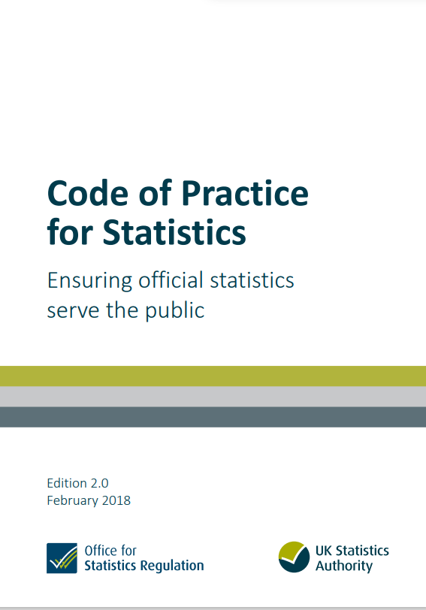
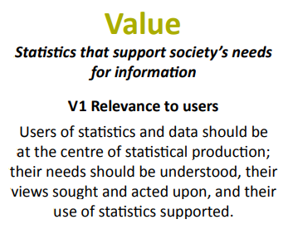
Official Statistics and User Engagement

Slide 4
Aim of today’s meeting
Update users on
COVID-19 impacts
new questions
developments
Obtain feedback from users on
publication plans
output formats
information needs

Slide 5
Agenda
Measuring jobs and earnings
Business Register and Employment Survey
Quarterly Employment Survey
Real Time Information from PAYE
Annual Survey of Hours and Earnings
Q&A and discussion
Labour Force Survey and administrative sources
Claimant count, furlough, redundancies
Data collection, processing and production
Developments and outputs
Dashboards
Q&A and discussion

Slide 6
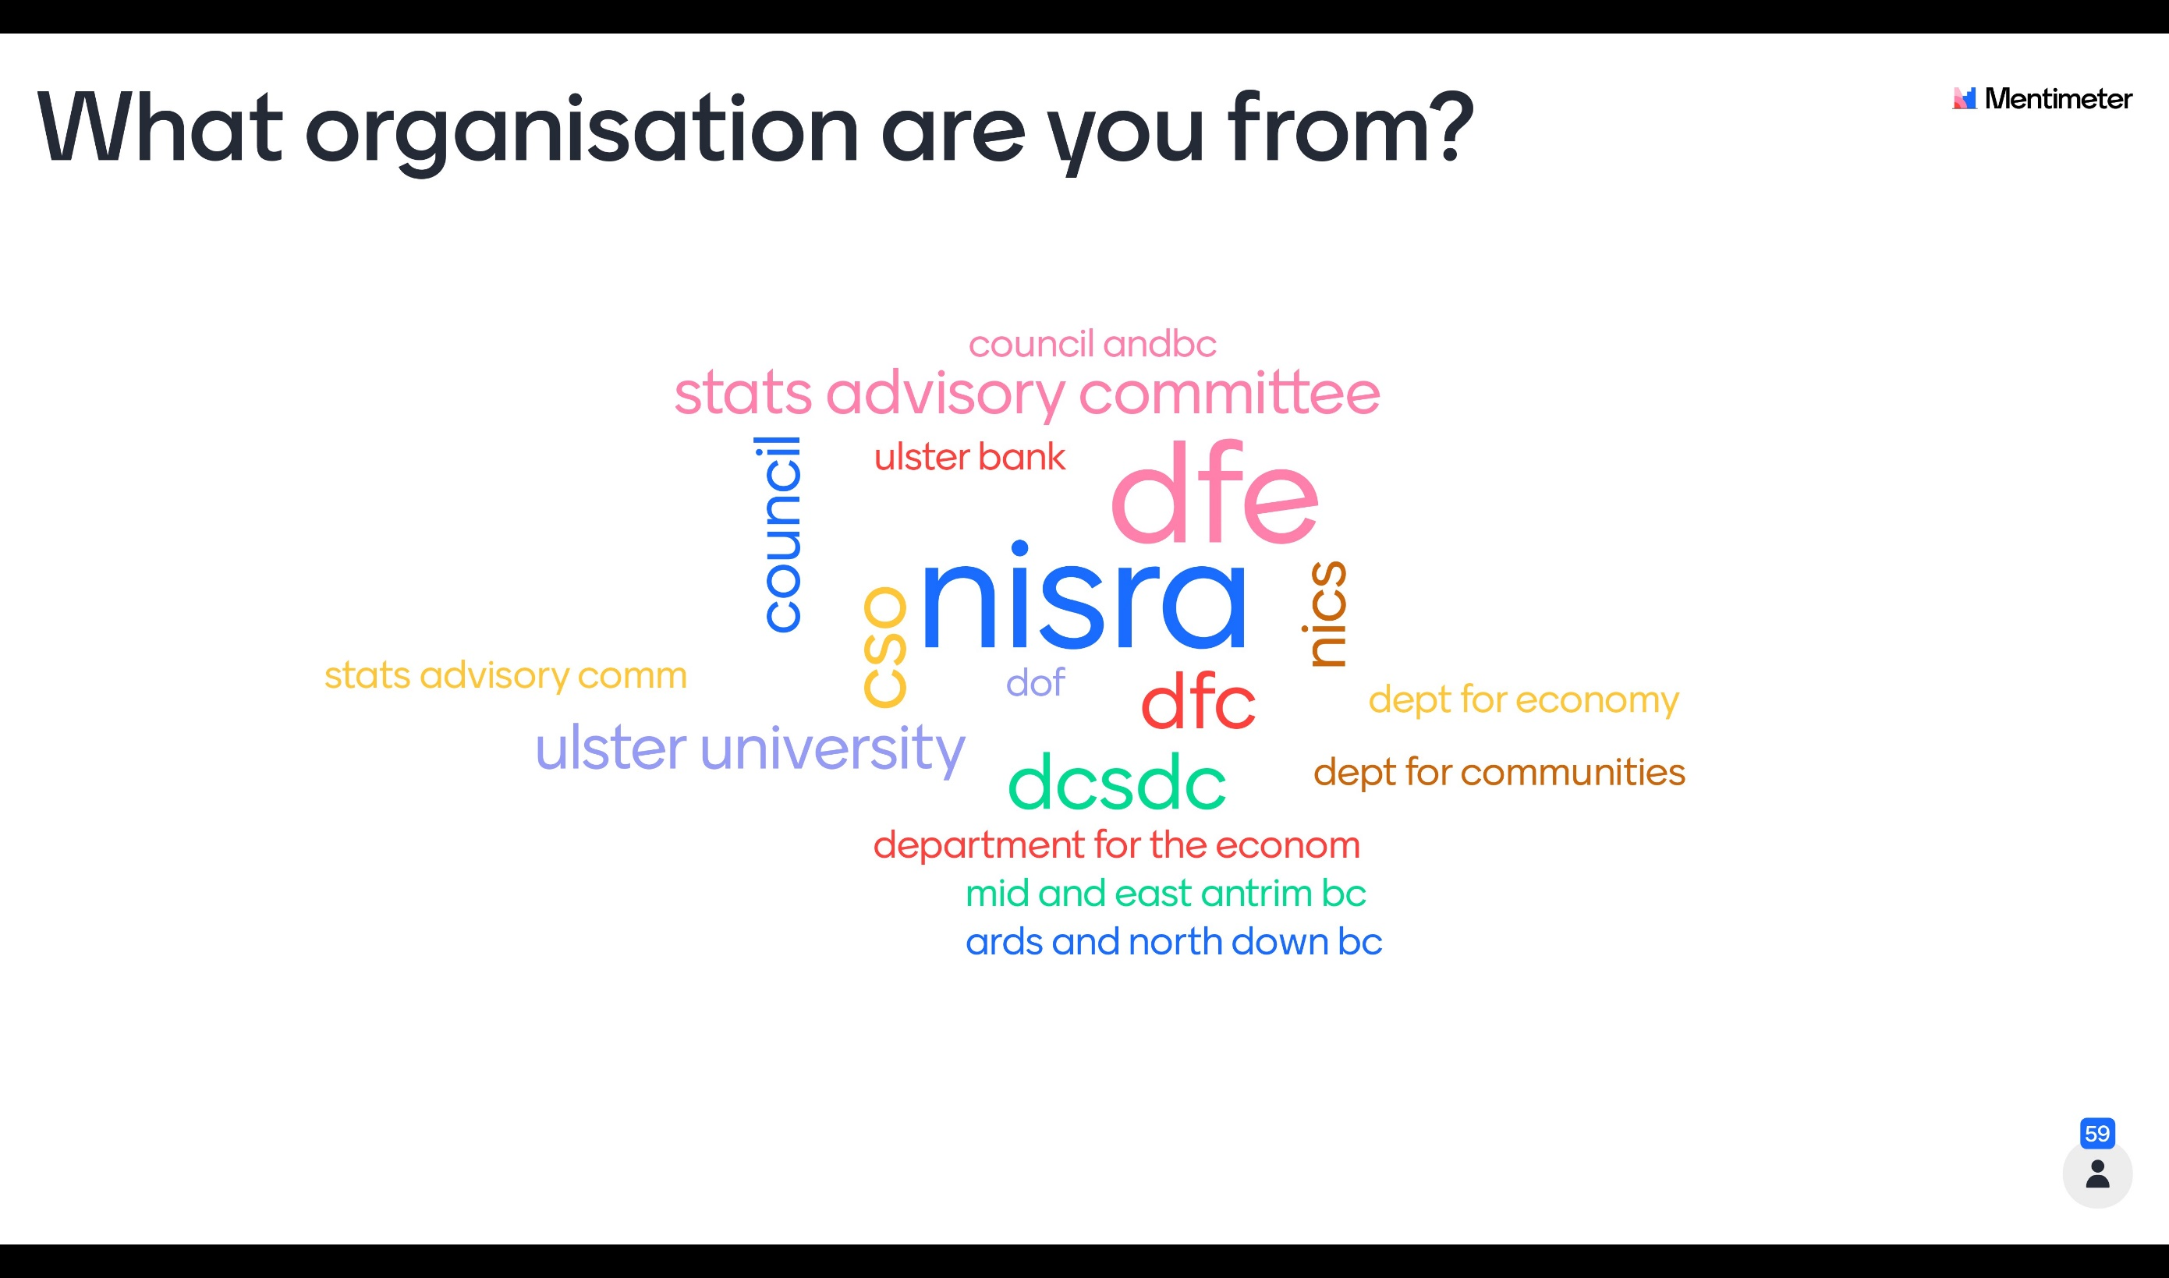

Slide 7
Business Register and Employment Survey
(BRES)
Arlene Connolly

Slide 8


Meet the team: BRES and IDBR
The Business Register is the sample frame for ELMSB surveys.
We publish the number of businesses by industry and geography.
Andrew Dunn
BRES
Neil Mulhern
IDBR
andrew.dunn@nisra.gov.uk
neil.mulhern@nisra.gov.uk
Arlene Connolly
arlene.connolly@nisra.gov.uk

Slide 9
Data Collection and Registration Team
BRES
Stephen McCune
Darren Haskins
Clare Logan
Andrew Murphy
John McBride
Steven Roberts
Paula Rogan
Sharon Booth
IDBR
Jenni Barrett
Nichola Lemon
Natasha Grieve
Alastair McCulloch
Ciara Adair

Slide 10
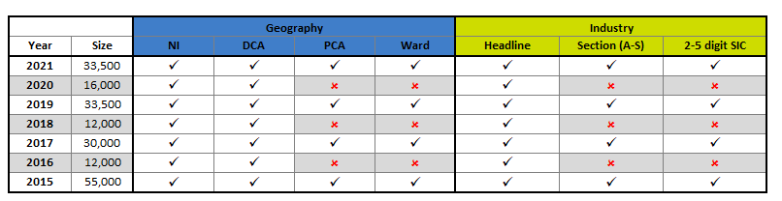
BRES Survey Cycle
Collects employee job data by geography and industry annually
Sample size changes from one year to next
This affects the level to which the data can be disaggregated
A larger sample size allows for smaller geographies and lower level industries
2019 - BIG
2020 - SMALL
2021 - BIG

Slide 11

BRES 2020
16,000 businesses surveyed
Furloughed staff included
71% response rate – down on previous year (74% in 2019)
Coverage sufficient in all strata
Survey Date: 7th September (same as Q3 quarterly employee job survey)

Slide 12
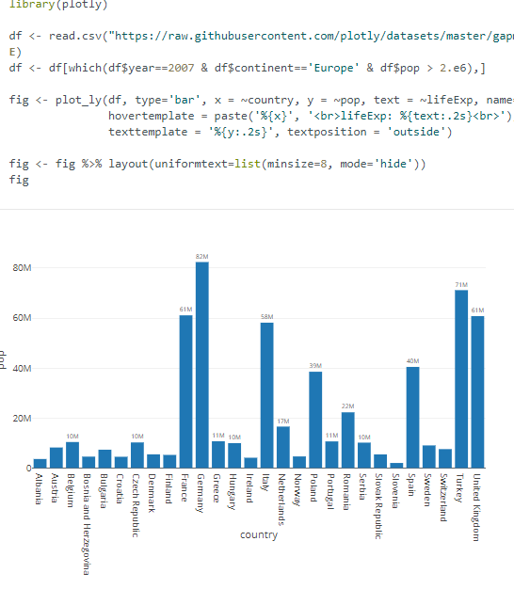
BRES 2020: Output
Benefits of HTML:
Accessibility
Fully reproducible
Search engines
Efficient to produce
Recommended by UKSA
Interactive charts
Report in PDF and HTML
Agriculture data added to tables
Infographics
Tweets
Email to users
Accessibility
New regulations – improve accessibility for those who require assistive technology.

Slide 13
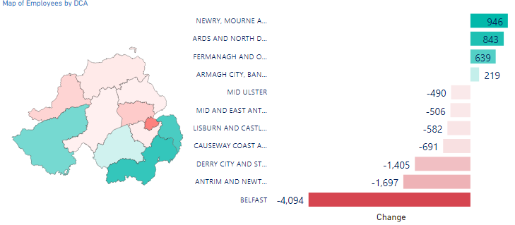
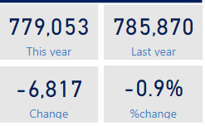


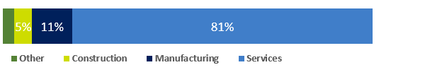


Employee Jobs
2020
District Council Area
Services
Manufacturing
-6,423
-1.0%
-1,958
-2.2%
Headline Industry
Construction
Other
1,093
3.1%
471
2.0%

Slide 14


Employee Jobs
2020
Composition of Employee Jobs
Gender
Working Pattern
Sector
Male
Female
Full-Time
Part-Time
Public
Private
380,985
-1.4%
-5,540
398,068
-0.3%
-1,277
511,809
-0.2%
-937
267,244
-2.2%
-5,880
213,003
+2.0%
4,097
566,050
-1.9%
-10,914

Slide 15
Next year: BRES 2021
35,000 forms in the field
Results expected June 2022
Geography – published DCA, Ward, PCA
Industry – published to 5-digit SIC
Developments
Potential addition of NI employment data (employees + working owners)
Review of addition of agriculture data to BRES tables in line with QES
Improvements in accessibility

Slide 16

How can we improve NI employee jobs and earning statistics?

Slide 17
Quarterly Employment Survey (QES)
Lynda Kennedy

Slide 18
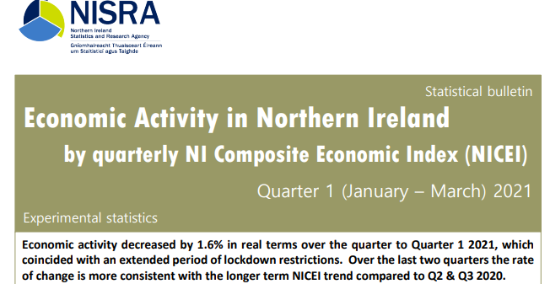
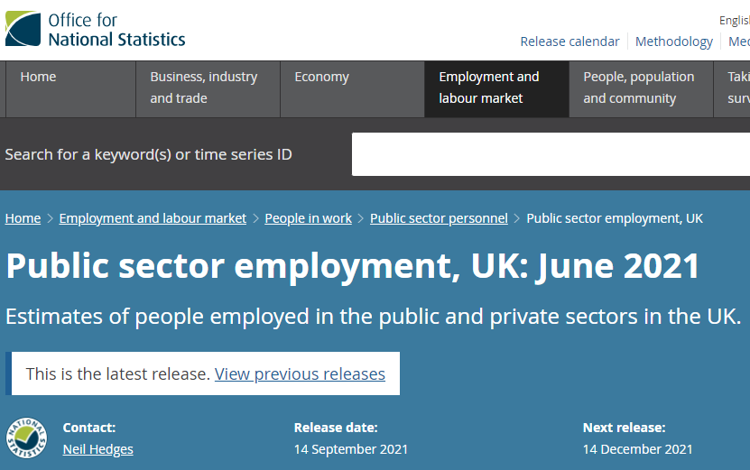
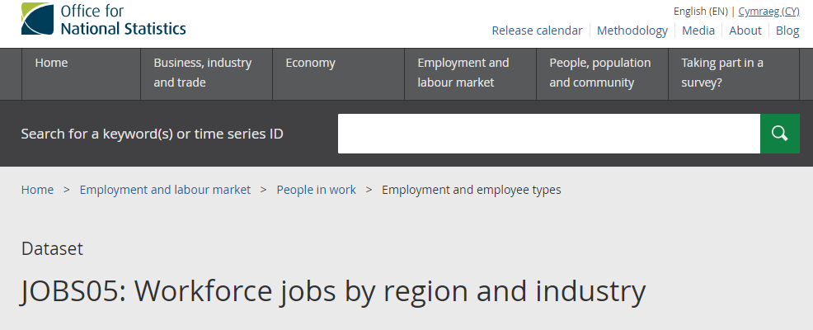
Quarterly Employment Survey (QES)
Overview
Short term estimates of employee jobs in NI through a quarterly sample survey of approx. 6,000 businesses.
Only includes Pay As You Earn (PAYE) jobs – the self employed are not included.
Counts jobs rather than people.
QES estimates are used in the calculation of:
  ONS UK Workforce Jobs
  ONS UK Public Sector Employment estimates
  NICEI calculations

Slide 19
Quarterly Employment Survey (QES)
Meet the team
Data Collection Team
Carole-Ann McKay
Lynda Kennedy
Rebecca Kennedy
Carole-ann.mckay@nisra.gov.uk
Lynda.kennedy@nisra.gov.uk
Rebecca.kennedy@nisra.gov.uk

Slide 20
Quarterly Employment Survey (QES)
Latest Results
Published on 14th September 2021 at 7.00am for Quarter 2 2021.
The survey date for Quarter 2 was 1st June 2021.
Those who are furloughed under the CJRS are included in QES employee jobs estimates.
Latest HMRC furlough data (next release 7th October 2021): https://www.gov.uk/government/statistics/coronavirus-job-retention-scheme-statistics-9-september-2021

Slide 21

Quarterly Employment Survey (QES)
COVID-19 impacted on the data collection and validation of employee jobs data.
  Business closures – fewer responses and reduced business contact for validating data.
*median value achieved at QES database closure of quarter 1, quarter 2, quarter 3 and quarter 4 2019.
As a result:
  estimates for 2020 and 2021 may be subject to higher revisions than normal over the coming quarters (late returns etc.).
  estimates at lower industry levels (e.g. 2 digit Standard Industrial Classification level), should be treated with caution.
 | Quarter 2 2021 | Quarter 2 2020 | 2019 (median*)
Coverage response rate (returned employees) | 66% | 62% | 77%

Slide 22
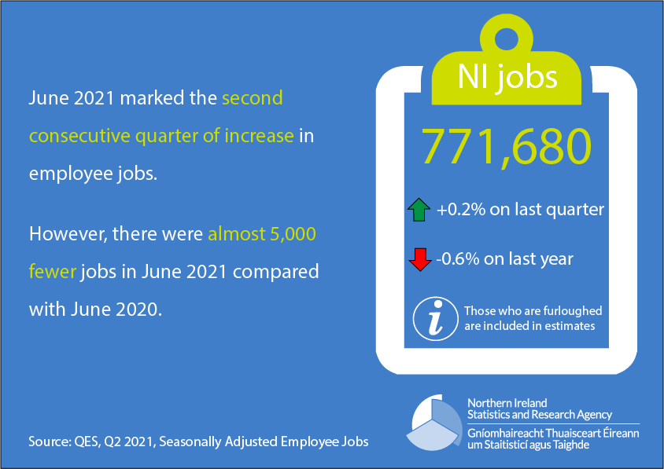


Quarterly Employment Survey (QES)
Key results from Quarter 2 2021
@NISRA
NISRA

Slide 23
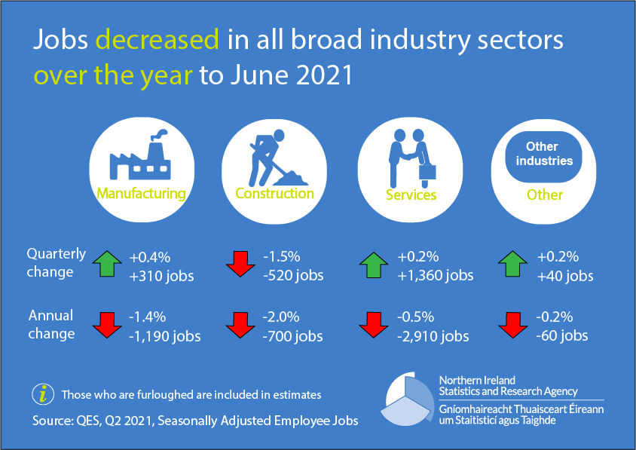
Quarterly Employment Survey (QES)
Key results from Quarter 2 2021
@NISRA
NISRA

Slide 24
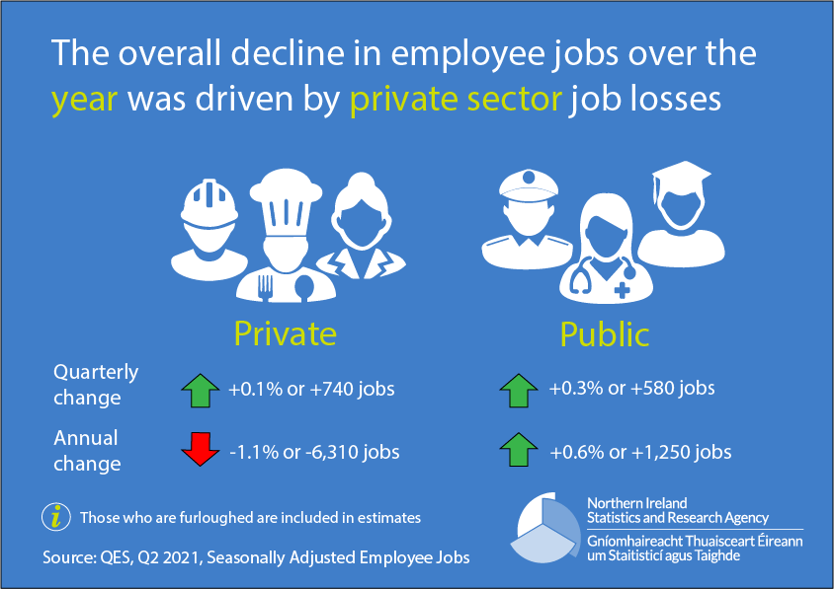
Quarterly Employment Survey (QES)
Key results from Quarter 2 2021
@NISRA
NISRA

Slide 25
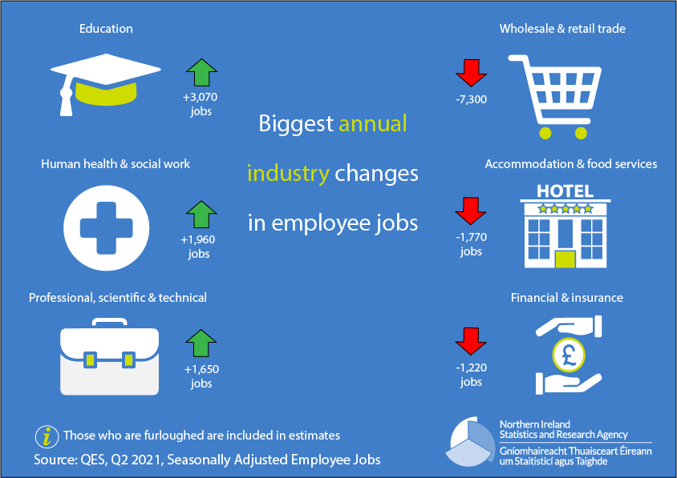
Quarterly Employment Survey (QES)
Key results from Quarter 2 2021
@NISRA
NISRA

Slide 26
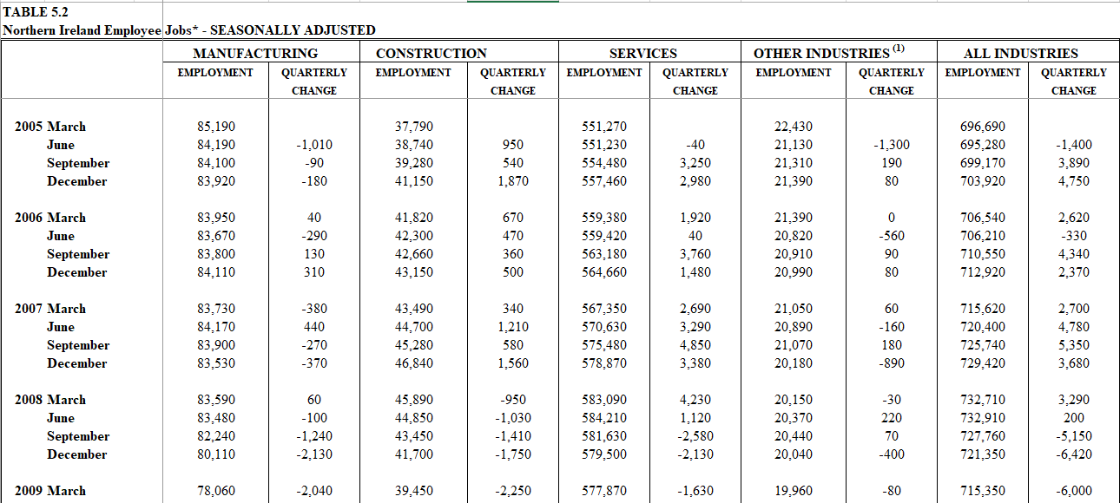
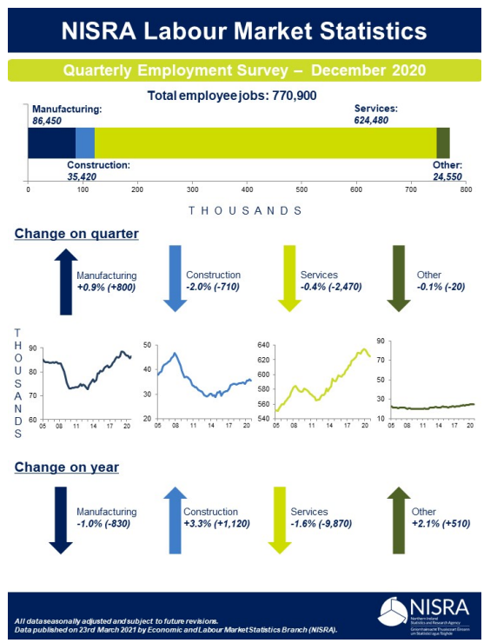
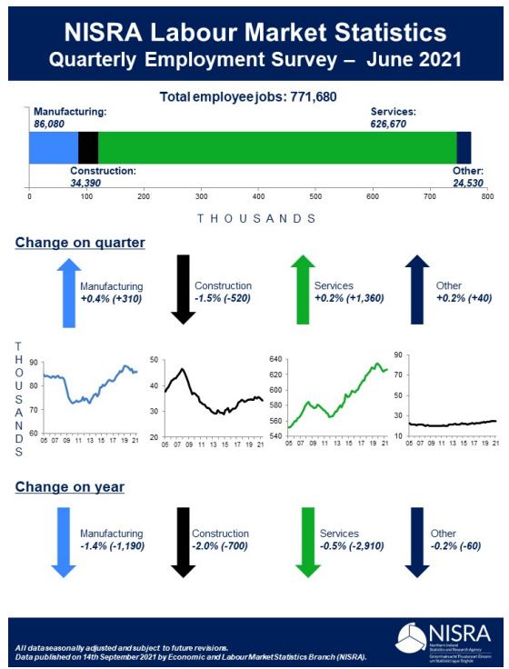
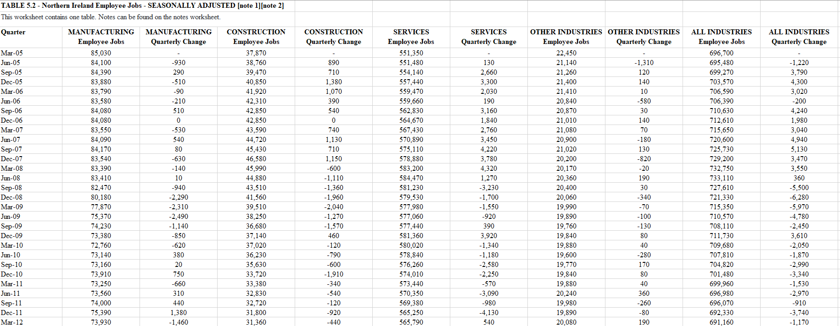
Quarterly Employment Survey (QES)
Old version
Developments - Accessibility
Old version
New version
New version

Slide 27
Quarterly Employment Survey (QES)
Developments - Seasonal Adjustment Review
Employee jobs estimates can be affected by events throughout the year. QES jobs estimates are seasonally adjusted to account for such seasonal trends.
Seasonally adjusted figures are available at industry section level, broad industry sector level and for the public and private sector series.
A seasonal adjustment review was carried out in July 2021, to ensure that seasonal adjustment was appropriate and working well.
This was especially pertinent following the COVID-19 pandemic. As a result of the impact of the pandemic, many of the series now have additive outliers for Quarter 2 2020. An additive outlier is a data point which falls out of the general pattern of the trend.
The findings from the seasonal adjustment review were incorporated in the Quarter 2 2021 results. A paper detailing the review, its findings and impacts can be found at: https://www.nisra.gov.uk/publications/quarterly-employment-survey-revisions

Slide 28
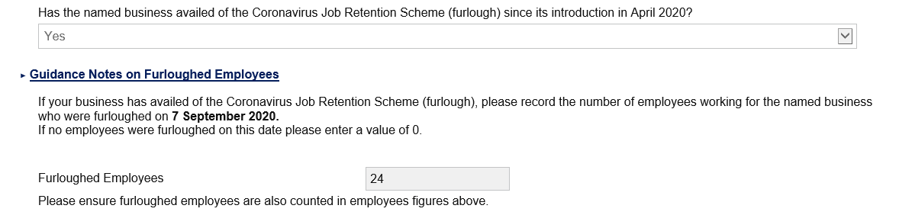
Quarterly Employment Survey (QES)
Upcoming work
Furlough data
In response to the pandemic, the QES asked a question to businesses about number of furloughed employees, from Quarter 2 2020.
At this time it was uncertain whether NI furlough data would be captured via any other source, however an official estimate is reported by HMRC.
The administrative data as published by HMRC are the best source of furlough data, and they are available by region, sector, age, gender and employer size.
We are currently investigating whether the information collected on the QES could offer users additional insight, such as lower industry breakdowns. Feedback on the usefulness of this would be greatly appreciated.

Slide 29
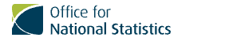

Quarterly Employment Survey (QES)
Real Time Information (RTI)
What is it?
Produced as a joint release between HMRC and the Office for National Statistics (ONS) and was introduced in April 2020 in response to coronavirus.
Experimental monthly estimates of payrolled employees and their pay from HMRC’s Pay As You Earn (PAYE) RTI administrative system. HMRC PAYE RTI is the system employers use to take Income Tax and National Insurance contributions before they pay wages to employees.
Why is it useful?
While RTI statistics are still considered to be experimental and the existing Labour Market releases are recommended as the definitive source of official statistics, RTI statistics have been referred to as ‘the most timely and best single, overall indicator of the labour market’.
What Northern Ireland data is available?
Estimates from PAYE RTI are currently available at the total NI level and at NI District Council Area for the following: payrolled employees, median pay, mean pay and aggregate pay. Estimates are provided back to July 2014.
Further detailed breakdowns for NI by age and industry are expected over the coming months.

Slide 30
Quarterly Employment Survey (QES)
Real Time Information (RTI) Continued…
What are the differences between RTI jobs estimates and those provided by QES/BRES?
RTI counts people in employment and is not a measure of jobs (as measured by the QES and BRES).
RTI counts anyone who has a paid employee job during the reference period; it is a monthly average of daily counts of the number of individuals in payrolled employment. The QES and BRES count the number of jobs occupied by people aged 16 years and older on a specific count date.
RTI data cover the whole employee population (for those paid through PAYE), whereas QES and BRES are sample surveys of businesses. Imputation, weighting and sampling variability as a result of collecting data via sample surveys are another explanation for some of the differences seen.
RTI data is released monthly – QES is quarterly and BRES annually.
RTI data not yet available by NI industry or demography. QES and BRES available by low level industry, gender and working pattern.

Slide 31
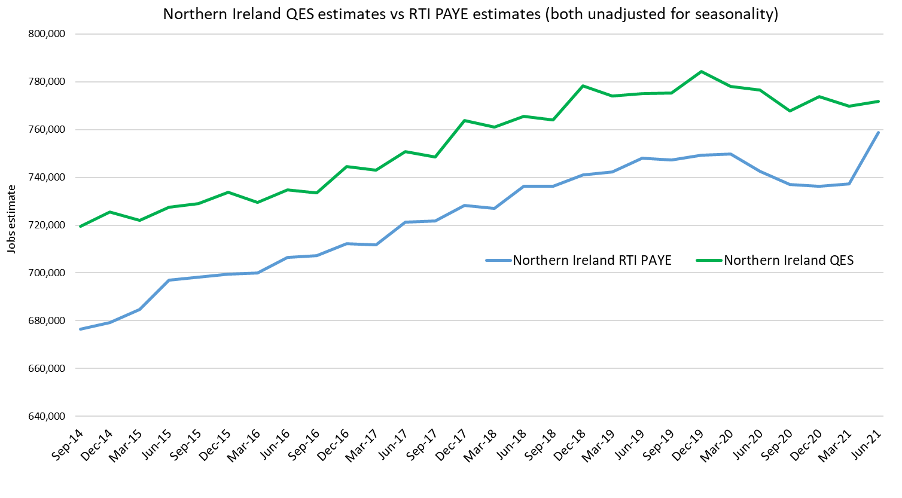
Quarterly Employment Survey (QES)

Slide 32
Quarterly Employment Survey (QES)
Real Time Information (RTI) Continued…
Further information on the differences, strengths and limitations of the main data sources used to produce labour market statistics, including the advantages of new administrative data sources can be found here:
  https://www.ons.gov.uk/employmentandlabourmarket/peopleinwork/employmentandemployeetypes/methodologies/comparisonoflabourmarketdatasources

Slide 33
Quarterly Employment Survey (QES)
Next publication
Estimates from QES Quarter 3 2021 will be published on Tuesday 14th December 2021 on the QES website:
https://www.nisra.gov.uk/statistics/labour-market-and-social-welfare/quarterly-employment-survey
Further Information
Further information on the background and methodology of the QES, as well as the full publication document and a suite of accompanying tables (including breakdowns by gender, working pattern, public/private sector, and industrial activity at the two-digit SIC level) is available on the QES website:
https://www.nisra.gov.uk/statistics/labour-market-and-social-welfare/quarterly-employment-survey
Contact: Lynda Kennedy
Email: Lynda.kennedy@nisra.gov.uk

Slide 34

How could we improve NI jobs and earnings statistics?

Slide 35
Earnings
HMRC RTI PAYE and
Annual Survey of Hours and Earnings
Ashleigh Warwick

Slide 36
Meet the team: Earnings
Brian Grogan
Steven Roberts
brian.grogan@nisra.gov.uk
steven.roberts@nisra.gov.uk
Ashleigh Warwick
ashleigh.warwick@nisra.gov.uk

Slide 37
HMRC RTI PAYE Earnings v ASHE
RTI | ASHE
Whole employee population | 1% sample of PAYE employees
More precise and detailed statistics | More breakdowns of the data
Published monthly | Published annually
Doesn’t differentiate between FT & PT | Focuses on FT employee earnings
Includes those who pay is affected by absence | Only those whose pay was unaffected by absence
Includes under 16s | Only those on adult rate of pay
Excludes self-employed | Excludes self-employed
Includes furloughed employees | Includes furloughed employees
Mean and median | Mean and median
Home address | Work address (but home address available)

Slide 38
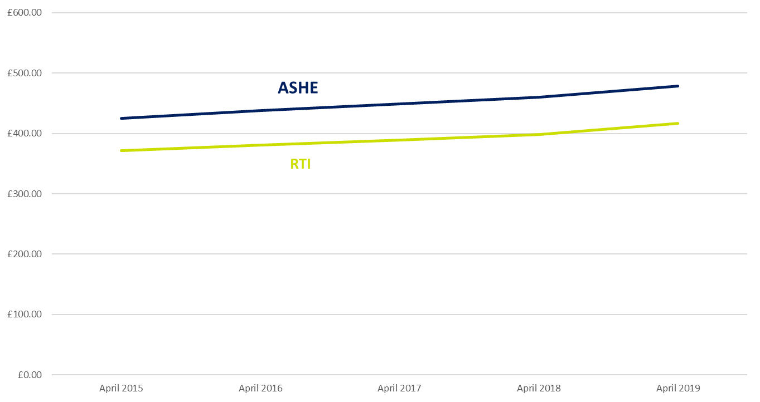
HMRC RTI PAYE Earnings v ASHE
Median weekly earnings are consistently higher in the Annual Survey of Hours and Earnings (ASHE) than in Real Time Information (RTI)
Median Weekly Pay for RTI and ASHE, UK, non-seasonally adjusted, April 2015 to April 2019

Slide 39
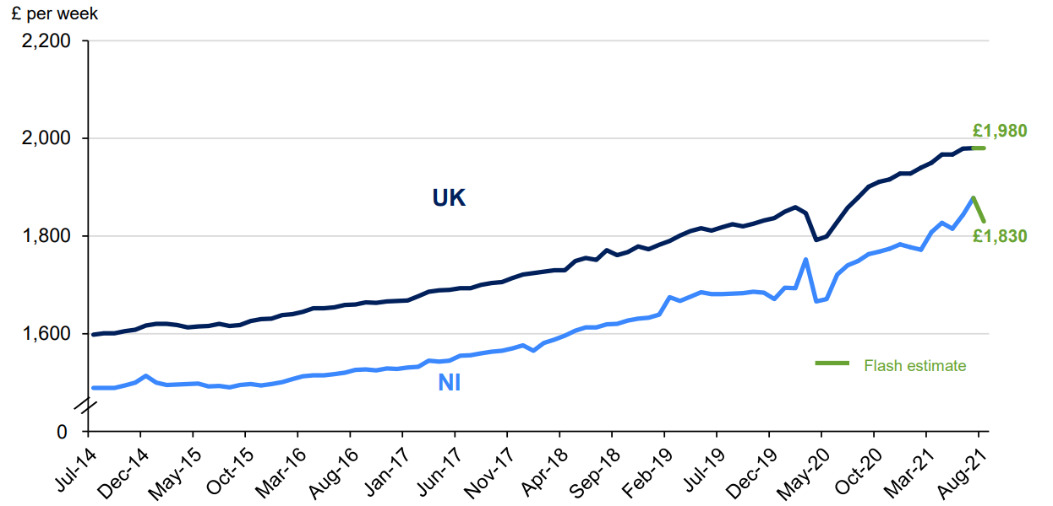
HMRC RTI PAYE Earnings
Median Monthly Pay from PAYE RTI, UK and NI, July 2014 to August 2021

Slide 40
Annual Survey of Hours and Earnings
Impact of Covid-19
Outputs
Data
collection

Slide 41
Impact on Data Collection
Furlough

Slide 42
Impact on Data Collection
Online form

Slide 43
Impact on Data Collection
More online respondents

Slide 44
Impact on Data Collection
90%

Slide 45
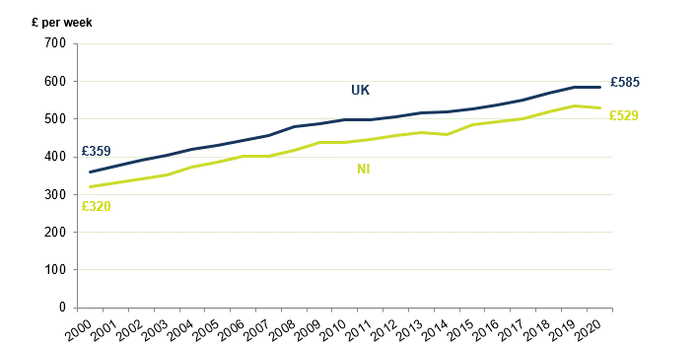
2020 ASHE Outputs
Median weekly earnings fell by £5.90 (1.1%) over the year in NI
Median Gross Weekly Earnings for Full-time Employees in NI and the UK, April 2000 to April 2020

Slide 46
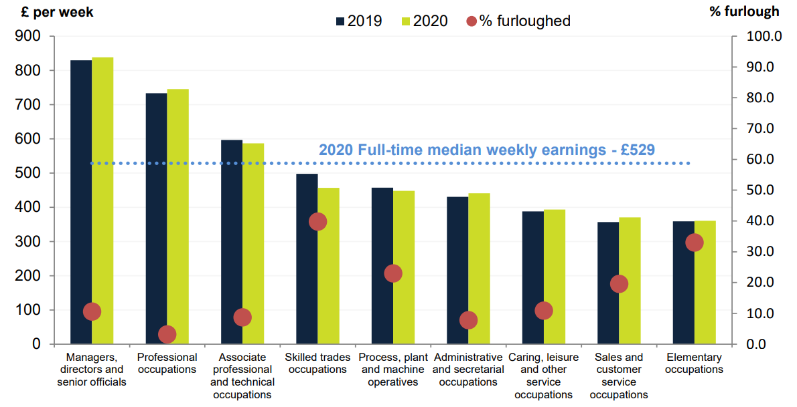
2020 ASHE Outputs
Median Gross Weekly Earnings for Full-time Employees in NI by Occupation, April 2019 and April 2020

Slide 47
2020 ASHE Outputs
£8.72
National
Living
Wage
Earnings distribution of furloughed employees with reduced earnings
The impact of furlough on the earnings distribution:
fewer employees around the Living Wage rate
more employees earning below it
2020

Slide 48
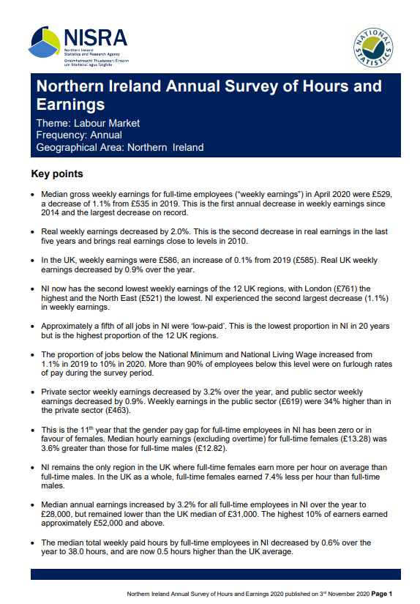
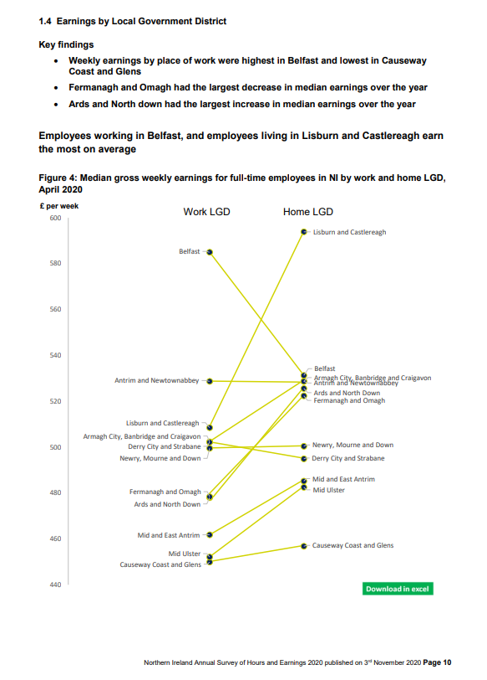
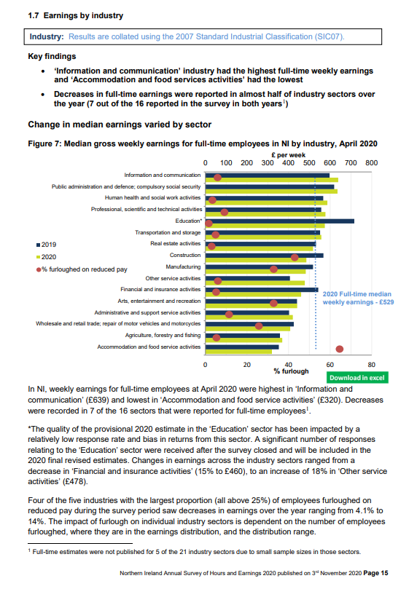
ASHE Outputs
Annual Publication
26th October at 9:30am
Summary report
  Overview of earnings
  Low and high pay analysis
  Gender Pay Gap
Detailed tables
2nd year of furlough data
Additional tables - new SOC20 classification

Slide 49



Earnings and Employees Study (EES) 2011
Description
The EES 2011 links together variables from the Annual Survey of Hours and Earnings (ASHE) 2011 with aggregated variables from the Census of Population and Housing 2011, and Capital Value data from the Land and Property Service.
The dataset takes the form of one pre-linked table.
Sample
The ASHE sample is comprised of 5,770 distinct ASHE records, approximately 1% of all employees in NI who were covered by Pay As You Earn (PAYE) schemes.
These records are linked to 5,528 distinct Census records. The difference in the amount of distinct ASHE and distinct Census records is because several individuals within the dataset have more than one job.

Slide 50
Accessing the data
Researchers should contact RSU in the first instance and will be asked to complete one page proposal. Once this has been approved, researchers and their project will need to be accredited under the Digital Economy Act.
Accredited researchers
Access to the EES dataset is limited to researchers and research teams with accredited researcher status under the DEA Information on how to apply for accreditation is available on the NISRA and ONS websites.
Accreditation of projects
RSU will organise an Project Sub Group meeting with research teams and the data providers. Researcher will be required to complete an application for approval by the UK Statistics Authority Research Accreditation Panel (RAP).
Data can be accessed in NISRA or on the ONS SRS subject to approval on a project by project basis.

Slide 51
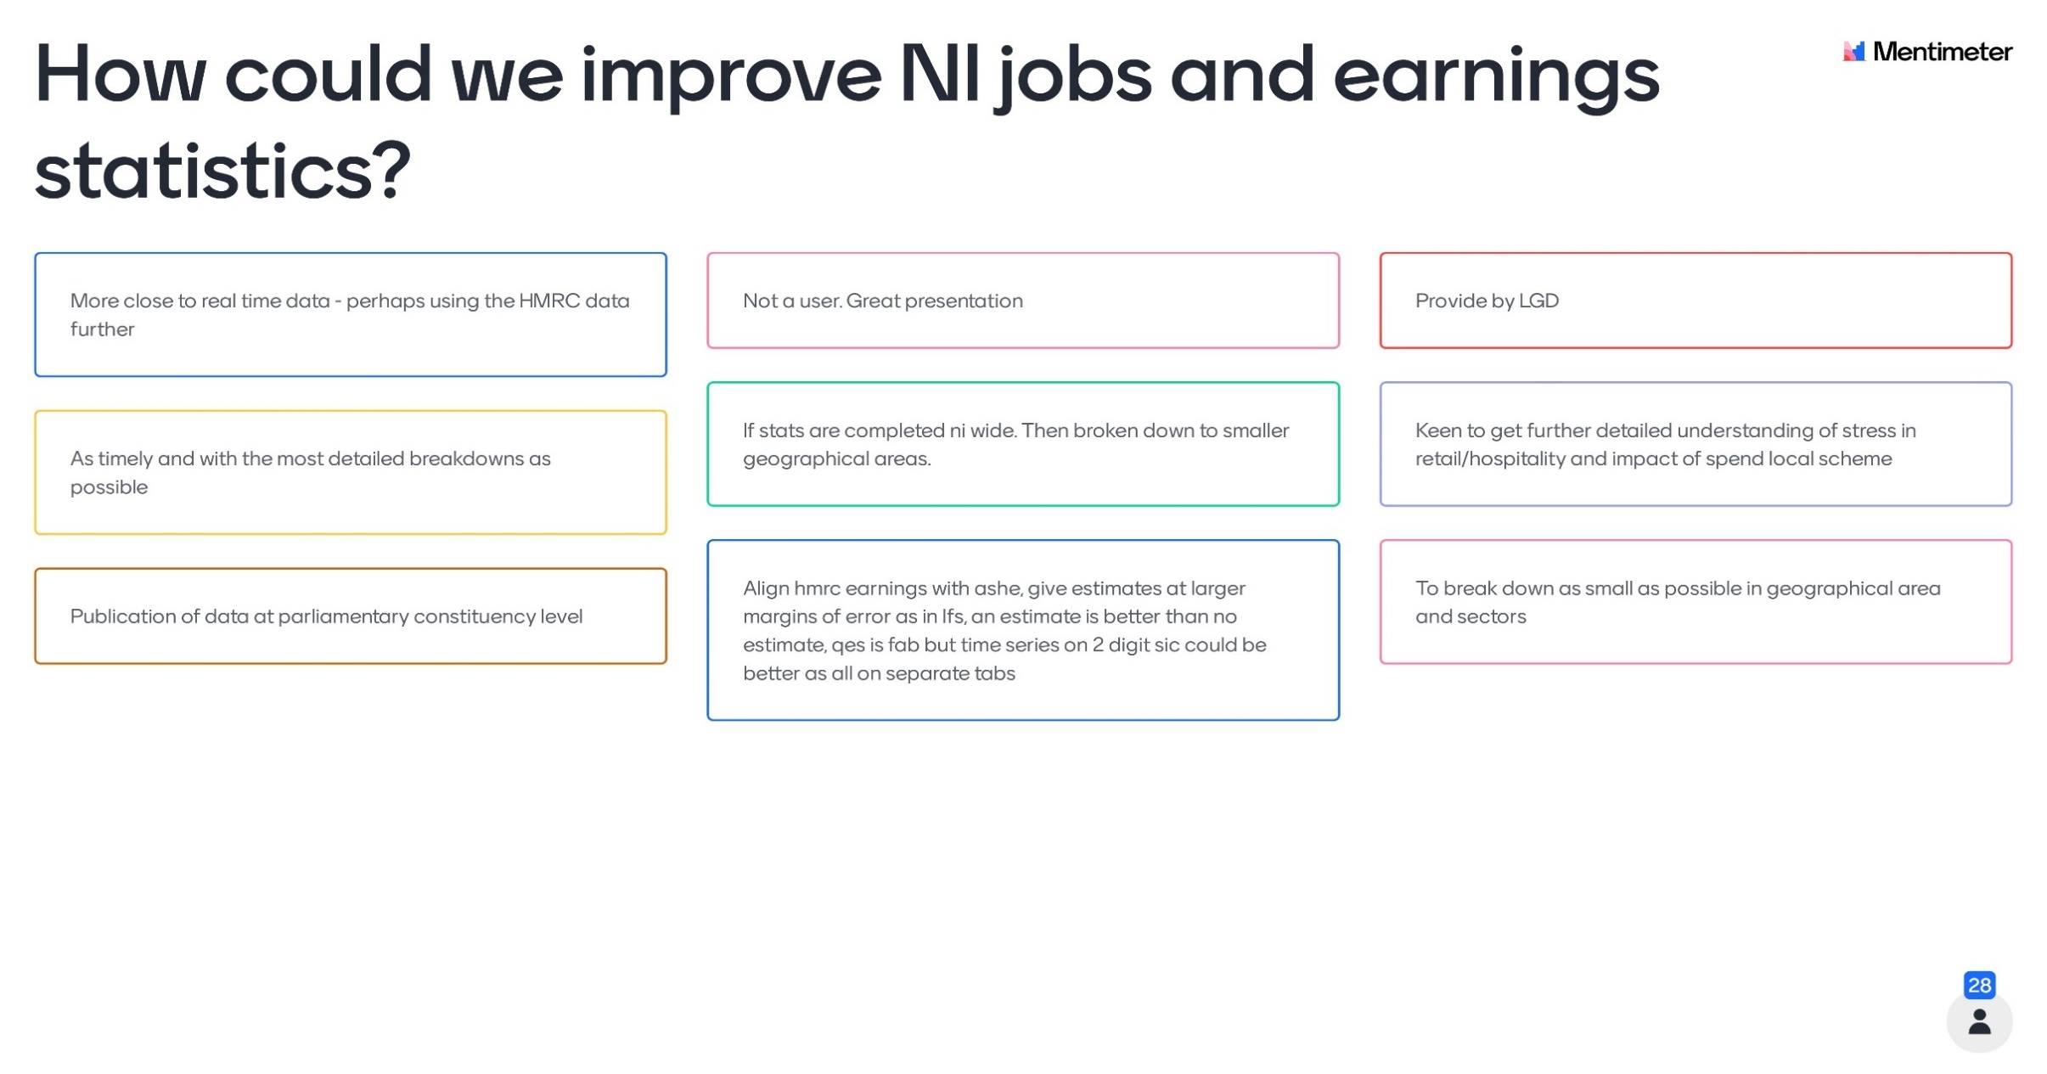
Mentimeter results – question 2

Slide 52
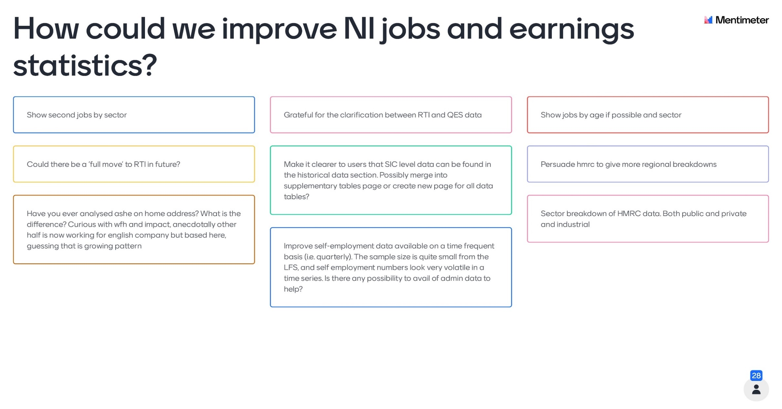
Mentimeter results – question 2 (continued)

Slide 53
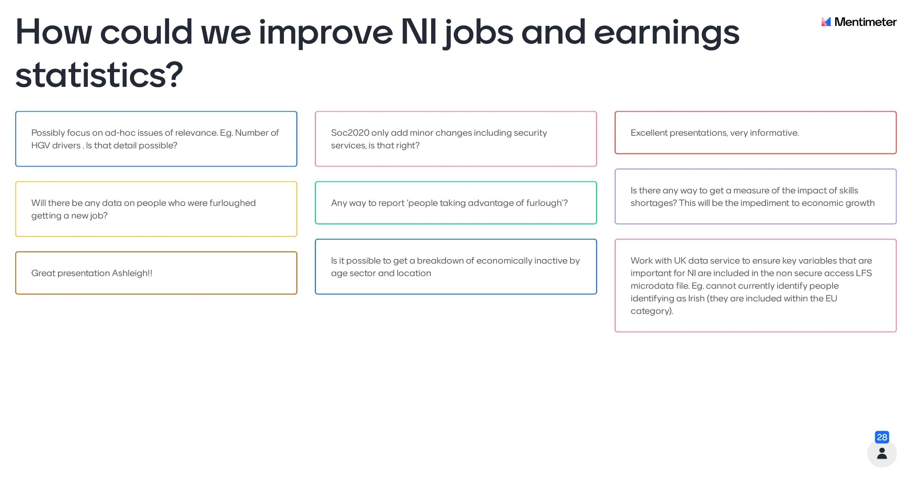
Mentimeter results – question 2 (continued)

Slide 54
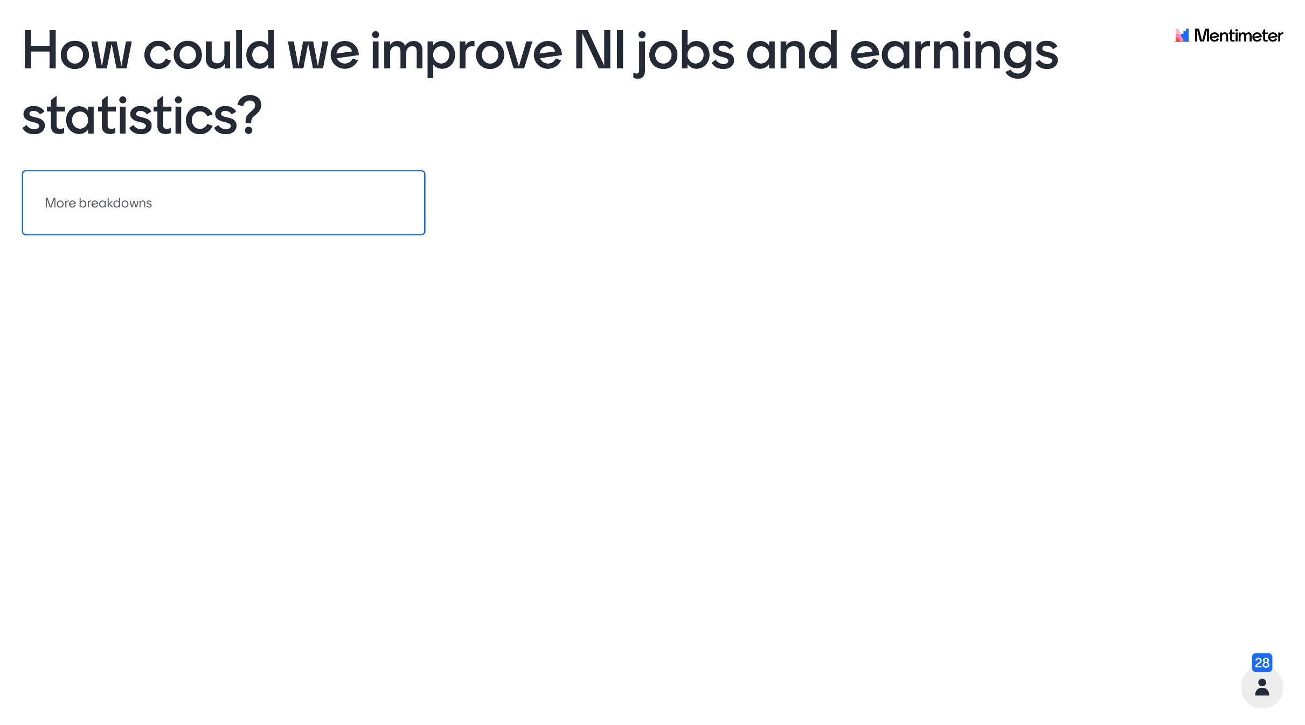
Mentimeter results – question 2 (continued)

Slide 55
Meet the team:
LFS, Redundancies & Claimant Count
Jennifer McLoughlin
Mark McFetridge
Richard Ramsden
Holly McAteer
Jacquie
McManus
Janet Wright
Irene
Shooter
Work Quality
LFS
Redundancies & Claimant Count
jennifer.mcloughlin@nisra.gov.uk
holly.mcateer@nisra.gov.uk
mark.mcfetridge@nisra.gov.uk richard.ramsden@nisra.gov.uk
jacquie.mcmanus@nisra.gov.uk Janet.wright@nisra.gov.uk Irene.shooter@nisra.gov.uk

Slide 56
Redundancy Statistics

Slide 57
Collective Redundancies
Under the Employment Rights (Northern Ireland) Order 1996 (Amended 8 October 2006) companies are legally required to notify the Department of impending redundancies of 20 or more employees.
Employers are required by law to notify the Department of proposals to make 20 to 99 redundancies at least 30 days before the first dismissal, and, for 100 or more redundancies, 90 days before the first dismissal.

Slide 58
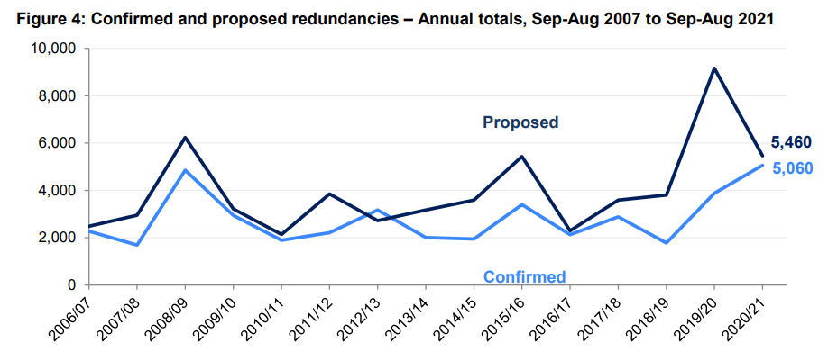
Redundancy Statistics
Two headline statistics
  Proposed redundancies
  Confirmed redundancies
To note:
  Companies who propose less than 20 redundancies are not required to notify the Department, therefore the figures provided are likely to be an underestimate of total job losses
  Proposed is a more timely indicator than confirmed. Not all proposed redundancies take place. Confirmed provides a better indication of real job losses.

Slide 59
Changes in 2020 and 2021
Greater focus on monthly statistics
Improved the timeliness of redundancy statistics
  Produce calendar month proposed and confirmed redundancies
  Faster indicator – proposed redundancies in first two weeks of month
Developed a statistical disclosure control policy for redundancy data requests
Background quality report
  More detail on statistical quality of redundancy statistics

Slide 60
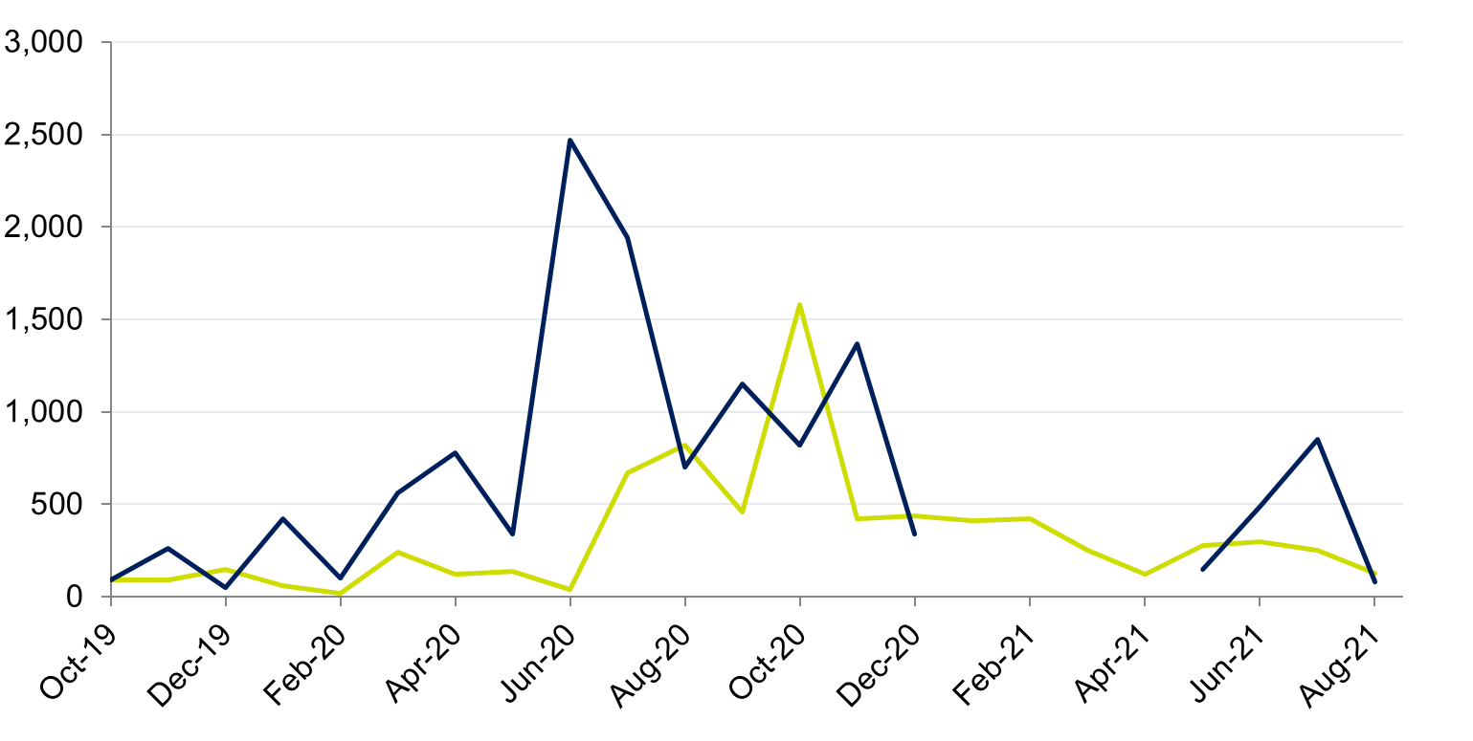
Redundancies Outputs
Monthly proposed and confirmed redundancies, October 2019 and August 2021
Proposed
Jun-20 2,470
Confirmed
Oct-20 1,580
X
X
X
X

Slide 61
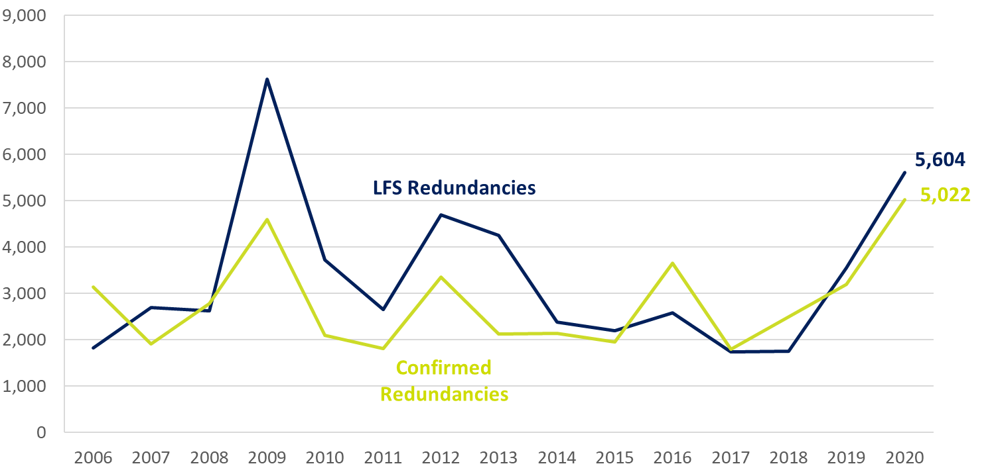
Redundancies Outputs
LFS redundancies vs confirmed redundancies, 2006-2020

Slide 62
Furlough Data

Slide 63
HMRC Furlough Data
  Coronavirus Job
  Retention Scheme
  Self Employment Income
  Support Scheme
  Industry sector
  Size of business
  Age and gender
  Furlough type
  Parliamentary Constituency
  LGD
  Industry sector
  Age and gender
  Parliamentary Constituency
  LGD

Slide 64
Experimental Claimant Count

Slide 65
Claimant Count- Overview
        Measure of the number of people claiming unemployment related benefits
        Data is derived from Jobs and Benefits Offices systems
        Main economic indicator since 1970s
        Timely outputs

Slide 66

Claimant Count- Overview
        Universal Credit was rolled out for new claimants on a phased basis between September 2017 and December 2018
        Jobseeker’s Allowance Claimants and those in the searching for work conditionality of Universal Credit – since March 2018
        Steady decline in the proportion of JSA claimants in the Claimant Count
          March 2019 broadly 50/50
          March 2021 – JSA 23%, UC 77%

Slide 67
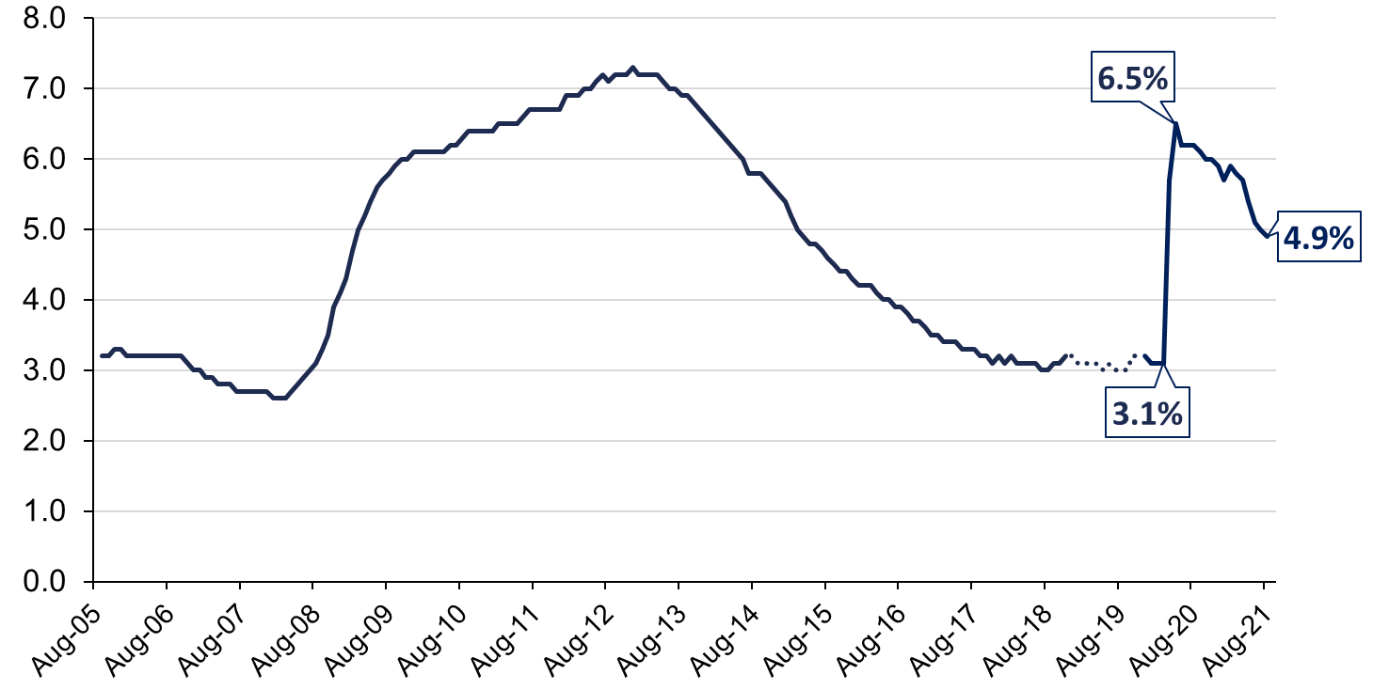
Claimant Count Outputs
Seasonally adjusted claimant count (experimental) monthly rates, September 2005 – August 2021

Slide 68
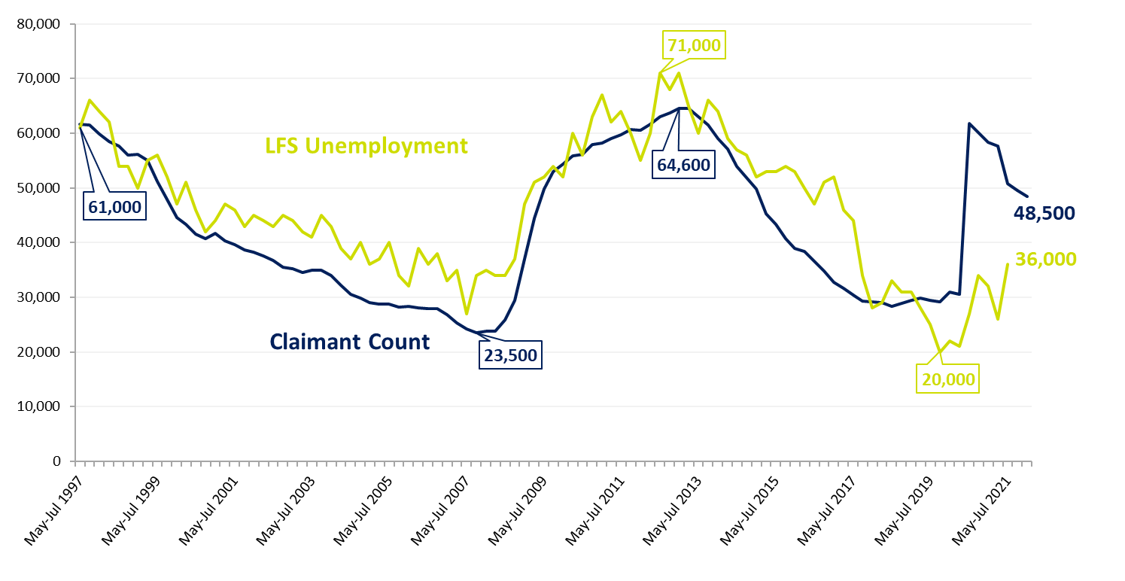
Claimant Count Outputs
Seasonally adjusted claimant count and LFS Unemployment, September 2005 – August 2021

Slide 69
Difference between
LFS Unemployment and Claimant Count
        Claimant Count
        … includes JSA claimants plus out-of-work Universal Credit (UC) claimants who were claiming it principally for the reason of being unemployed (those in the “searching for work” conditionality regime).
        Those claiming such benefits may be wholly unemployed and seeking work, or may be employed but with low income and/or low hours, that make them eligible for unemployment-related benefit support.
        LFS Unemployment
        …includes those without a job who were able to start work in the two weeks following their LFS interview and had either looked for work in the four weeks prior to interview or were waiting to start a job they had already obtained.

Slide 70
Increase in Claimant Count
The recent increases in claimant count can largely be attributed to:
increase in the numbers of people becoming unemployed,
people having their hours reduced
increase in number of people with very low earnings (below the administrative earnings threshold)
work allowance increases

Slide 71
Labour Force Survey
Economic and Labour Market
Statistics, Mark McFetridge and
Jennifer McLoughlin

Slide 72
Data collection
Outputs
Impact of Covid-19
Data processing
Sample size

Slide 73
Impact on Data Collection
Face-to-face interviews suspended since March 2020
Telephone Interviewing
In July 2020, increased number of addresses selected
In July 2021, introduction of knock-to-nudge and decreased sample size

Slide 74
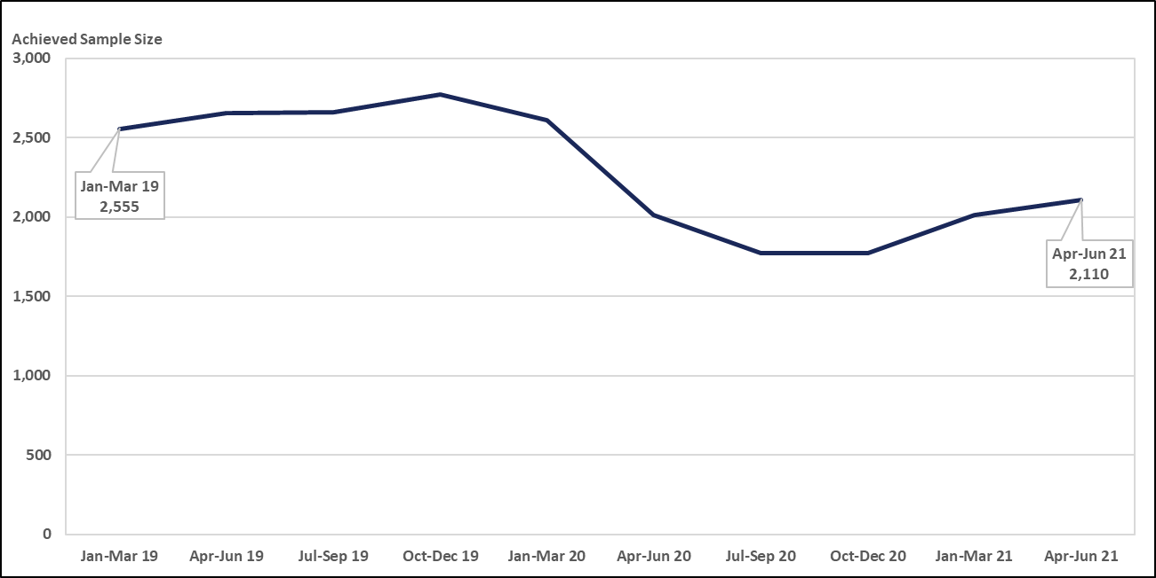
Impact on achieved sample size
47%

Slide 75
Impact to Precision
 | Confidence Intervals
 | October-December 2019 | April-June 2021
Employed (number) | +19,000 | + 22,000
Unemployed (number) | +5,000 | +7,000
Economically Inactive (number) | +18,000 | +21,000
Employment Rate | +1.5 | +1.8
Unemployment Rate | +0.6 | +0.8
Economic Inactivity Rate | +1.5 | +1.7

Slide 76
Impact on Data Processing
Reweighting in October 2020 – household tenure
Reweighting in July 2021 – changes to LFS population

Slide 77
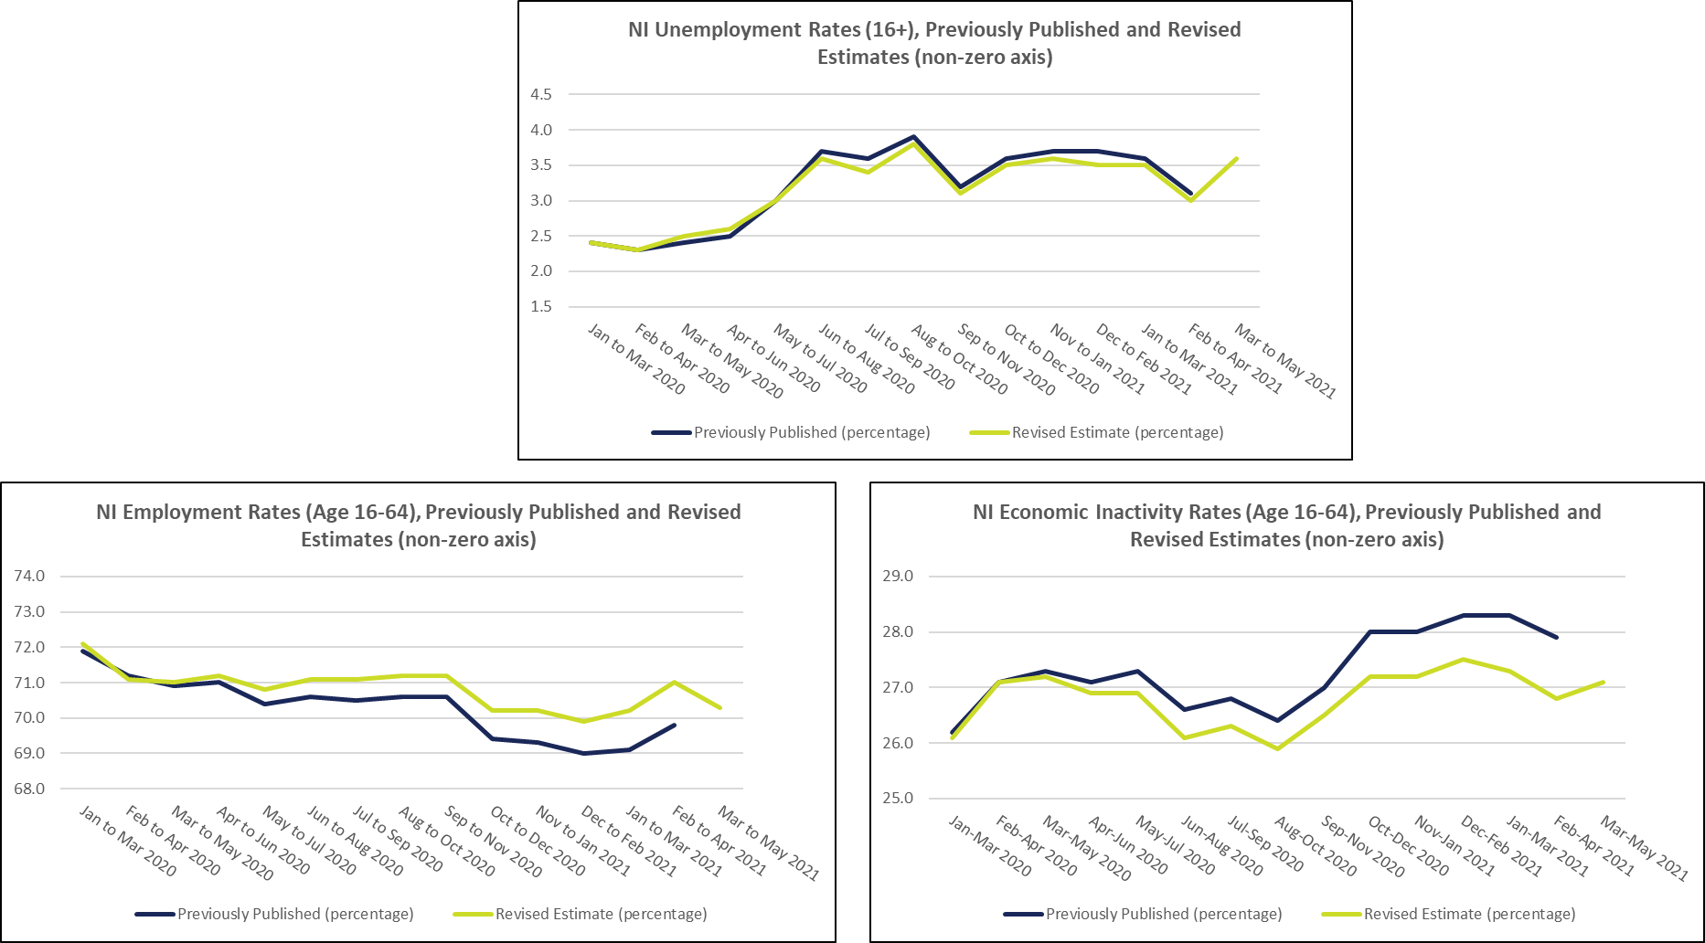

Slide 78
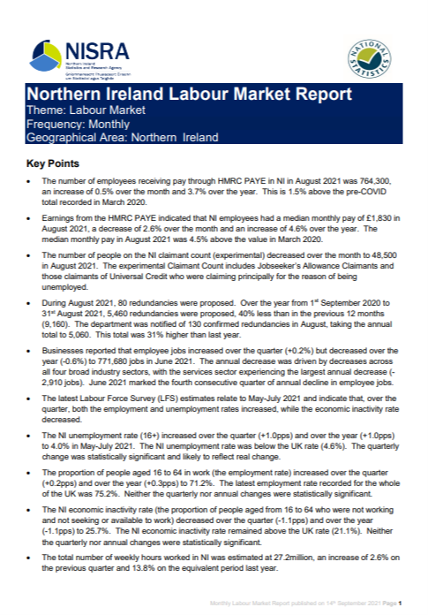
Impact on Monthly Outputs
LMR analysis:
HMRC Pay As You Earn-Real Time Information
Hours Worked series
Working fewer Hours (inc. Temporarily away
from work)
7am release time & Release practices
consultation

Slide 79
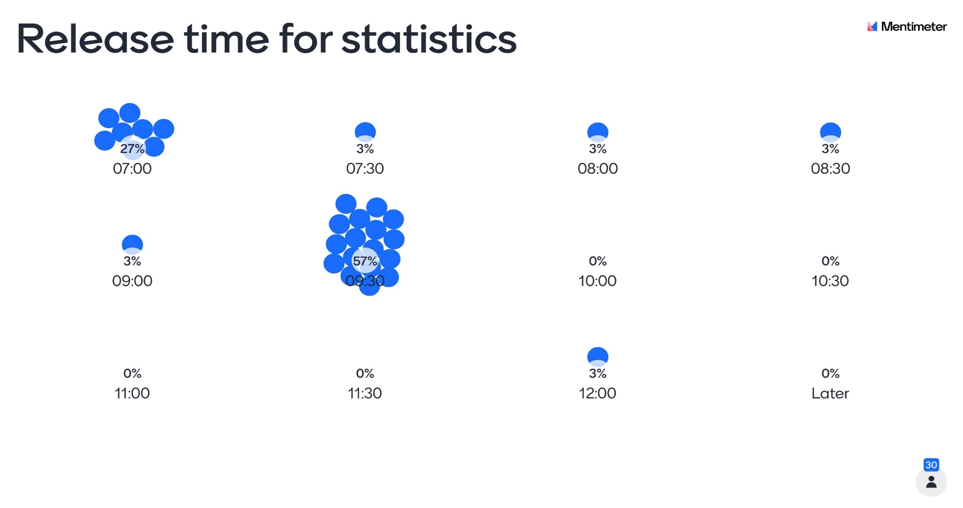
Mentimeter results – question 3

Slide 80
New questions and outputs
Jennifer McLoughlin

Slide 81

New questions added
  Gender identity – NI only
  Covid related
  Work quality - new analysis now published on:
  Meaningful work (NI only)
  Employee involvement in decision making
  Career progression
  Passports held

Slide 82
New questions - upcoming
    Settled status
    Gig economy
  Pending outcome of LFS dress rehearsal:
    Work quality
  Levels of support from immediate line manager
  Skills required to perform work duties (skills mismatch)
  Experiences of bullying and harassment
    Education

Slide 83
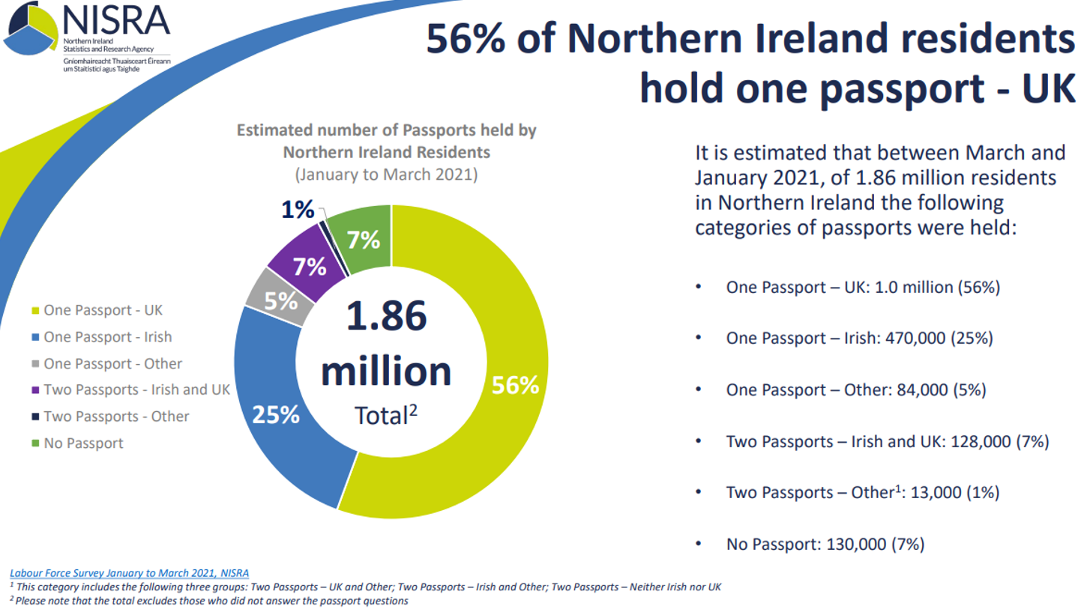
New passport question added to LFS in April 2020
Source: Overview of People Movement, Migration and Transport in Northern Ireland, August 2021

Slide 84

Work Quality - publications
December 2020
19/20 data - Headline estimates of 6 LFS indicators, including first release of data from 3 new questions:
- Career progression, meaningful work and involvement in decision making
February 2021
Further analysis by gender, age and skill level
7 LFS indicators and an earnings indicator from Annual Survey of Hours and Earnings (ASHE)
First release of data relating to flexible working
Analysis related to proportion of employees meeting 1 to 7 aspects of work quality (LFS)

Slide 85
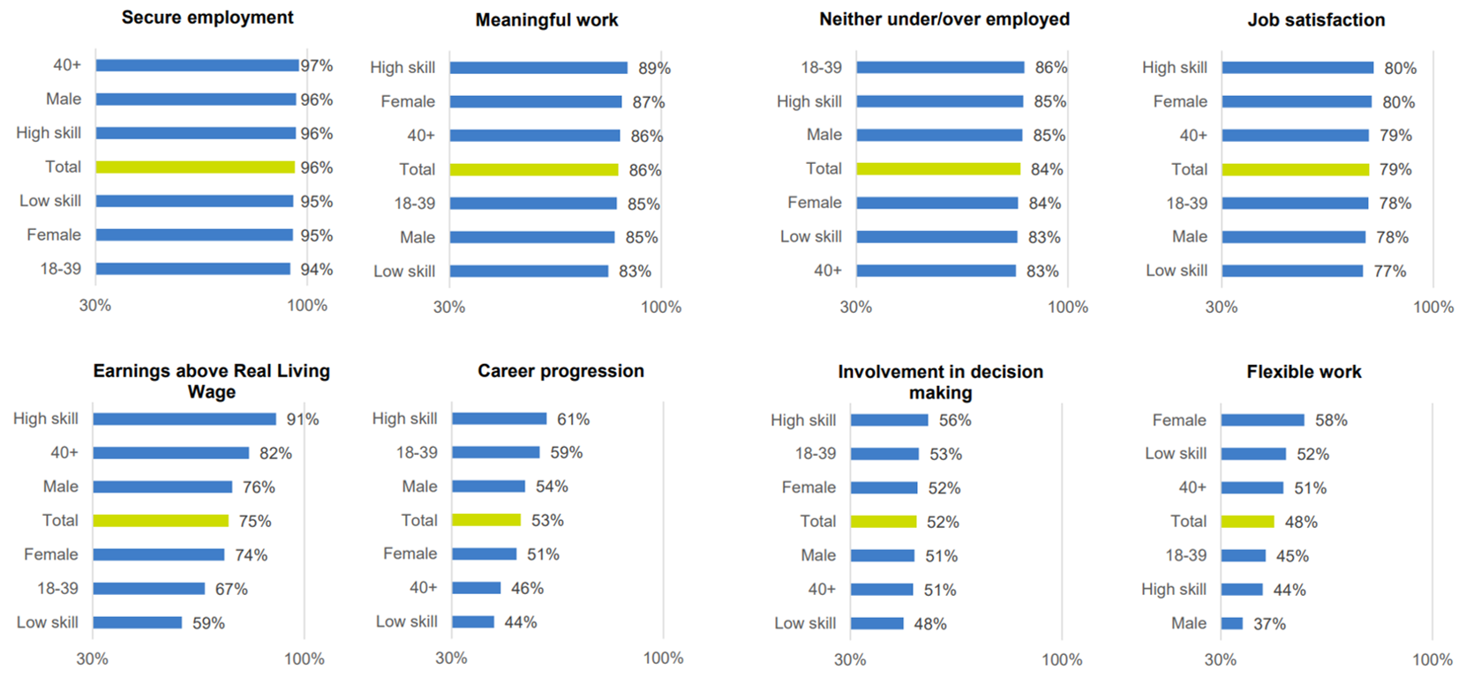
Work Quality indicators by gender, age and skills level, 2019/2020, 18+ employees
Source: Work quality in NI, July 2019 to June 2020

Slide 86
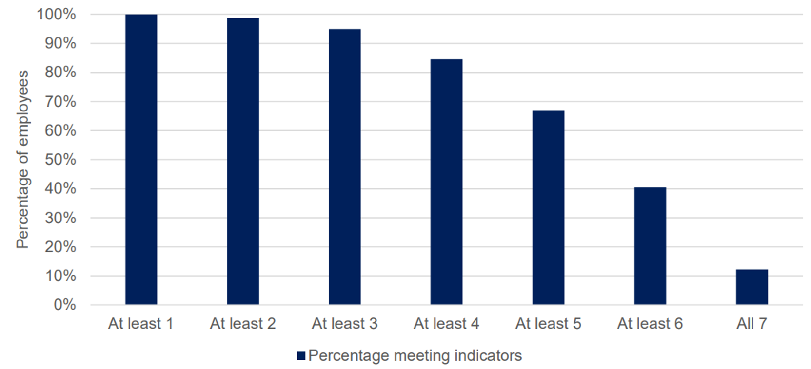
Percentage of employees meeting LFS work quality indicators, 2019/20
Source: Work quality in NI, July 2019 to June 2020

Slide 87
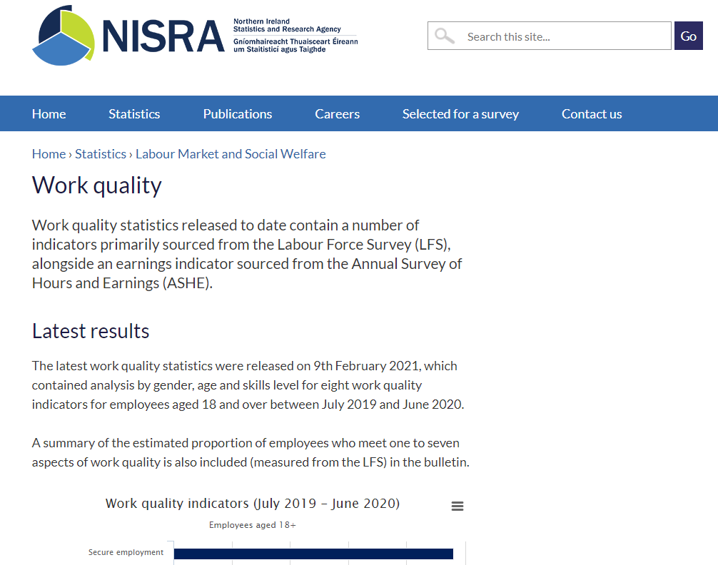
Work Quality – development
New area dedicated to work quality on NISRA website
Work plan published – live document

Slide 88
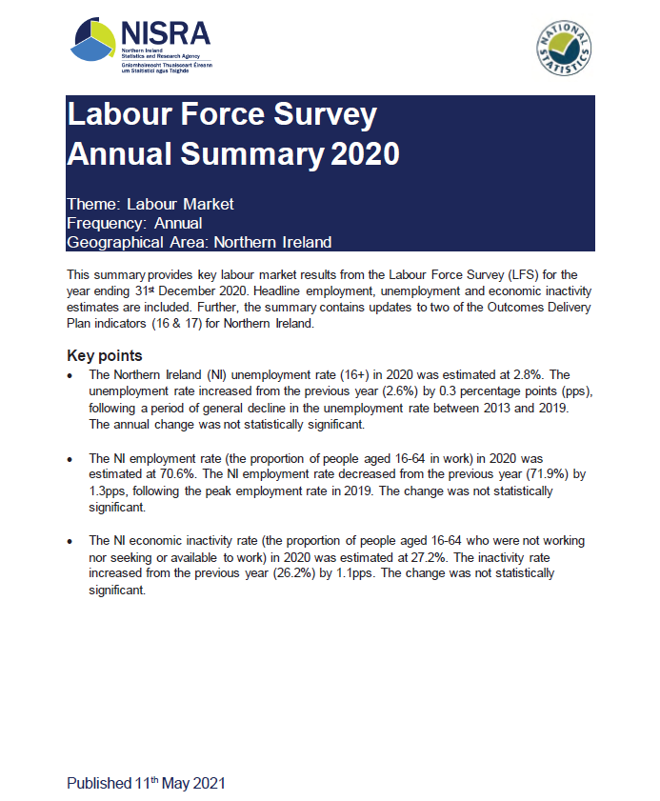
Publications – Annual Summary and Annual Report
Annual Summary – May 2021
Headline labour market data for 2020
Included data related to 2 Programme for Government (PfG) indicators
Annual Report – October 2020
Detailed report for 2019 data
Included latest data (2019) for the remaining 4 PfG indicators

Slide 89

Plans for the Future
4 short topic papers in October/November:
Disability employment gap – 7th October
Qualifications – 21st October
Employment, unemployment and economic
inactivity – 28th October
Not in Education, Employment or Training (NEETs) – November
Additional breakdowns of annual data for 2020 – November
Work Quality publication – early 2022
Women in NI – planned for March 2022
2020/2021
2021/22
Please get in touch if you would like added to LFS mailing list for new outputs -
email LFS@finance-ni.gov.uk

Slide 90
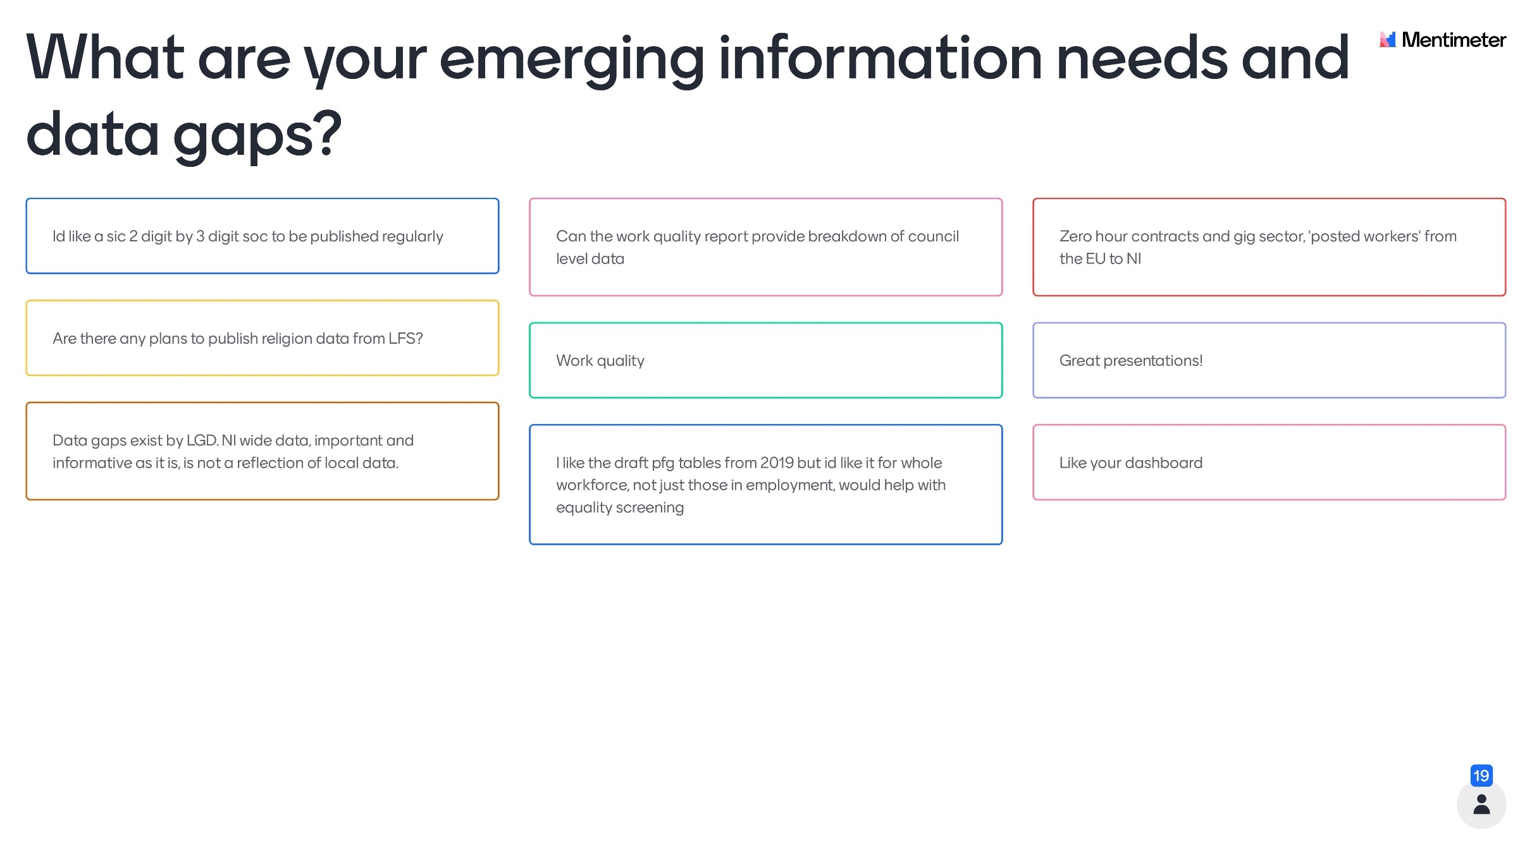
Mentimeter results – question 4

Slide 91
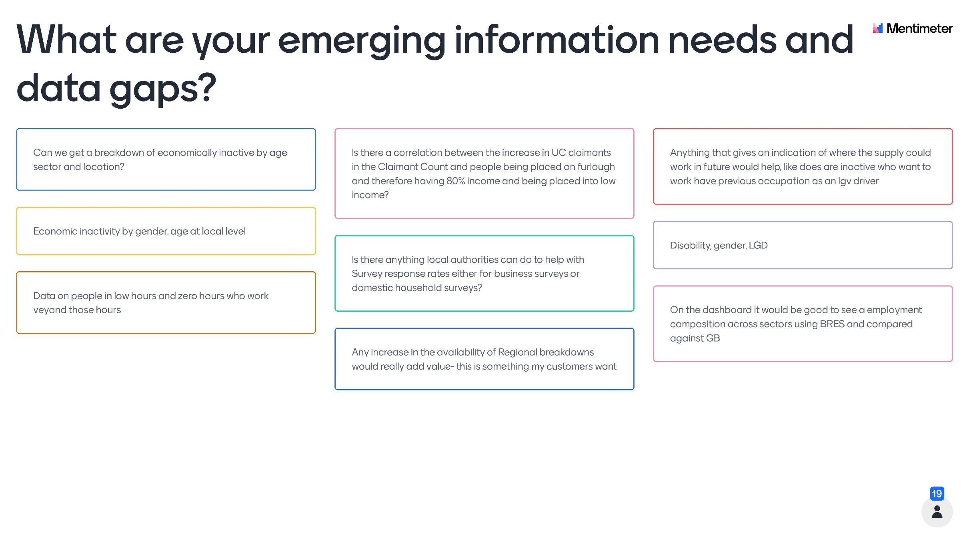
Mentimeter results – question 4 (continued)

Slide 92
Final Comments and Close
Presentations and ‘Questions and Answers’
will be uploaded to the
Labour Market Statistics User Engagement page
Thanks!

