Slide 1
Labour Market Statistics
User Group
24th September 2019

Slide 2
Aim of today’s meeting
update users on upcoming changes to data collection and outputs
provide an overview of the labour market consultation
obtain feedback from users on proposed changes
obtain feedback from users on information needs
Notes:
Second user group in this format

Slide 3
Labour Market Statistics Consultation
Launched on 8th July to 16th August
Accessed via NISRA website, DoF website, twitter, circulation list
Questions covered
use of main labour market outputs
LFS publications
proposed changes to Business Register & Employment Survey
benchmarking of Quarterly Employment Survey
information gaps

Slide 4
Agenda
Labour Force Survey
Jobs, Vacancies and Redundancies DfC and DfE statistics Earnings
Final Comments and Close

Slide 5
Labour Force Survey
ONS Social Survey Transformation
Office for National Statistics, Ian O’Sullivan
NI Labour Force Survey Operations
Central Survey Unit, Ruth Hewitt
NI Labour Force Survey Outputs
Economic and Labour Market Stats, Carly Gordon
Q&A

Slide 6
ONS Social Survey Transformation
Office for National Statistics, Ian O’Sullivan

Slide 7
NISRA: Labour Market Statistics User Engagement
September 2019
Belfast

Slide 8
Vision for the future

Slide 9
ONS Vision
Admin data first population, migration and wider statistical system but supplemented by surveys.
Iterative transformation rather than binary decision between an admin data census and a 2031 Census
    Produce the best possible statistical outputs using all available sources of information and methods before 2021, in 2021 and beyond
    Telling a coherent, understandable story to users
    Incrementally build admin data led statistics system
    Incorporate wider statistics, including outcome focused longitudinal analysis
Recommendation on the future of population statistics in 2023 based on progress made, and how well new system is matured and meets user needs

Slide 10
Administrative data
Admin data first population, migration and social stats system but supplemented by surveys
Admin data at core of population and migration statistics
Iterative transformation rather than big bang decision
Partnering across government departments working collaboratively with us in a timely manner, including to deliver the data required to transform PPP statistics
Enabled by Digital Economy Act (2017)

Slide 11
But…..
There remains a place for surveys within this future vision.
    To assess the coverage of admin data sources
    To produce statistical estimates:
        for topics currently not available from admin data e.g. amount of voluntary care or sexual orientation
        in conjunction with admin data via a sampling frame for follow up specialist surveys of small populations e.g. small locally concentrated ethnic groups
        by supplementing/modelling with admin data to adjust for definitional differences e.g. ILO unemployment using survey estimates and admin data on benefits/income

Slide 12
Background – Pop Stats Transformation
ONS produces:
population statistics for England and Wales
international migration statistics for the UK as a whole
Two key components of our statistics system are:
- ‘Stocks’: measuring the size of the population at a point in time
‘Flows’: measuring and understanding how the population is changing over time

Slide 13
Why are we transforming population and migration statistics?
ONS have long acknowledged that the existing approach for measuring international migration - the International Passenger Survey (IPS) - has been stretched beyond its original purpose and that all available sources must be considered to fully understand international migration in future.
There is a high demand from our users – including calls from parliamentary committees - for better evidence on migration. A changing policy context means decision-makers and the public need more evidence on migration, including the impact and contribution of migration on the economy and society. Our existing survey data doesn’t allow us to do this in sufficient depth and there are gaps in the evidence base.

Slide 14
The transformation journey
Admin data driven population and migration statistics
2021 Census
2023 - first new fully integrated outputs
Recommendation on future of the population statistics 2023
Admin data
Admin data
Admin data
What do we need to further support the admin data first approach?
Survey transformation – Integrated Population and Characteristics Survey (IPACS)

Slide 15
Progress so far

Slide 16
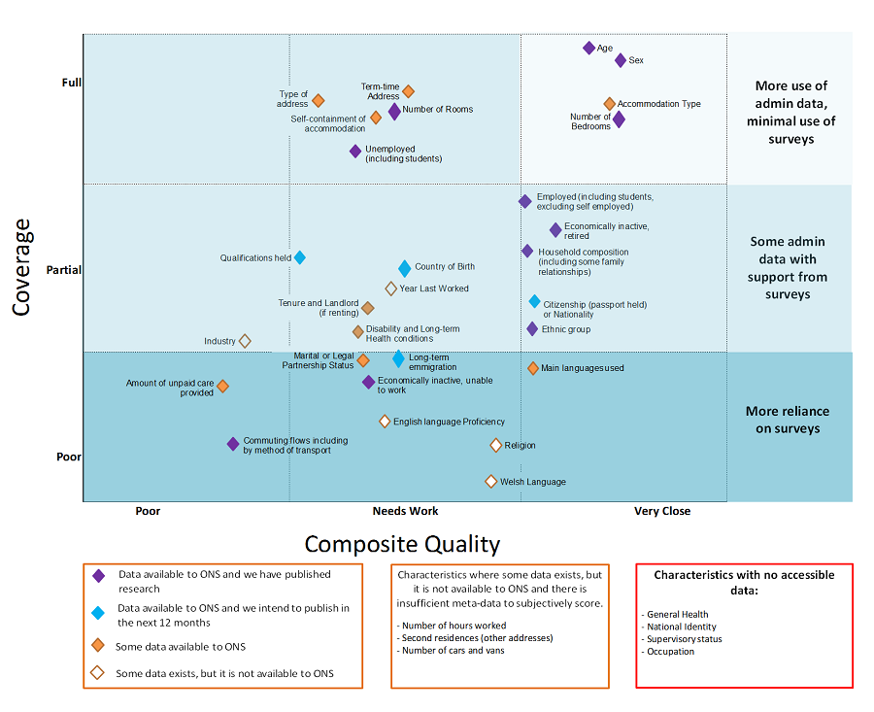
Census topics and availability in admin data

Slide 17

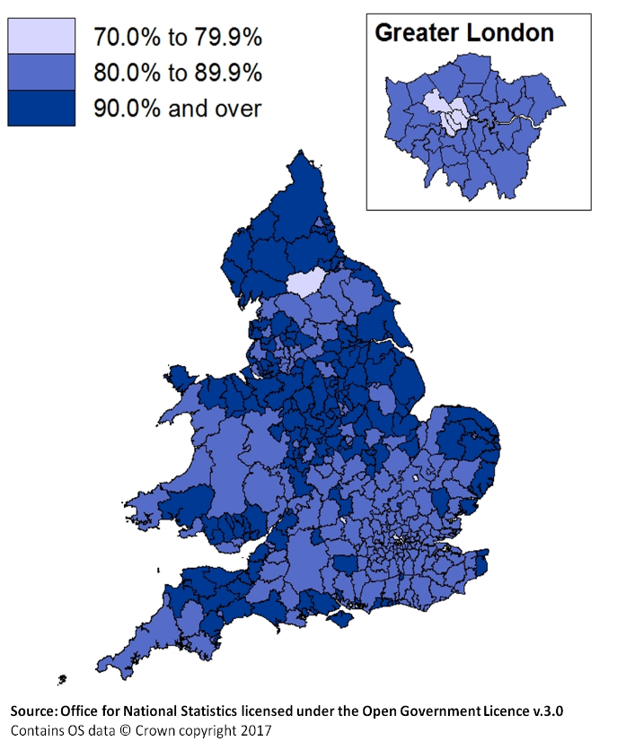



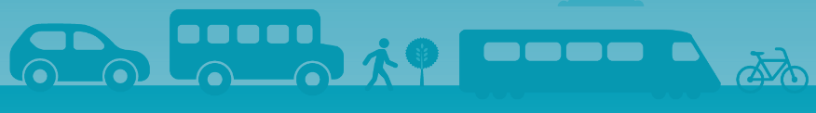
Making best use of all available data – providing new insights
Examples of where we (ONS and the wider GSS) are already doing this:
Admin data based
income
estimates (ONS)
Understanding the educational outcomes
of offenders
Migration
Housing statistics
Estimating suicide among higher education students
Commuting patterns using
mobile phone data

Slide 18
Other admin data research outputs so far
Admin based population and migration estimates
Occupied address (household) estimates
Occupied address (household) by size
Admin based income estimates
Labour market status
Economic activity of undergraduate students
Ethnicity using survey and admin data
Mobile phones to estimate commuter flows
New mother’s income from PAYE and benefits
Fuel poverty at LA level
Future publications on
Highest level of qualification
Ethnicity
Labour market status
Admin based income estimates
Housing characteristics
Annual Assessment

Slide 19
Opportunity Knocks!
The ONS transformation vision and strategy provides an opportunity to rethink social surveys end-to-end.
Overall ‘framework’
Modes of collection
Questionnaire design
Operations
Systems
Organisational design

Slide 20
From a statistical perspective Social Survey Transformation
  Admin data first approach but a requirement for large scale social surveys will remain
  New modes of collection - Digital by Default
  Re-design of questionnaire content to be respondent centric
  New focus
    to fill evidence gaps and fulfil user needs for info that admin data cannot provide
    to assess the coverage of admin data sources
  Integration
23rd September 2019

Slide 21
Population Coverage Survey
Admin data population and migration system requires a Population Coverage Survey (PCS)
Large scale sample required to assess the quality of the admin data; fill the gaps etc
Can we merge additional requirements into this PCS questionnaire?
Karlberg, Reis, Calizzani, and Gras (2015)
  A toolbox for a modular design and pooled analysis of sample survey programmes”

Slide 22
Bias in Admin Data Population Estimates
  Under-coverage
  Persons not registered with government departments (e.g. recent migrants, people de-registered due to inactivity)
  Statistical framework established for measuring under-coverage (dual system estimation)
  Over-coverage
  Persons that have emigrated or moved out of area still registered at
  Statistical framework not yet established
  Dependent Interviewing – no longer pursuing
  Under and over-coverage to be measured and adjusted from the same survey collection

Slide 23
Integrated Population and Characteristics Survey (IPACS)
An Integrated Population and Characteristics Survey (IPACS) would support the production of Population, Migration and Social Data from non-survey data sources
The IPACS can also be used as the future sourcing model for any residual population, migration and social data collection – for whatever purposes these residual data are required.

Slide 24
How did we come up with the idea of IPACS?
Admin data population and migration system requires a Population Coverage Survey – new survey requirement.
Assess the quality of the admin data; fill the gaps etc
Sample of 500,000 households
Cost between £20- £25 million
Most of the cost driven by face-to-face collection
Merge additional requirements (Labour Market) into a PCS questionnaire could make it more efficient? Economies of scale.

Slide 25
IPACS: Benefits and Challenges
Benefits
Cost efficient
Increased precision for smaller geographies
Reduce respondent burden
Flexible to user needs
Improved opportunities for cross-analysis
Challenges
Harmonisation of sample designs
Harmonisation of questions and definitions
Understanding user requirements
Reference dates
Interviewer challenges
Mode effects
Attrition
Non-response
23rd September 2019

Slide 26
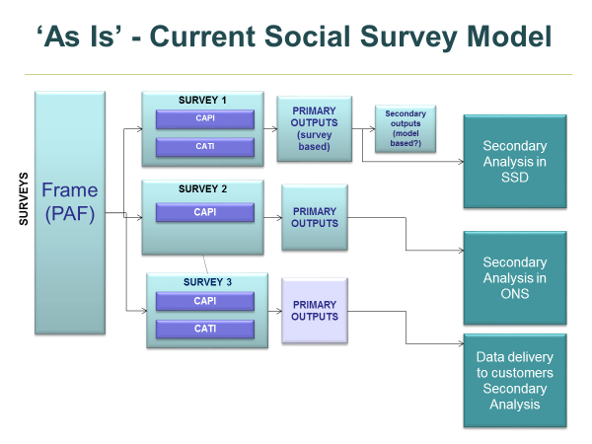

Slide 27
Concept of the IPACS ‘Master Wave’
Sample size - circa 500,000 households per annum
Integrate questions required for PCS and Labour Market estimates
Mixed mode collection
Full household enumeration
Sample design requires stratification for admin data coverage (under-coverage and over-coverage)
Will have a design effect on current LFS estimates

Slide 28
IPACS Structure

Slide 29
IPACS – Example Wave 2 Structure

Slide 30
Progress so far

Slide 31
Key statistical challenges
Online uptake
Mixed-mode response
Longitudinal design – attrition/retention
Sample design – integrating LMS and PCS (and other modules)
Bias
Breaks in time series

Slide 32
Results: Engagement Strategy
Letter Combinations:
Invitation
2 Reminders
Pre-Note
Invitation
1 Reminder
Invitation
1 Reminder
19.5%
18.4%
16.3%
Letter Dispatch Day:
18.8%
Wednesday
17.4%
Friday

Slide 33


Results: Incentives Testing
4 Experimental Conditions:
No incentive
£5 voucher (unconditional)
£5 voucher (unconditional) & £10 voucher (conditional)
A tote bag

Slide 34
Overall (adjusted for 95% eligibility):
30.5%
£5 unconditional / £10 conditional
28.9%
£5 unconditional
27.5%
Tote Bag
22.3%
No Incentive

Slide 35
Merged LMS / PCS Testing – 2018/19
‘Statistical’ Test
Areas of research:
  What is the mixed-mode response rate?
  Mode bias investigation
  Responding sample composition
  What can we learn from the paradata?
  Comparisons between transformed LMS employment estimates and ‘regular’ LFS data
  Evidence of feasibility to support admin data population estimation system
  Sample of 14,149 households across Great Britain, issued over 15 weeks
  Collection period: 01 Nov 18 – 02 April 19
  Online first (2 weeks exclusive), Face-to-Face issued for non-responding households (6 weeks F2F/online)
  Data collection contracted out to Ipsos Mori

Slide 36
Merged LMS / PCS Testing – 2018/2019
‘Statistical’ Test – Uptake Rates
Overall uptake: 60.7%
Online uptake: 31.1%
F2F uptake: 29.6%
Data is being analysed; results to be communicated in the Autumn

Slide 37




Merged LMS / PCS Testing - 2019
Attrition Test
Wave 1
BWE
Wave 2
BWE
Wave 3
Testing online uptake and attrition rates – 3 waves
Integrated LMS and PCS
Test of Between Wave Engagement (BWE) strategies
BWE issued at mid-point between waves
Incentivisation at W2 and W3
Wave 1: May 2019
Wave 2: August 2019
Wave 3: November 2019
50,000 Hhlds
Tote Bag
Incentive
Email
£5 Incentive
Email
No Incentive
No Incentive
No Incentive
Postcard
£5 Incentive
Postcard
No Incentive
No Incentive
No Incentive
No BWE
£5 Incentive
No BWE
No Incentive
No Incentive
No Incentive
£5 Incentive
£5 Incentive
No Pre-Note
No Incentive
No Pre-Note
No Incentive

Slide 38
Attrition/retention
Overall retention at wave 2 - 62.5%
Ranged from 52.3% to 71.7% uptake at wave 2

Slide 39
Key statistical challenges
Online uptake
Mixed-mode response
Longitudinal design – attrition/retention
Sample design
Breaks in time series TBC Autumn 2018
Bias TBC Autumn 2018
Sample design – integrating LMS and PCS (and other modules)

Slide 40
IPACS Implementation
Initial planning for the implementation of IPACS including a longitudinal tests & parallel run
Approach is centred upon people, process and technology workstreams
Commercial activities required to source external capacity and capability to commence data collection in 2020.
Also includes the activities required to deliver the end-to-end solution internally (technology, and services – data collection and processing)

Slide 41
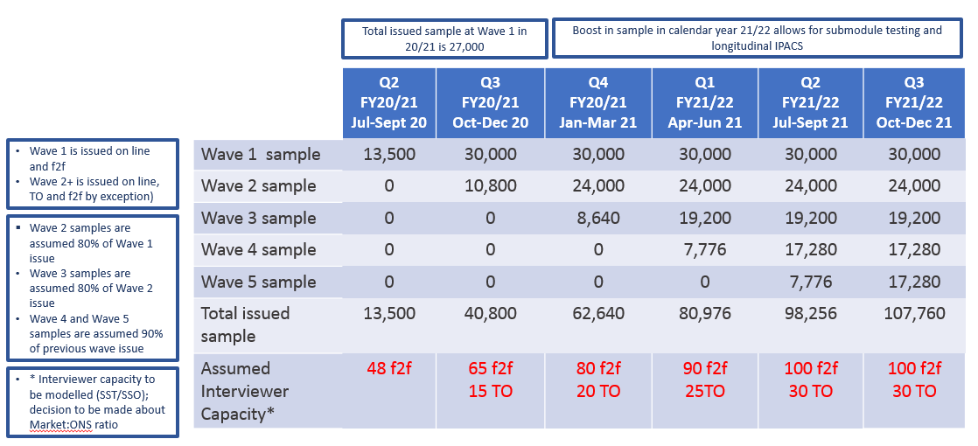
Longitudinal test design

Slide 42
 | 2020 | 2020 | 2021 |  |  |  | 2022 |  |  |  | 2023
 | Jul-Sep 13.5K | Oct-Dec 30K | Jan-Mar 30K | Apr-Jun 30K | Jul-Sep 30K | Oct-Dec 30K | Jan-Mar 125K | Apr-Jun1 125K | Jul-Sep 125K | Oct-Dec 125K | Jan-Mar 125K | Apr-Jun 125K | Jul-Sep 125K | Oct-Dec 125K
IPACS | W1 | W1 | W1 | W1 | W1 | W1 | W1 | W1 | W1 | W1 | W1 | W1 | W1 | W1
 |  | W2 | W2 | W2 | W2 | W2 | W2 | W2 | W2 | W2 | W2 | W2 | W2 | W2
 |  |  | W3 | W3 | W3 | W3 | W3 | W3 | W3 | W3 | W3 | W3 | W3 | W3
 |  |  |  | W4 | W4 | W4 | W4 | W4 | W4 | W4 | W4 | W4 | W4 | W4
 |  |  |  |  | W5 | W5 | W5 | W5 | W5 | W5 | W5 | W5 | W5 | W5
 |  |  |  |  |  |  | Decision
LFS | W1 | W1 | W1 | W1 | W1 | W1 | W1 | W1 | W1 | W1 | Stop the LFS/APS at the end of 2022 and continue with IPACS?
 | W2 | W2 | W2 | W2 | W2 | W2 | W2 | W2 | W2 | W2
 | W3 | W3 | W3 | W3 | W3 | W3 | W3 | W3 | W3 | W3
 | W4 | W4 | W4 | W4 | W4 | W4 | W4 | W4 | W4 | W4
 | W5 | W5 | W5 | W5 | W5 | W5 | W5 | W5 | W5 | W5

Slide 43
Many thanks
ian.o’sullivan@ons.gov.uk

Slide 44
NI Labour Force Survey Operations
Central Survey Unit, Ruth Hewitt

Slide 45
Labour Force Survey
Level of precision of NI LFS estimates markedly lower than in the UK
Precision of LFS estimates limited the ability to detect real turning points in the economy
PFG required greater disaggregation of LFS data
NI LFS – concerns about declining household response rates at Wave 1 and Waves 2-5
ONS – Transformation of UK LFS

Slide 46
Labour Force Survey
Increase in sample size
Introduction of financial incentives
Response rates

Slide 47
Sample
Historically 2,600 new addresses sampled each year
Small, often seasonal increases over a few years
From January 2018 a major increase in sample size throughout the whole year
Now there are 5,148 new addresses sampled per year, effectively double what it was previously

Slide 48
Rise in monthly allocations since 2017

Slide 49
Number of Completed Interviews since 2017

Slide 50
Incentive Scheme
Trial introduced in April 2018
(GB introduced incentives in June 2017)
£10 Post Office voucher at waves 1, 2 and 5
Low encashment rate of unconditional vouchers by householders who did not participate in the survey
Analysis of trial shows that incentives are having a positive effect on wave 1 response rates

Slide 51
Incentive Scheme
Wave 1 response rate is significantly higher (+ 7.7%) when unconditional incentives are used, compared to conditional
Other benefits of Unconditional Incentives:
  More efficient use of staff time in office
  Removes risk of interviewers handling vouchers
  More straightforward approach for interviewers
    Too early to state the benefits of the incentive scheme on the longitudinal aspect of the survey

Slide 52
Response Rates
Wave 1 response rate and overall response rate
Comparison with GB
Impact of
  Increased sample size
  Incentives

Slide 53
NI and GB Quarterly Wave 1 Response Rate

Slide 54
NI and GB Quarterly Wave 1 Response Rate

Slide 55
NI and GB Quarterly Wave 1 Response Rate

Slide 56
NI Quarterly Response Rate - All Waves

Slide 57
Continuing to Improve Survey Performance
Roll out of incentive trial in waves 1, 2 and 5
Future incentives analysis:
  Effect of wave 2 and wave 5 incentives
  Incentives in areas of deprivation
Continuous training and briefing of interviewers
Achieving Co-operation Training

Slide 58
NI Labour Force Survey Outputs
Economic and Labour Market
Statistics, Carly Gordon

Slide 59
Progress - Summary
What we had planned | What we did
Survey:
Reweighting to latest population estimates | Reweighting began in February 2019 with quarterly datasets and has been rolled out to all other datasets – completed summer 2019
Large scale boost to the LFS sample | Boost implemented throughout 2018 and roll-out completed by Q2 2019
Publications:
Quarterly supplement | Most tables now incorporated into LMR – more timely release of NEETs and household data
Annual Report | Summary in March 2019 and full report in June 2019
Women in NI | Published in December 2018 with focus on LFS only and links to other data sources. An inactivity report was also published in June 2019 to provide more in depth analysis
Economic Inactivity in NI 2018 | Topic paper examining economic inactivity in NI, regionally and compared with UK
Work quality | Outputs from new job sat question and work quality tables published
NEW
NEW

Slide 60

Progress - Survey
Reweighting – impact on outputs
Sample boost – Impact on confidence intervals/precision of estimates
https://www.nisra.gov.uk/publications/labour-force-survey-changes-outputs

Slide 61
Impact to Estimates

Slide 62
Impact to Precision
 | Confidence Intervals
 | May-July 2017 | May-July 2019
Employed (number) | +24,000 | + 19,000
Unemployed (number) | +10,000 | +6,000
Economically Inactive (number) | +22,000 | +19,000
Employment Rate | +1.8 | +1.5
Unemployment Rate | +1.1 | +0.6
Economic Inactivity Rate | +1.7 | +1.5

Slide 63

Progress - Publications
Quarterly Supplementary Tables
Annual Data
Women in Northern Ireland
Inactivity Paper
Work Quality

Slide 64
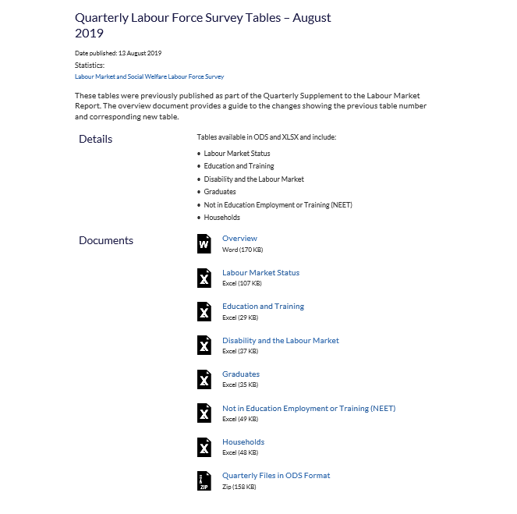
Quarterly Supplementary Tables

Slide 65


Annual Data

Slide 66


Women in Northern Ireland

Slide 67
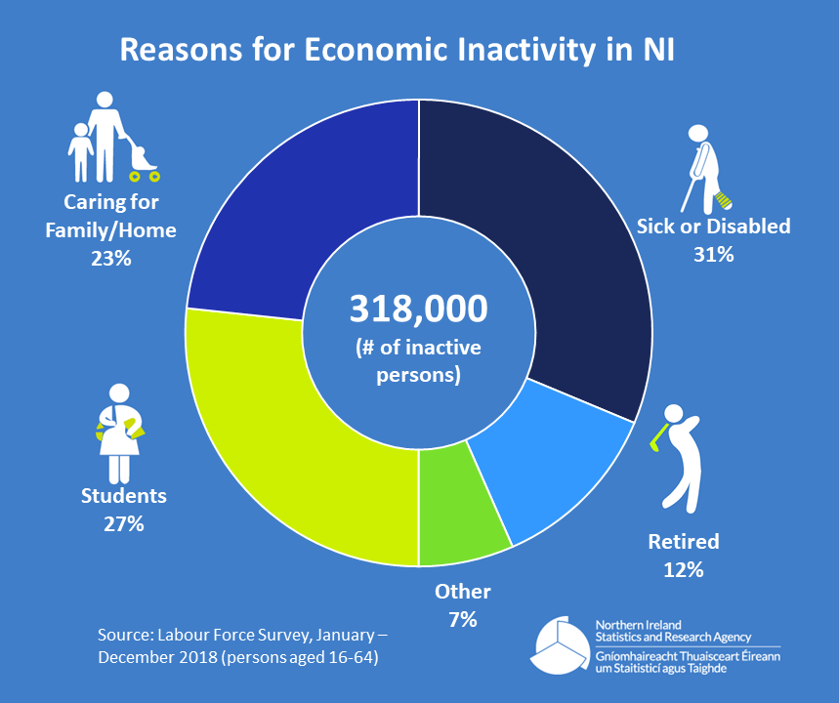
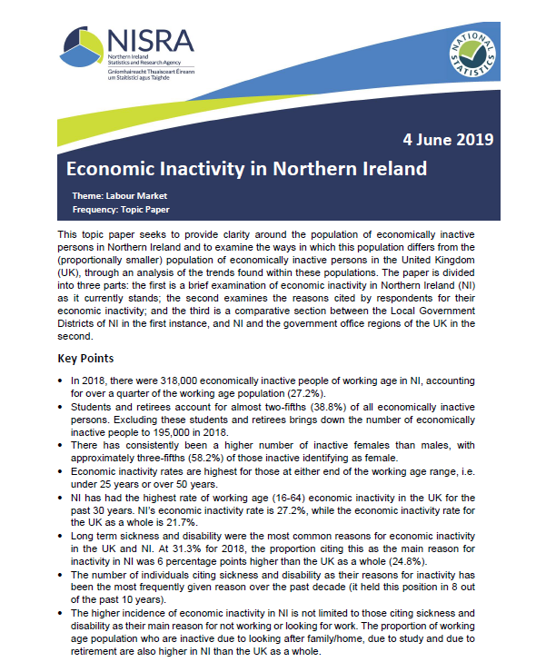
Economic Inactivity in Northern Ireland 2018

Slide 68

Work Quality

Slide 69
“An excellent report”

Slide 70
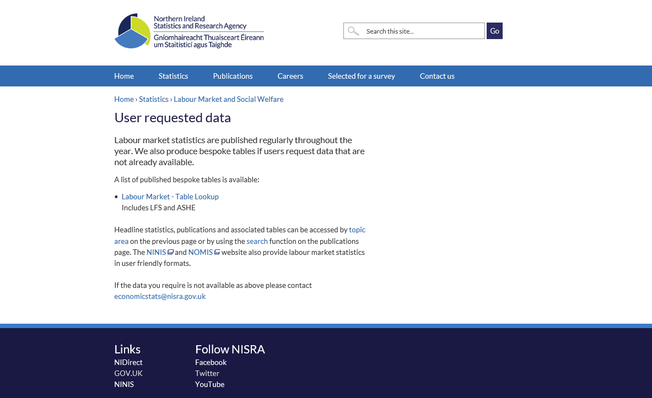
Bespoke Analysis
  www.nisra.gov.uk/statistics/labour-market-and-social-welfare/user-requested-data

Slide 71

Changes and Developments
Questionnaire
Additional validation of SIC data
Work Quality Agenda
Twitter

Slide 72

Work Quality Agenda
New questions relating added to NI LFS from July 2019:
The extent to which your job offers good opportunities for career progression?
How good are managers at involving employees and their representatives in decision making?
The extent to which you feel you do meaningful work?

Slide 73
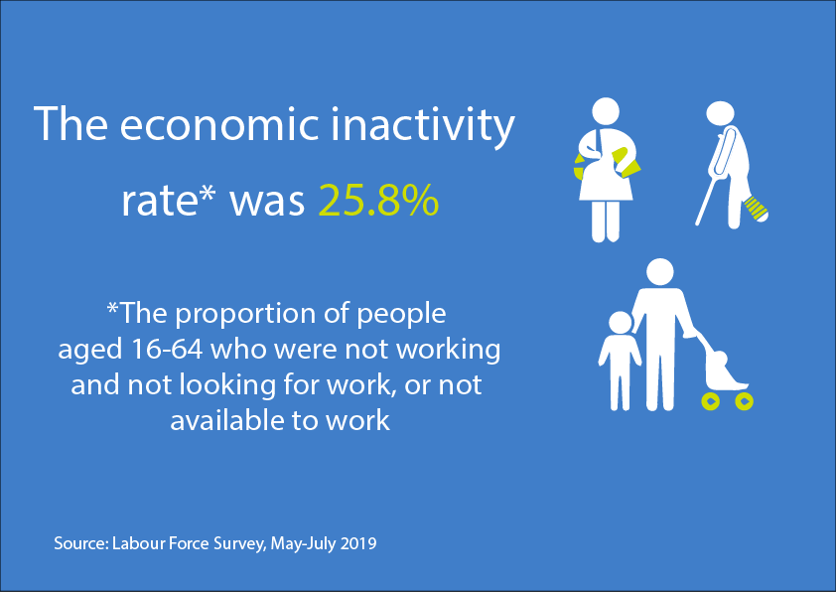



Twitter
Infographics – twitter @NISRA

Slide 74

Plans for the Future
OSR Compliance check
Religion outputs
HTML
Continuous improvements and quality checking

Slide 75


Slide 76
Jobs, Vacancies and Redundancies
Business Register and Employment Survey Changes
ELMS
Redundancy Statistics
ELMS, Ashleigh Warwick
Q&A

Slide 77
Business Register and Employment Survey (BRES) changes
Economic and Labour Market
Statistics

Slide 78
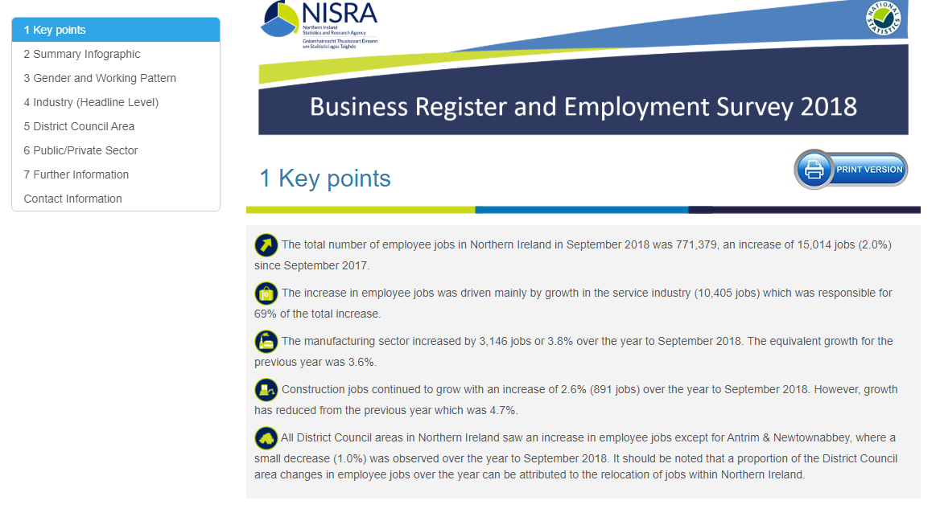
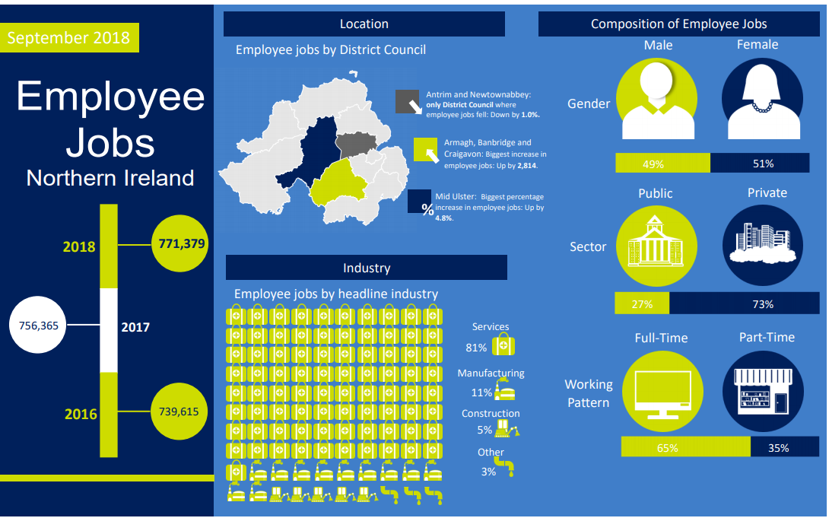
BRES 2018
Publication Date: 27th June 2019
Small BRES (Sample size ≈ 12,000)
Outputs:
  Full Bulletin (PDF, HTML)
  Tables:
    Employee jobs by DCA
    Employee jobs by Headline
    Employee jobs by Public/Private
    Employee jobs by DCA and Headline
  Infographics
  NINIS
New: HTML version of publication
Summary Infographic

Slide 79
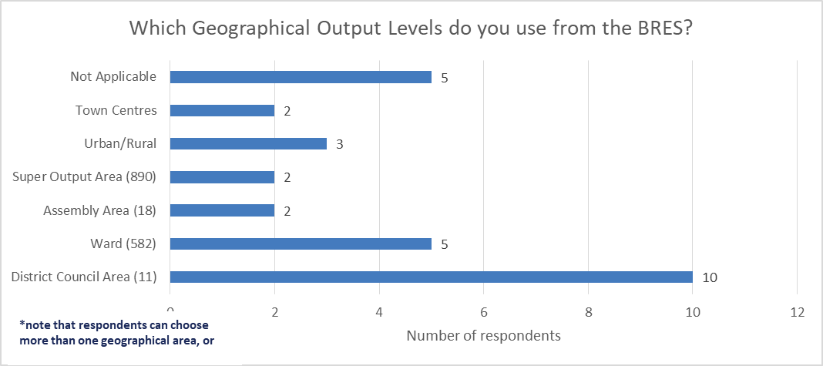
User Consultation
Geographical Outputs
62.5% of consultation respondents use District Council Area (11) level outputs whilst 31.3% of respondents use Ward (582) level outputs.

Slide 80
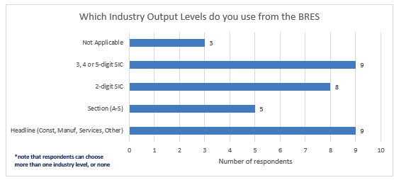
User Consultation
Industry Outputs
Both Headline (Construction, Manufacturing, Services, Other) and 3,4 or 5-digit SIC codes are used by 56.3% of respondents.

Slide 81
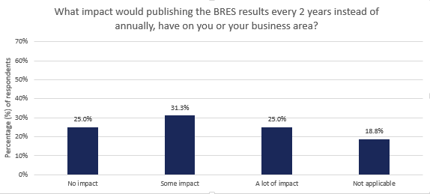
User Consultation
Impact of no small BRES

Slide 82
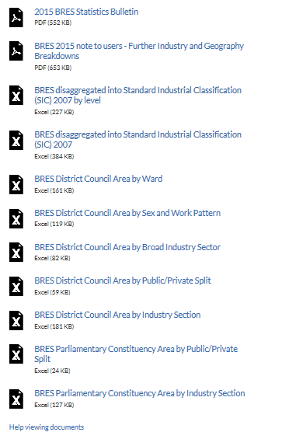
BRES 2019
Outputs from last BRES Census (2015)
Currently in the field
Not a Census
Big BRES (Sample size ≈ 30,000)
Same outputs available:
  Full Bulletin
  Data tables of employee jobs:
    SIC5, SIC4, SIC3, SIC2
    Headline Industry and Section
    Ward
    District Council Area
    District Council Area by Headline Industry
    District Council Area by Public/Private split
    Parliamentary Constituency Area by Public/Private split
    Parliamentary Constituency Area by Industry Section

Slide 83


Migrant/Vacancy Questions
New questions added to BRES 2018, and remained on BRES 2019:
Based on the initial analysis of the 2018 data:
  Vacancy figures seem robust (more so at Reporting Unit Level)
  Migrant data less reliable (lower response in this question, as many businesses highlighted they didn’t hold this information)
Next steps:
  Work with colleagues in the ONS to finalise the methods for producing these results
  Possibility of waiting for the 2019 results, to publish both sets of data together
Migrant Question
Vacancy Question

Slide 84
Redundancy Statistics
Economic and Labour Market
Statistics, Ashleigh Warwick

Slide 85
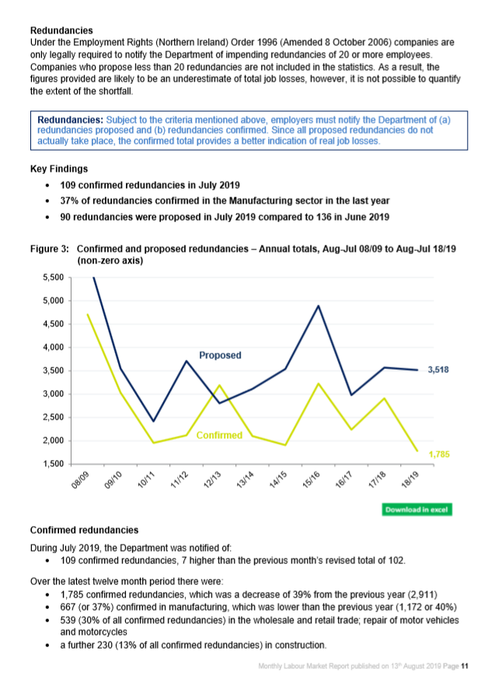
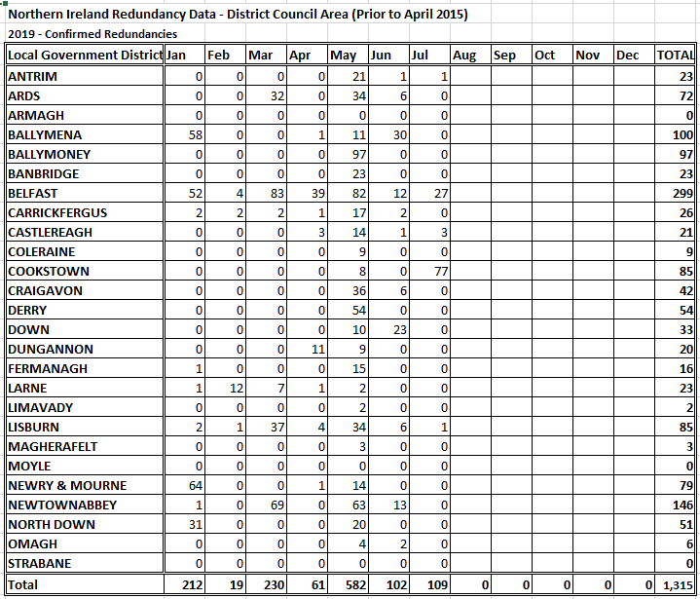
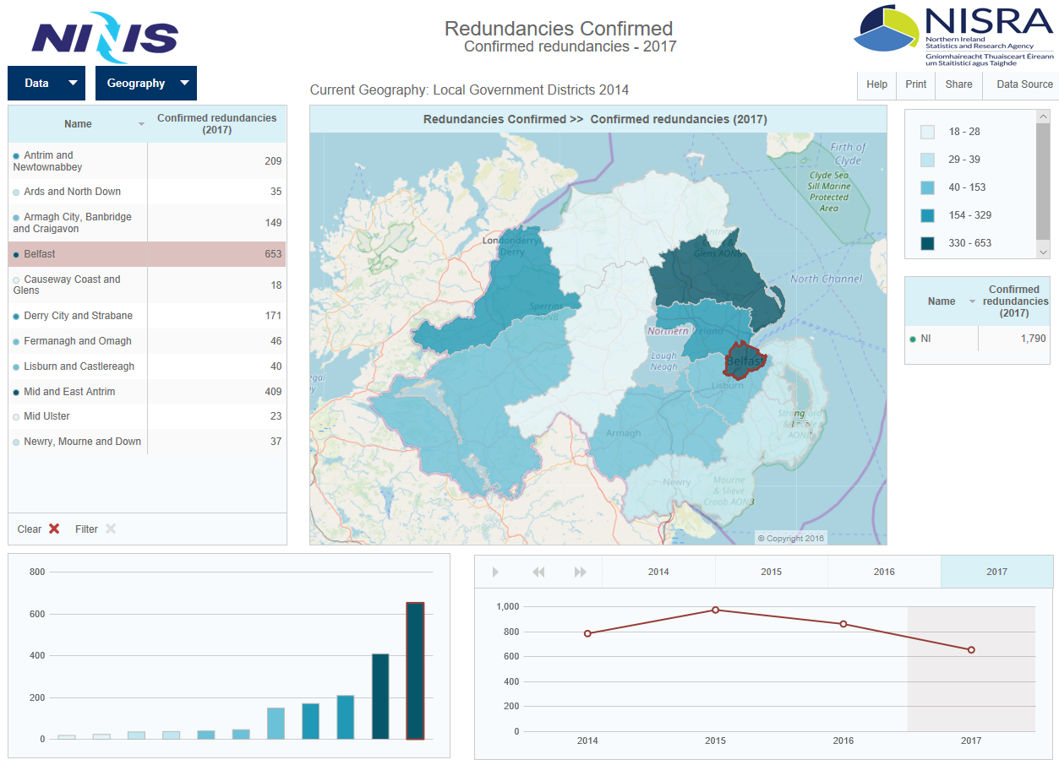
Labour Market Report
Redundancy Tables
NINIS

Slide 86
Redundancies
UNDER REVIEW

Slide 87
How useful do you find the redundancies data in the LMR?

Slide 88












Slide 89

Views or Questions

Slide 90
DfE and DfC Labour Market Statistics
Universal Credit
Department for Communities, Stuart Gilmore
Developments in statistics on tertiary education, training and apprenticeships
Department for Economy, Brian French, Jamie Stainer
Q&A

Slide 91
Universal Credit
Department for Communities, Stuart Gilmore

Slide 92
Introduction
Universal Credit
Jobseekers Allowance
Employment and Support Allowance
Income Support
Child Tax Credit
Working Tax Credit
Housing Benefit
Universal Credit was introduced in NI from September 2017
Replaces 6 benefits and tax credits currently administered by 3 different branches of government
Universal Credit provides a single award per household based upon the circumstances of the household.
Support for housing costs, children and childcare costs are integrated into Universal Credit.
It also provides additions for disabled people and carers.

Slide 93
Impact of Universal Credit
Estimates in September 2016 showed there were 453,000 claims to “Legacy” benefits amalgamated to 282,000 benefit units on UC
New claimants and those with a change in circumstances from September 2017
Move to UC expected to commence in January 2021
+
114,000 benefit units entitled to average of £26 more per week
72,000 benefit units with no change in entitlement
-
126,000 benefit units entitled to average of £39 less per week
No Change

Slide 94
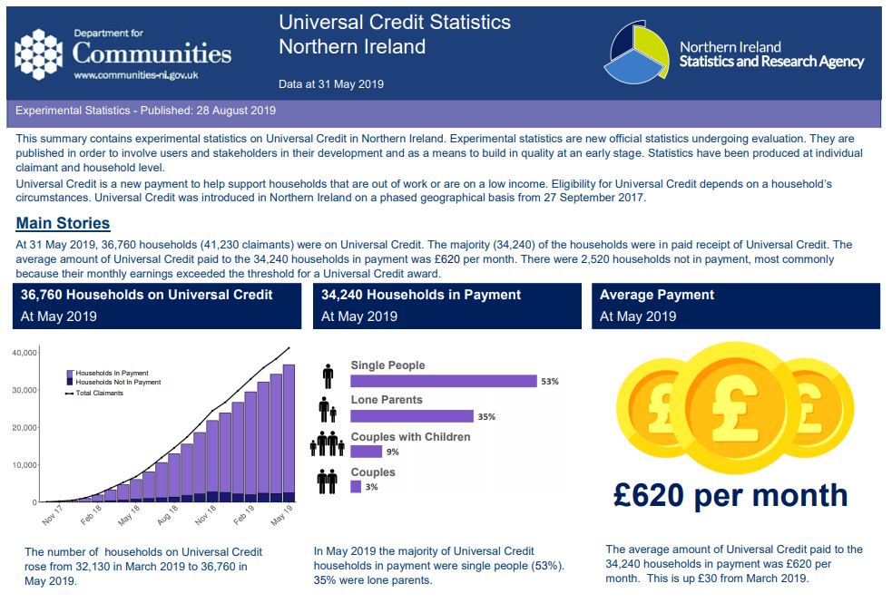
Statistics Publication
UC database holds 5,000+ variables
Data underwent rigorous quality assurance
First publication issued on 26th June 2019
Latest on 28th August 2019
Experimental statistics are new official statistics undergoing evaluation. They are published in order to involve users and stakeholders in their development and as a means to build in quality at an early stage.

Slide 95
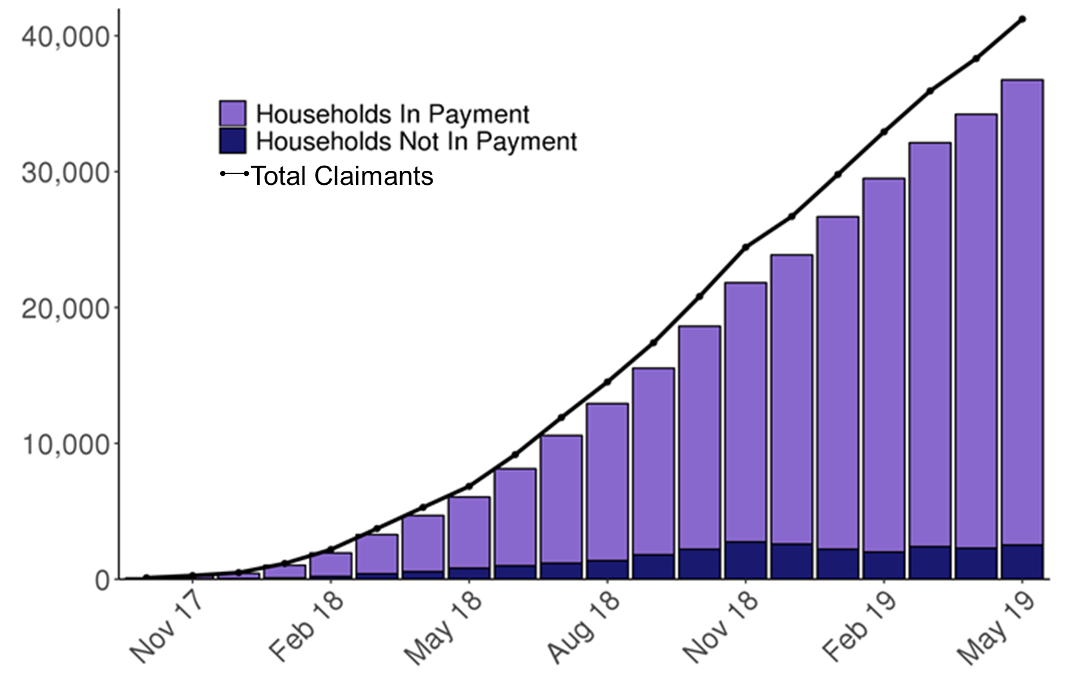

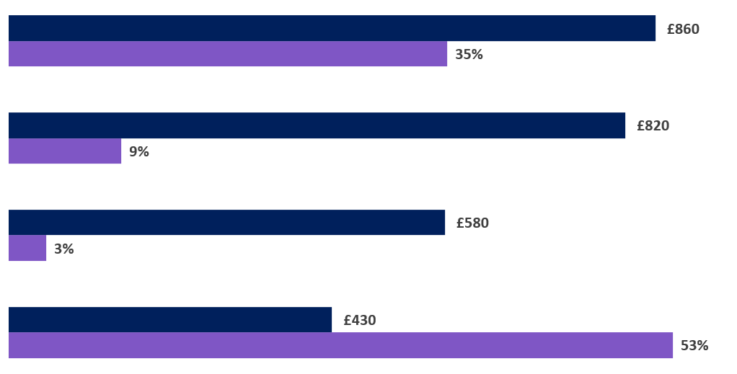







36,760 Households
93% of Households currently in payment
£620 Average payment
56% Receiving support for housing costs
94% of Social rent sector housing costs paid direct to landlord
61% of Private rent sector housing costs paid direct to landlord
Lone Parents
Over half of households are single people without children
Lone parents receive, on average, the highest level of support
Couples with Children
Couples
Single People
Average Payment
Proportion of Households

Slide 96
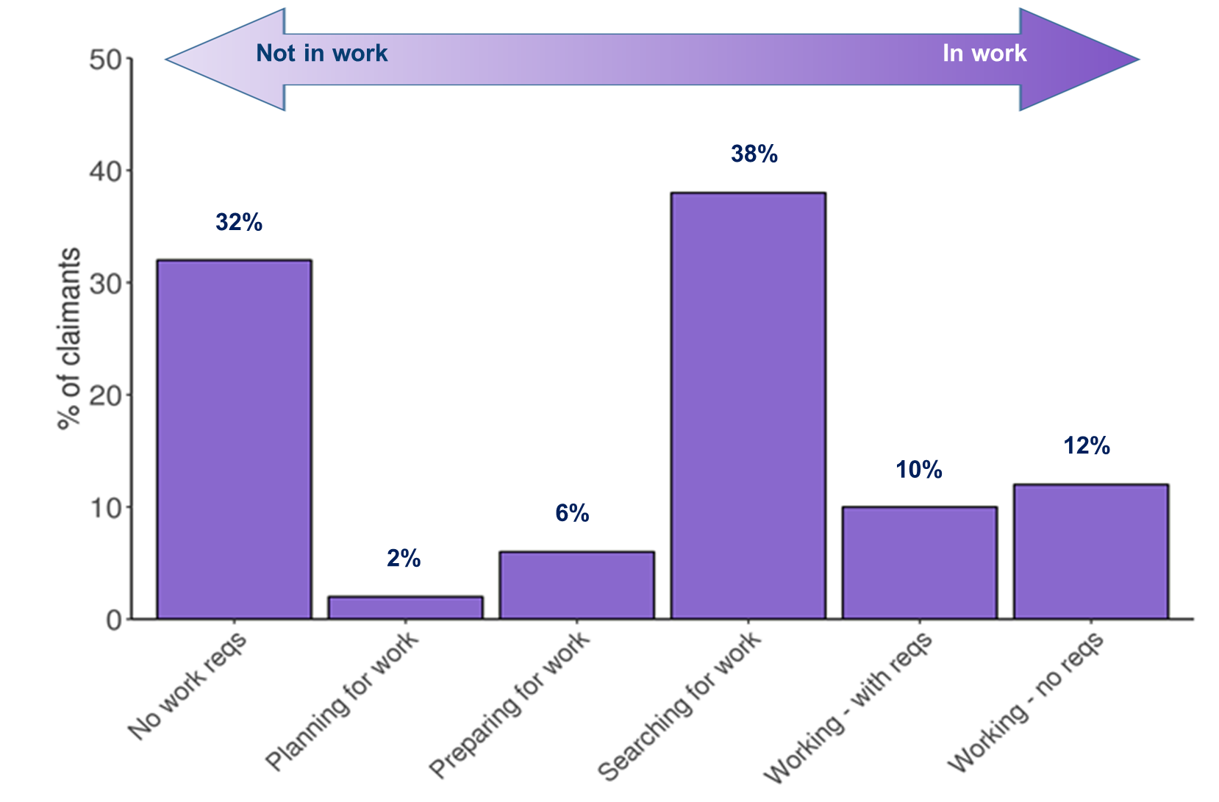
41,230 Claimants
38% of claimants in Searching for Work (Intensive) conditionality regime
The North & West, where rollout began, has higher claimant numbers

Slide 97
Impact on Legacy Benefits
48%
22%
5%
Decline since November 2017

Slide 98
Future Developments
Advances
Sanctions
Labour Market / Conditionality Regime
Earnings
Alternative Claimant Count
Notes:
Areas for development

Slide 99
Further Information
    UC Statistics Publication
    https://www.communities-ni.gov.uk/articles/universal-credit-statistics
    Feedback form also available at the link above.
    Welfare Changes, Briefing and Evaluation
    https://www.communities-ni.gov.uk/topics/welfare-changes-briefing
    Universal Credit Statistics Contacts
    Claire McCann – Claire.McCann@communities-ni.gov.uk
    Ben Davoll – Ben.Davoll@communities-ni.gov.uk

Slide 100
Developments in statistics on tertiary education, training and apprenticeships
Brian French – Statistics and Research Branch (Tertiary Education), DfE
Jamie Stainer – Youth Training Statistics and Research Branch, DfE

Slide 101
Statistics and Research Branch (Tertiary Education), DfE
brian.french@economy-ni.gov.uk

Slide 102

Tertiary Education statistics and research outputs
Higher Education Performance Indicators (3 publications)
Higher Education Age Participation Index and Fact Sheets (8 publications)
Destinations of Leavers from Higher Education (DLHE) (2 publications)
Higher Education Qualifications
Higher Education Enrolments
Higher Education Student Flows Between Republic of Ireland and Northern Ireland
Further Education Activity (2 publications)
Essential Skills
360 ad hoc queries (e.g. PfG, Industrial Strategy, funding models, skills barometer)
Survey of Further Education College Leavers

Slide 103
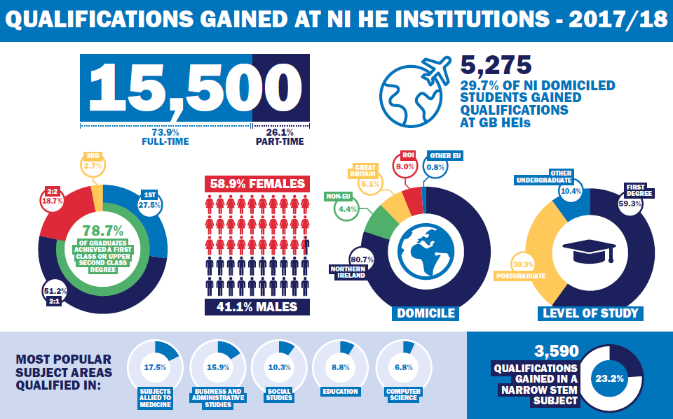
Tertiary Education statistics and research outputs

Slide 104

Tertiary Education statistics and research outputs

Slide 105

Tertiary Education statistics and research outputs

Slide 106

Tertiary Education statistics and research outputs

Slide 107

to replace DLHE
Background
The largest UK-wide annual social survey
Captures employment / study status and perspectives of 700,000 graduates from 450 HE providers (including FE Colleges)
Designed to help:
  understand graduate destination choices and how these reflect their skills
  inform course and career destination choices of prospective students

Slide 108
to replace DLHE
Changes and Impacts
Completed 15 months after graduation (online, phone or post)
  more time to find career path, do a master’s or take a ‘gap year’
Administered independently of providers:
  conducted consistently and less likely to be susceptible to ‘gaming’
More core questions (and optional question banks)
But it will mean a reduced response rate
And it’s also meant a ‘gap year’ for destinations outputs

Slide 109
to replace DLHE
Outputs (still under discussion)
HESA to release ‘Experimental’ statistics initially (spring 2020)
  More interactive, but perhaps less extensively disaggregated
Stats Authority to reassess National Statistics status at later stage
DfE to determine need for additional NI-specific outputs
DfE to revisit PfG measure on destinations 6 months after graduation

Slide 110
Youth Training Statistics and Research Branch, DfE
Department for Economy, Jamie Stainer

Slide 111
YTSRB Outputs
    Apprenticeships NI Statistical Bulletin
    Training for Success Statistical Bulletin
    Higher Level Apprenticeships Bulletin
    Next bulletins – February 2020

Slide 112


Slide 113
New Developments
Analysis of apprenticeship pay – HMRC data linked to AppsNI records
Plans to link DfE post-school education records to Schools data from DE to create an All Education Database
Ambition to create a Longitudinal Education Outcomes dataset for NI including education, HMRC and benefits data

Slide 114
Proposed Linkage for LEO-NI
Longitudinal
Education Outcomes Study for NI
(LEO-NI)
Apprenticeships and Training programme data
DE/DfE Education Database
Further Education (FE)
HMRC
Higher Education (HE)
DfC Benefits data
School Census/School Leavers (DE)

Slide 115

Questions Comments Suggestions?
Graphic?

Slide 116
Earnings
Annual Survey of Hours and Earnings
ELMS, Ashleigh Warwick
HMRC - Real Time Information from PAYE system -
ELMS, Ashleigh Warwick
Q&A

Slide 117
Annual Survey of Hours and Earnings
Economic and Labour Market
Statistics, Ashleigh Warwick

Slide 118
ASHE 2018
Publication date – 29th October
Publication
  Full bulletin
  Separate PDFs for each section
GIFs
  Distribution of hourly earnings
  Gender Pay Gap
Infographics
NINIS

Slide 119

ASHE 2018
Publication date – 29th October
Publication
  Full bulletin
  Separate PDFs for each section
GIFs
  Distribution of hourly earnings
  Gender Pay Gap
Infographics
NINIS

Slide 120
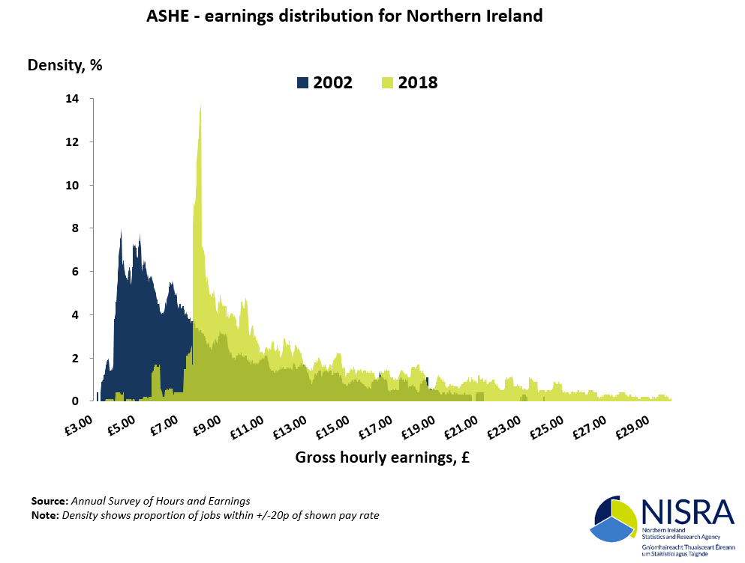
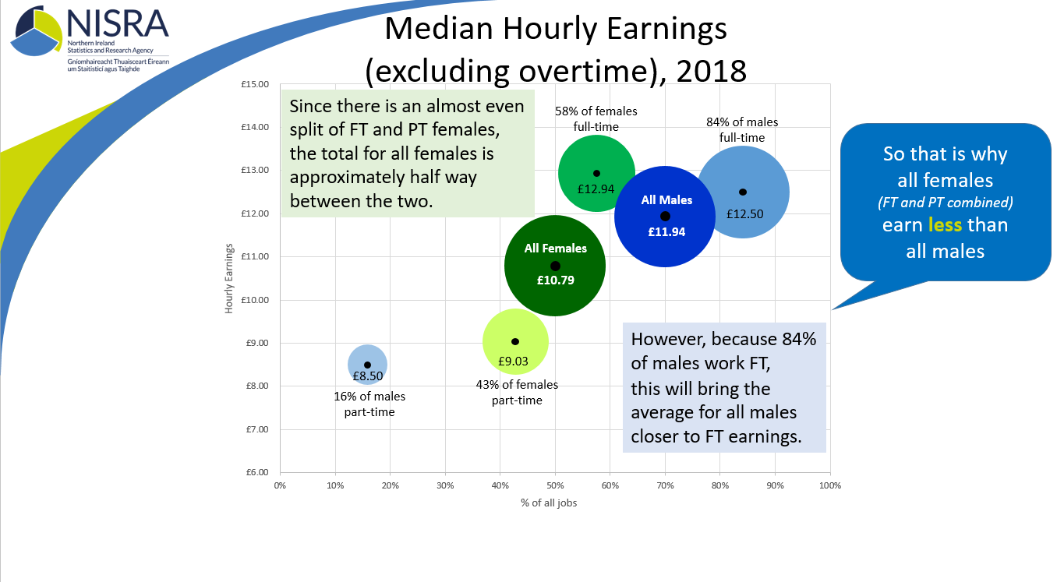
ASHE 2018
Publication date – 29th October
Publication
  Full bulletin
  Separate PDFs for each section
GIFs
  Distribution of hourly earnings
  Gender Pay Gap
Infographics
NINIS

Slide 121






ASHE 2018
Publication date – 29th October
Publication
  Full bulletin
  Separate PDFs for each section
GIFs
  Distribution of hourly earnings
  Gender Pay Gap
Infographics
NINIS

Slide 122
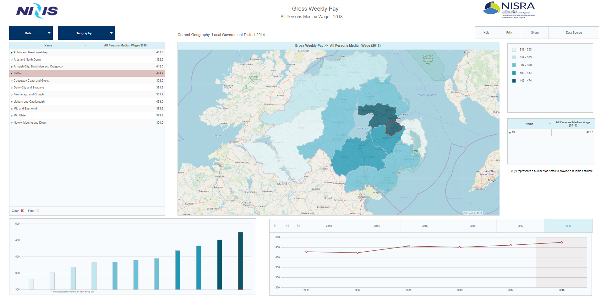
ASHE 2018
Publication date – 29th October
Publication
  Full bulletin
  Separate PDFs for each section
GIFs
  Distribution of hourly earnings
  Gender Pay Gap
Infographics
NINIS

Slide 123

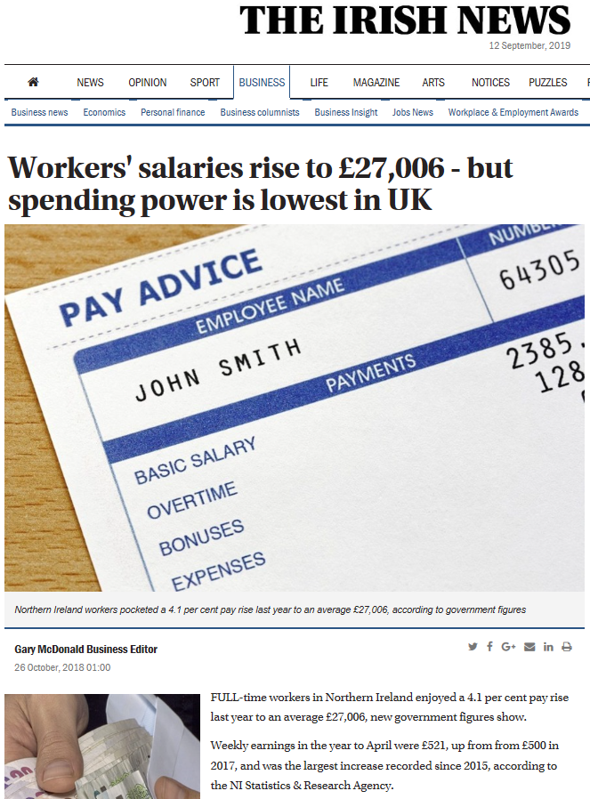
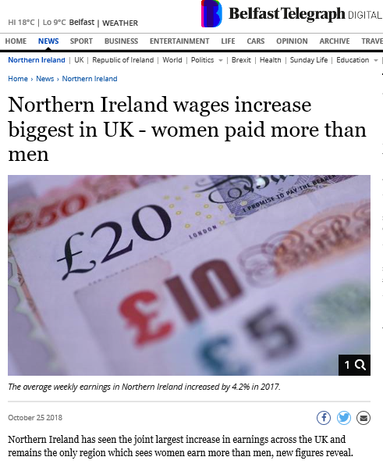




Slide 124
To what extent do you use the
Annual Survey of Hours and Earnings statistics?
User Consultation
Additional analysis suggestions
Times of hours worked
Linkage to business survey data
Qualification level, subjects studied (especially at NQF level 6+)
Commuting

Slide 125
Census Data Linkage
ASHE 2011
ASHE 2013
Census 2011
ASHE 2012
ASHE 2014
ASHE 2017
ASHE 2016
ASHE 2015
ASHE 2018

Slide 126
HMRC- Real Time Information from PAYE system
Economic and Labour Market
Statistics, Ashleigh Warwick

Slide 127
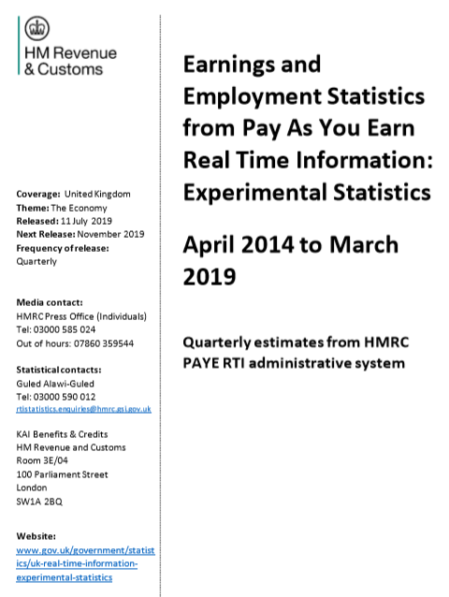
RTI PAYE Data
EXPERIMENTAL

Slide 128
RTI PAYE Data
First published – 30th January 2019
JANUARY 2019
Mon Tue Wed Thu Fri Sat Sun
1 2 3 4 5 6
7 8 9 10 11 12 13
14 15 16 17 18 19 20
21 22 23 24 25 26 27
28 29 30 31
EXPERIMENTAL

Slide 129
RTI PAYE Data
First published – 30th January 2019
Latest publication date – 11th July 2019
JANUARY 2019
JULY 2019
Mon Tue Wed Thu Fri Sat Sun
Mon Tue Wed Thu Fri Sat Sun
1 2 3 4 5 6
7 8 9 10 11 12 13
14 15 16 17 18 19 20
21 22 23 24 25 26 27
28 29 30 31
1 2 3 4 5 6 7
8 9 10 11 12 13 14
15 16 17 18 19 20 21
22 23 24 25 26 27 28
29 30 31
EXPERIMENTAL

Slide 130
RTI PAYE Data
First published – 30th January 2019
Latest publication date – 11th July 2019
Next release – 12th November 2019
HMRC & ONS
Monthly releases
JULY 2019
NOVEMBER 2019
Mon Tue Wed Thu Fri Sat Sun
Mon Tue Wed Thu Fri Sat Sun
1 2 3
4 5 6 7 8 9 10
11 12 13 14 15 16 17
18 19 20 21 22 23 24
25 26 27 28 29 30 31
1 2 3 4 5 6 7
8 9 10 11 12 13 14
15 16 17 18 19 20 21
22 23 24 25 26 27 28
29 30 31
EXPERIMENTAL

Slide 131
ASHE 2019
Publication date – 29th October
Publication
  Full bulletin
  1: Overview of Earnings
  2: Gender Pay Gap
  3: High and Low Pay
GIFs
  Distribution of hourly earnings
  Gender Pay Gap
NINIS
Infographics
2
0
P
I
a
n
9

Slide 133
Final Comments and Close
Thanks!

