Slide 1
Vital Statistics Unit
User Group Meeting
10 November 2021

Slide 2
Agenda
Structure and role of the branch
Publications
  Current outputs
  Recent developments
  Future plans
Dissemination
Suicide Review

Slide 3
Branch Structure
VARS
Branch
Admin Research Unit
Vital Statistics Unit
Data Management
Publications
Covid Research
Other Research

Slide 4
Role of Vital Statistics Unit
  Validate and clean the administrative data collected by GRO during the process of registering births, deaths, marriage and civil partnerships
  Produce a range of outputs in a timely manner and to a high level of accuracy
  Answer ad hoc requests, FOIs, Assembly Questions etc.
  Provide briefing materials for Ministers
  Share data with relevant authorities
  Working within the framework of the OSR Code of Practice

Slide 5
What we seek from you
Positives and negatives
Key data gaps – entire or partial
Views on presentation of data e.g. commentary, infographics, dashboards, timeliness

Slide 6
Vital Statistics Unit Outputs
Carly Gordon

Slide 7
Legislation
Section 34 of the Marriage (Northern Ireland) Order, 2003
Article 3(3) of the Births and Deaths Registration (Northern Ireland) Order, 1976
Section 154 of the Civil Partnership Act, 2004

Slide 8
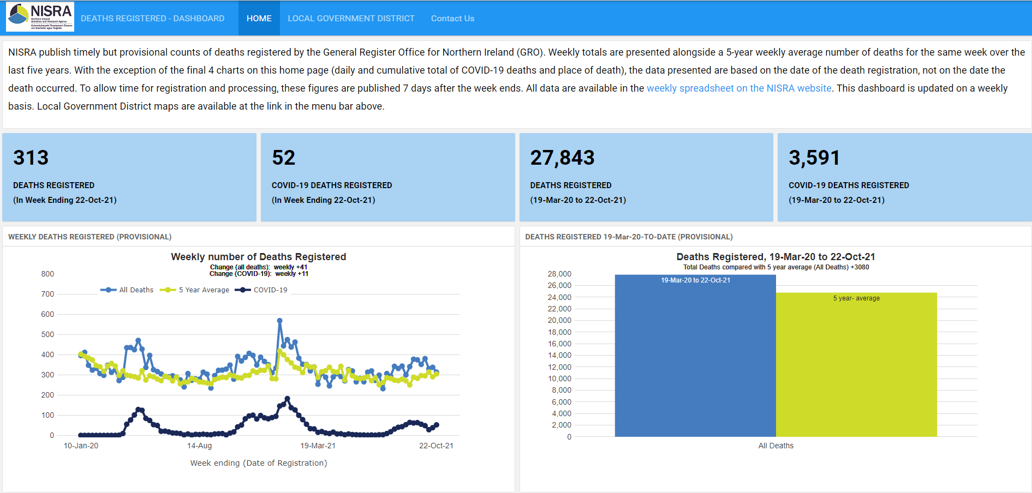

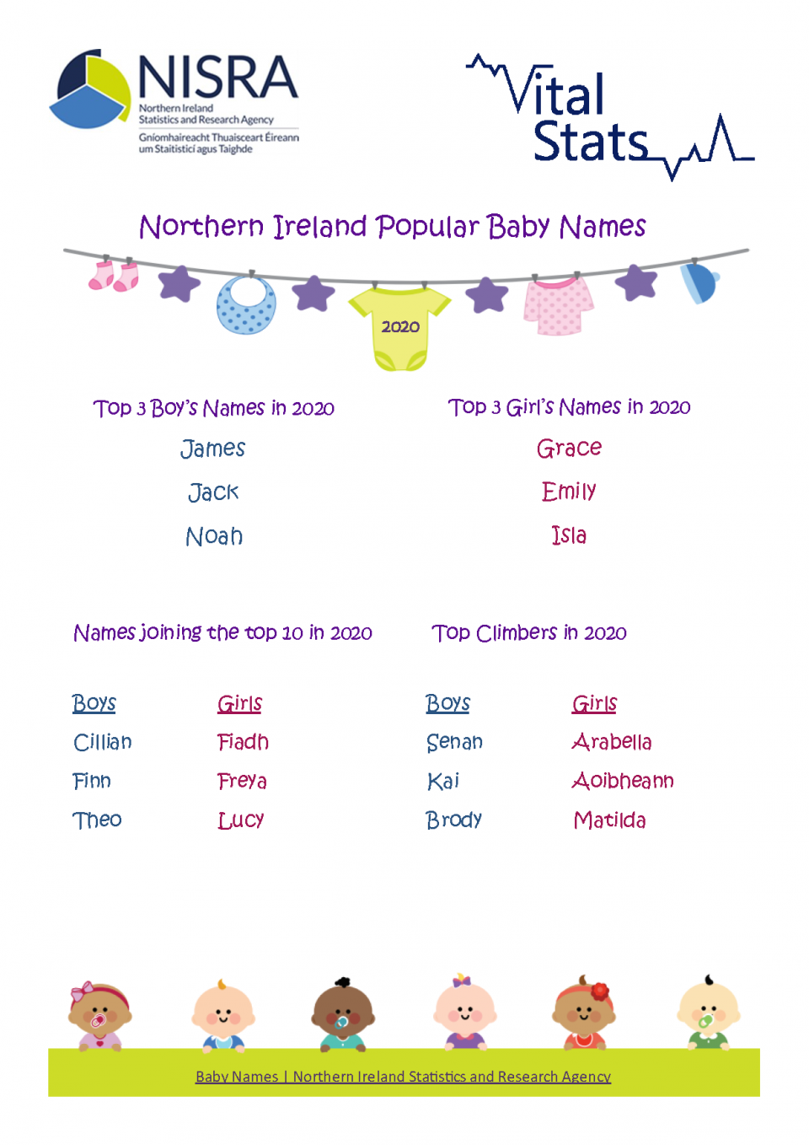
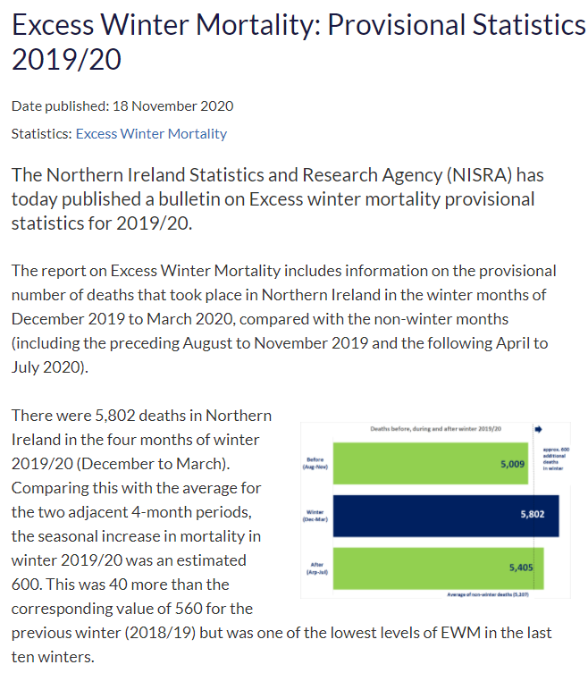
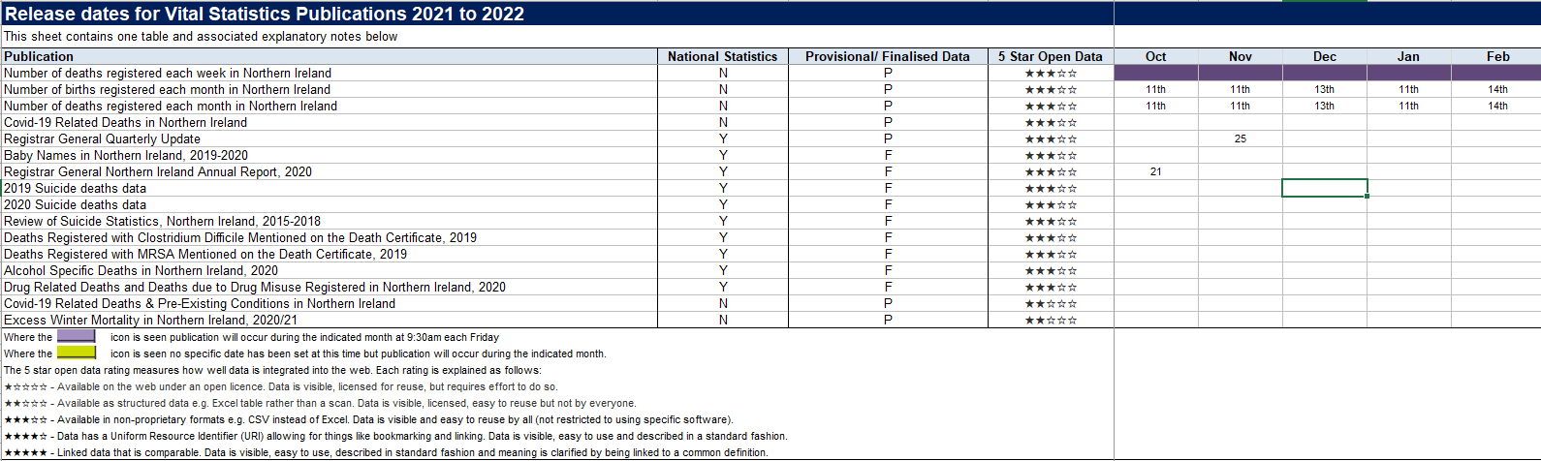

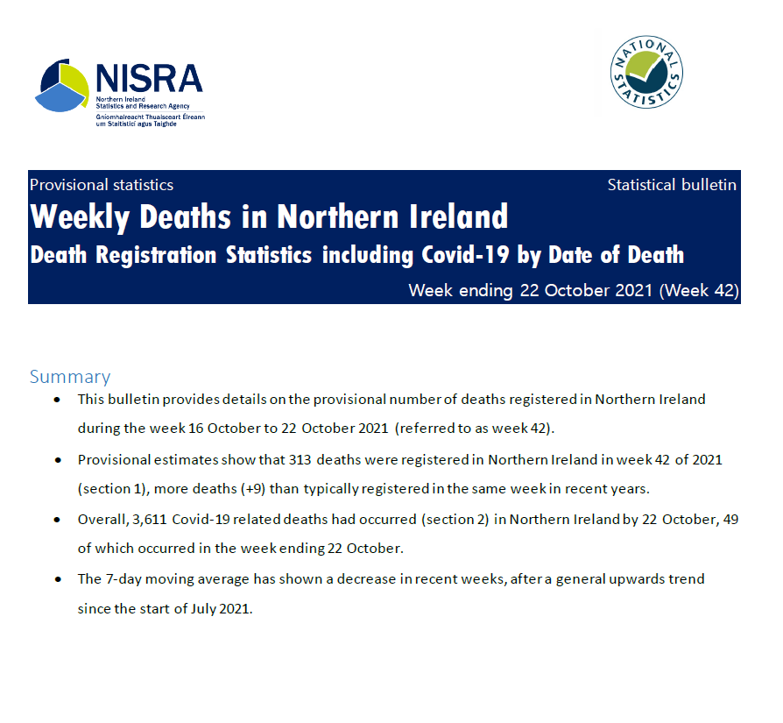
Publication schedule - https://www.nisra.gov.uk/publications/vital-statistics-documentation
Weekly – deaths bulletin
Monthly – monthly count of deaths and births
Quarterly – Quarterly RG Tables on births, deaths and marriages
Annual – Annual RG Report; Alcohol specific deaths; Drug related deaths; Suicides; HCAI deaths; Baby names, Excess winter mortality

Slide 9
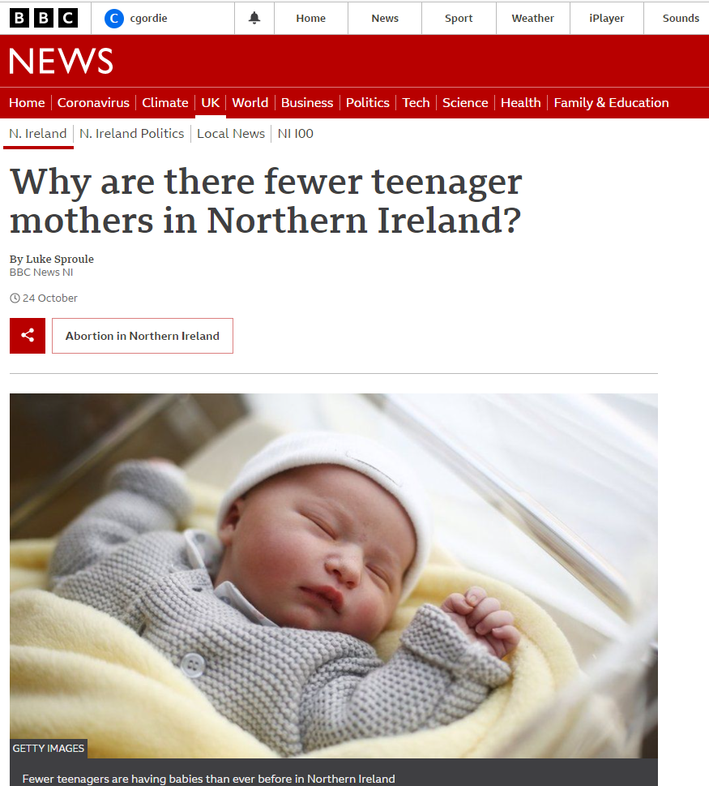
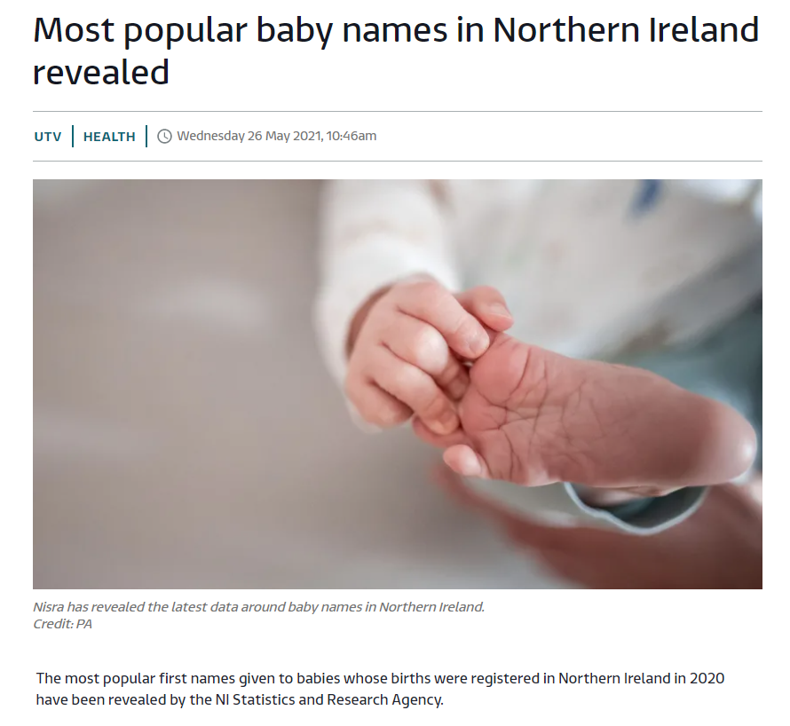
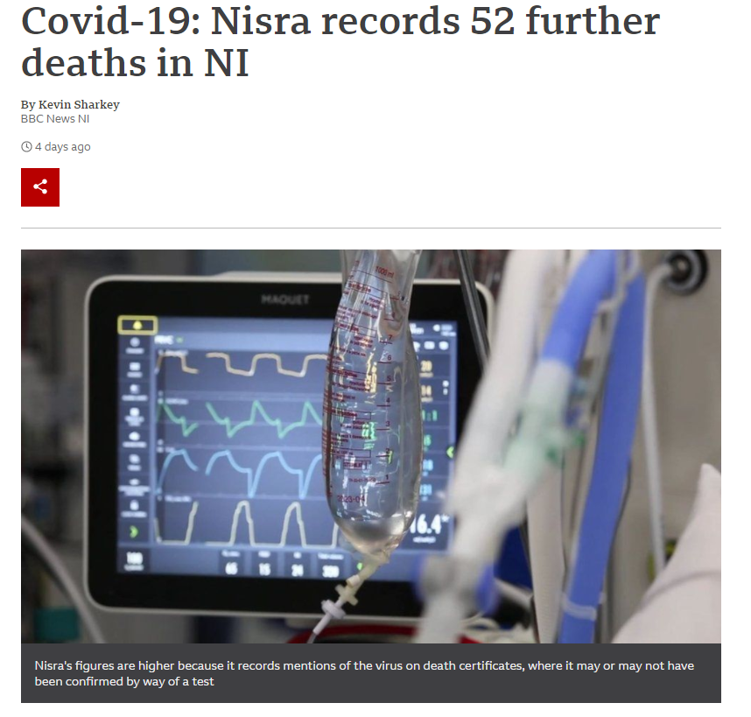
Media

Slide 10
Recent developments
Weekly deaths bulletin
Excess winter mortality – change in methodology
RG Annual Report and RG Quarterly– tables to cover changes in legislation around same sex marriage and opposite sex civil partnership; also incorporation of Covid-19 deaths
Baby Names dashboard
Accessibility/ODS
Website
Newsletter
Increased use of mailing list and social media
Media briefings

Slide 11
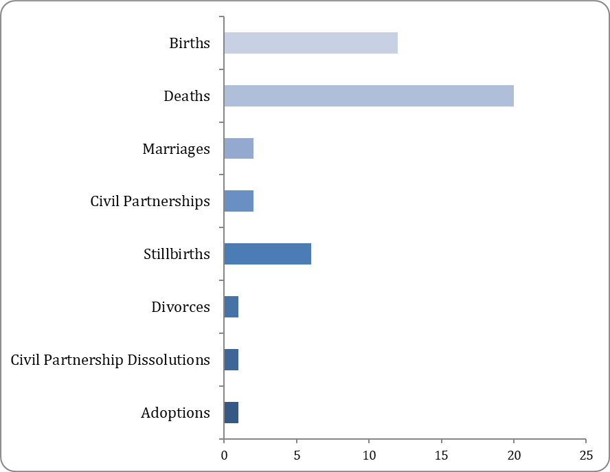
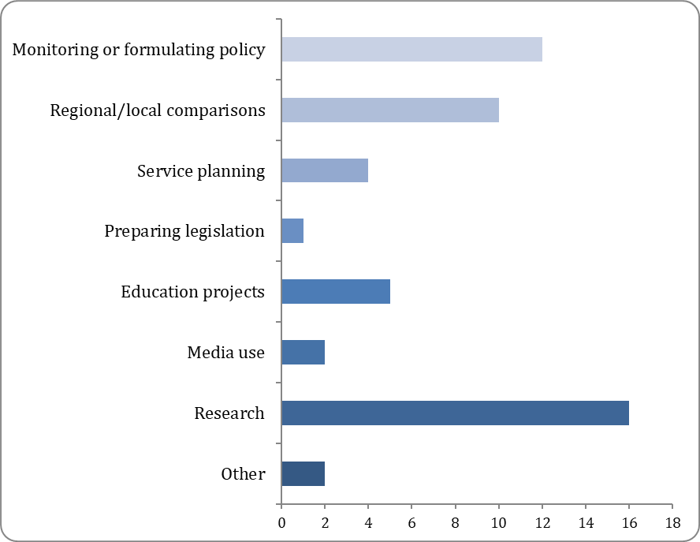
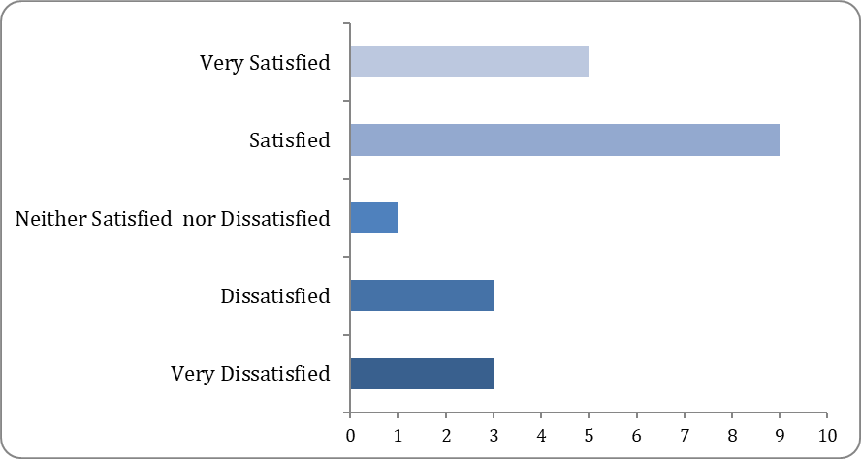
Feedback from Users – User Survey
Vital Events data used
How data is used
Satisfaction with Statistics
Notes:
-

Slide 12
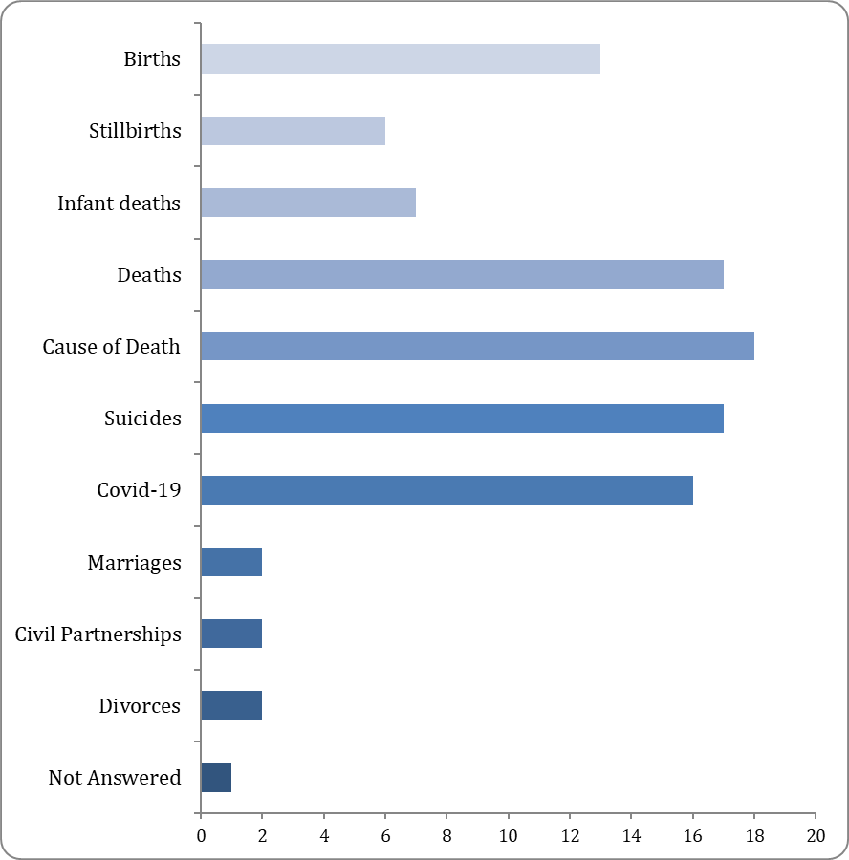
Feedback - Registration info
Which topics are you most interested in?
What specifically would you like to be covered at the User Group?
More information on the production of deaths data
How covid deaths are identified
Update on suicides

Slide 13
Direct feedback
“The statistical data being presented on Covid-19 is simply outstanding, really clear and useful” (anon user)
“The briefings have worked really well and have definitely helped the understanding and reporting of the COVID death statistics. Journalists have also really valued the opportunity to get to ask questions and gain a better understanding of the statistics.” [DoF Press office]
“I'm delighted that, in contrast to the ONS and NRS, NISRA is still providing data on the standard (2016-2020) 5 year average. And even more delighted to discover you're also making your data available in OpenDocument as well as Excel format.“ (anon user)

Slide 14
Future plans
Regular newsletters
Ongoing media briefings for new / complex outputs
RG 100
Consultations on current outputs
Topic specific user groups
Review of website layout (within the NISRA website)

Slide 15

Questions?

Slide 16
Dissemination
Our Vision:
"User Shaped, High Quality Vital Statistics"
Claire Rocks

Slide 17
Dissemination
Our users can be grouped into the following target groups:
The general population
Specific Interested Parties
Professional Users
Analysts

Slide 18
Dissemination

Slide 19
Dissemination
We plan to achieve this through Continuous Improvement & Innovation
Enhancing Commentary
Interactive Content
Develop User Defined Access

Slide 20
Discussion
Thoughts on dissemination plans
How clear is your understanding of data source, definitions, coverage and limitations?

Slide 21
Review of Suicide Statistics

Slide 22
Review of Suicide Statistics
Suicide Definition:
Deaths Due to Intentional Self Harm
ICD: X60-X84, Y87.0
Number of Suicides in NI
Events of Undetermined Intent
ICD: Y10-Y34, Y87.2

Slide 23
Period 2
Period 1
Standard of Proof lowered

Slide 24
Review of Suicide Statistics
Progress
Coroner’s Service currently reviewing cases – hope to be finished this early 2021
Revisions expected March 2022
Break in series in 2015 is likely

Slide 25
Review of Suicide Statistics
Questions?

