Slide 1
Labour Market Statistics User Group
Economic and Labour Market Statistics Branch

Slide 2
Agenda
Overview
Labour Force Survey Carly Gordon
Claimant Count Ashleigh Warwick
Annual Survey of Hours and Earnings Cathryn Blair
Quarterly Employment Survey
Business Register and Employment Survey
Close

Slide 3
Purpose of the meeting
Provide an overview of our main labour market outputs and plans for developments over the next year
Seek feedback on development plans

Slide 4
Year of Records
Unemployment reached its lowest on record, and is now 4.0%. Claimant count has been falling for the last five years
Number of employee jobs are at their highest level on record (765,000). Private sector jobs are also at highest.
Median weekly earnings above £500 a week for full-time employees for the first time, although adjusted for inflation, real wages decreased over the year.
Inactivity remains highest of UK regions and is similar to rates 5 years ago.

Slide 5
Data Collection
Labour market outputs are based on survey, census and administrative data
Labour Force Survey, Quarterly Employment Survey, Annual Survey of Hours and Earnings
Business Register and Employment Survey
Claimant Count and Redundancies
Falling response rates to household and business surveys

Slide 6
ONS data acquisition
Make effective and efficient use of non-survey data held across government to produce existing and new outputs, thereby reducing respondent burden and costs
Reducing our reliance on surveys to collect only those data that cannot be sourced from non-survey sources, moving to mixed mode data collection

Slide 7
Agenda
Overview
Labour Force Survey Carly Gordon
Claimant Count Ashleigh Warwick
Annual Survey of Hours and Earnings Cathryn Blair
Quarterly Employment Survey
Business Register and Employment Survey
Close

Slide 8
Labour Market Statistics User Group – Labour Force Survey

Slide 9
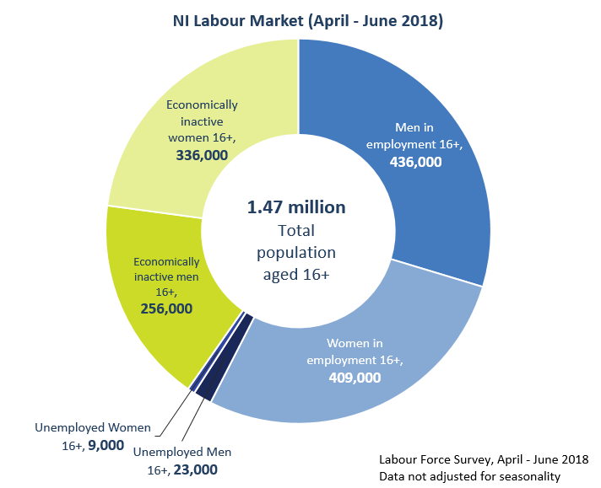
Labour Force Survey – Summary of changes
Operational
Boost
Reweighting
Incentives
ONS Transformation
Questionnaire
Job satisfaction
Test of work quality questions
Outputs/Publications
Quarterly Supplement
Labour Force Survey Annual Report
Women in Northern Ireland
User defined requests
Infographics

Slide 10
Operational – Sample Boost
Response Rates
Boost in 2016 (130 increase)
Boost in 2018 (extra 420 in each wave 1)
Fully implemented by Q2 2019 to 1300 Wave 1
Sample size (households per quarter)
750 households sampled per quarter Wave 1 2015

Slide 11
Operational - Incentives
Incentive trial to begin in 2018
Includes 3 waves
Aim to boost response rates and attrition
Similar trial in ONS with promising initial results

Slide 12
Operational - Reweighting
LFS data weighted up to population
Based on latest MYE
Will affect data back to 2012

Slide 13
Questionnaire
New questions
Job satisfaction began January 2018
Test of work quality questions (add in topics)

Slide 14
Publications – Quarterly Supplement
Current
Short report with a set of more in depth tables to supplement the Labour Market Report
Usually released 2 weeks after the relevant LMR
Covers disability, qualifications, self-employment, graduates, NEETs and some household analysis
Planned
Incorporate most tables into the LMR
Keep tables under review
Later release for NEET and household data

Slide 15
Publications – Labour Force Survey Annual Report
Then
LADB
District Council Brief
Now
Area level Analysis
PfG/ODP Indicator Updates
Future
Headline data in March/ April
Sub-national data released after
LFS Annual Report

Slide 16
Publications – Women in NI
Informal consultation – Dec 2017 to Jan 2018
Limited feedback
Future editions focus on LFS only

Slide 17
Outputs
User defined requests
www.nisra.gov.uk/statistics/labour-market-and-social-welfare/user-requested-data

Slide 18
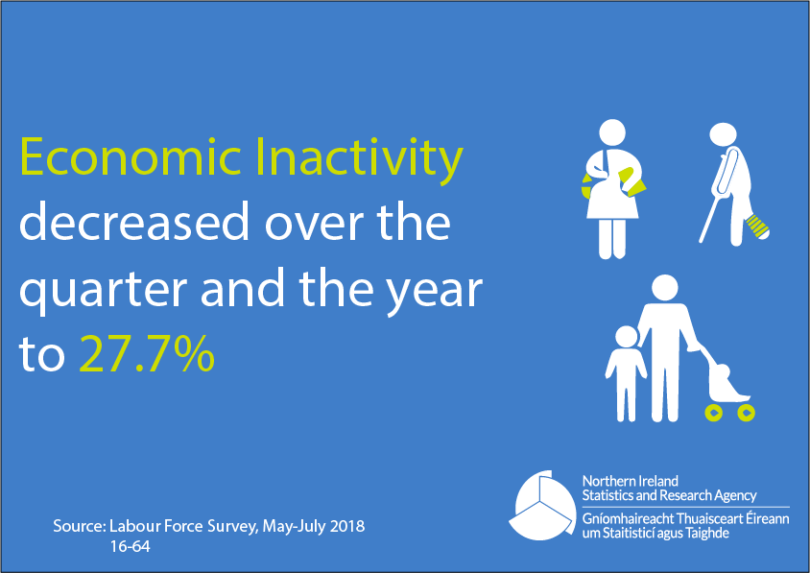
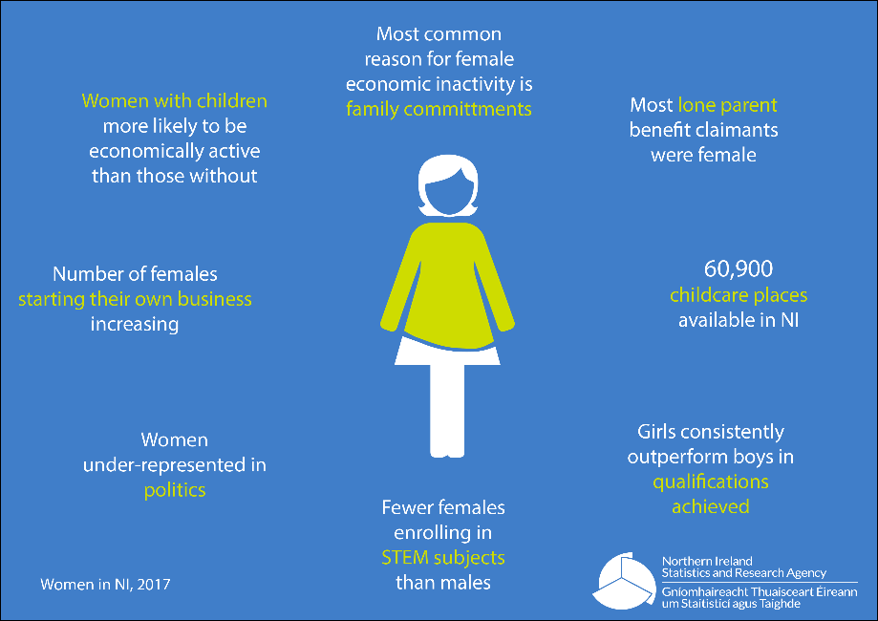
Outputs
Infographics – twitter @ELMSNISRA

Slide 20
Labour Market Statistics User Group – Claimant Count

Slide 21
Claimant Count- Overview
Results are published each month in the LMR
Data is derived from Jobs and Benefits Offices systems
Counts relate to second Thursday in each month
Published a month after count date
From 1996 to 2018, Claimant count was based on JSA
Universal Credit has now been introduced

Slide 22
Introduction of Universal Credit
Universal Credit is a benefit for working age people on low income or out of work
It will eventually replace six existing benefits and tax credits
It was introduced for new claims on a phased geographic basis from September 2017 to December 2018
All claimants will be transferred to universal credit by March 2023

Slide 23
Change in Claimant Count Definition
From March 2018, claimant count outputs have changed
Old definition (pre-2018)
The NI claimant count consists of all people claiming Jobseeker’s Allowance (JSA) at Jobs and Benefits offices.
They must declare that they are out of work, capable of, available for and actively seeking work during the week in which their claim is made
New definition (2018 onwards)
The NI claimant count consists of
all people claiming Jobseeker’s Allowance (JSA) PLUS out-of-work Universal Credit (UC) claimants who were claiming principally for the reason of being unemployed.
They must declare that they are out of work, capable of, available for and actively seeking work during the week in which their claim is made.
Old definition (pre-2018)
The NI claimant count consists of all people claiming Jobseeker’s Allowance (JSA) at Jobs and Benefits offices.
They must declare that they are out of work, capable of, available for and actively seeking work during the week in which their claim is made

Slide 24
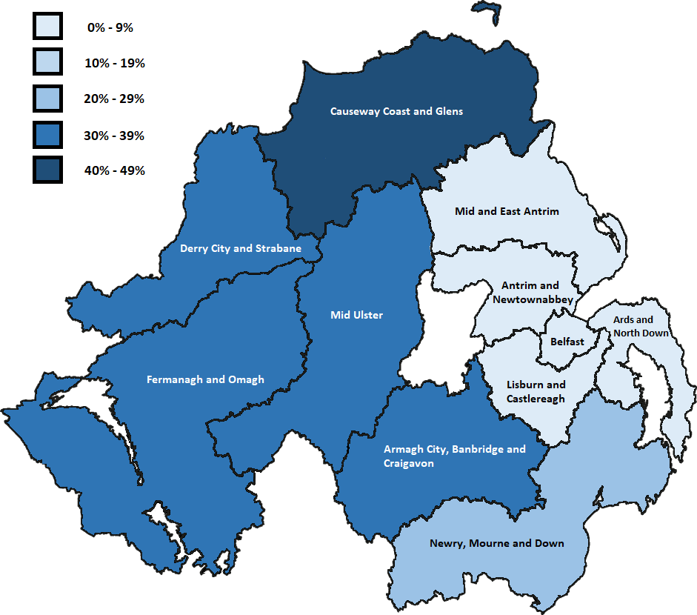
% of Claimants on Universal Credit

Slide 25
% of Claimants on Universal Credit

Slide 26
% of Claimants on Universal Credit

Slide 27
Impact of Universal Credit
Available in 25 out of 35 jobs centres
20% of claimants are now on Universal Credit
Original JSA only data still available from NOMIS
National Statistics Designation removed
Experimental Statistics
Experimental
www.nomisweb.co.uk

Slide 28
Impact of Universal Credit
Increase in numbers of claimants is expected
Geographical analyses have been removed from the LMR

Slide 29
DWP Consultation on Outputs
Consultation – May to July 2018
Option 1
Lifts the historical Claimant Count to what it would have been in a “Universal Credit world”
Option 2
Adjusts the current Claimant Count to remove additional claimants in order to continue to derive a measure of JSA jobseekers
Results will be available late October

Slide 31
Labour Market Statistics User Group – Annual Survey of Hours and Earnings (ASHE)

Slide 32
Annual Survey of Hours and Earnings Overview
Survey of employers
1% of all NI employees (7,000)
Pay – week containing 26th April 2017
Hourly, weekly, annual earnings
Gender, work pattern, industry, occupation
Public and private sector

Slide 33
Outputs
Publication date – 29th October (provisional)
Publication
Gender pay gap
Public/private sector
Low Pay
Hours
Distribution of hourly earnings GIF

Slide 35
Questions?

Slide 36
Labour Market Statistics User Group – Quarterly Employment Survey (QES)

Slide 37
Quarterly Employment Survey - Overview
Relates to first Monday in September, December, March and June
Published a quarter after survey date
Collects number of jobs,
male/female,
working pattern,
industry
Incl. temporarily away, agency workers on the payroll

Slide 38
Sample Design
Total sample size: ~6,000
Sample design: census 62%, sample 38%
* (10% rotation each quarter)
Coverage of businesses by employment size/sector:
Employment Size/Sector | Coverage
0-9 employees | Sample (4%)
10-24 employees | Sample (9%)
Multiple Industry Activities | Full Count (100%)
25+ employees | Full Count (100%)
Public Sector | Full Count (100%)
*Based on Q2 2018 data

Slide 39
Outputs
Aim to provide point-in-time estimates but also measure change in employee jobs
Data are produced each quarter for:
Total Employee Jobs
Public and Private Sector series
Working pattern: Full –time and Part-time
Industry breakdowns (Broad industry sector to 2 digit SIC code e.g. manufacture of textiles)
Breakdown of Public Sector Employment by quarter

Slide 40
Outputs

Slide 41
Total Employee Jobs
Figure 2.1: Index of Employee Jobs, June 2008 – June 2018
Figures are indexed to June 2008

Slide 42
Public and Private Sector series
Figure 3.1: Index of NI Private and Public Sector Jobs, June 2008 – June 2018
Figures are indexed to June 2008

Slide 43
Full -Time and Part- Time jobs
Figure 4.1: Full-Time and Part-Time jobs annual change, June 2008 – June 2018

Slide 44
Change in outputs
In 2017 consultation held and two annual outputs were removed;
Civil Employment and Workforce in Employment
Added confidence intervals to headline outputs this quarter (Q2 2018), develop now on ongoing basis
765,100 +/- 5,600
Seasonal adjustment review in next 6 months

Slide 45
Benchmarking….
QES revise estimates each quarter back to Q3 2015 (BRES 2015)
Next benchmarking is due following BRES 2017 results
Benchmarking process brings QES and BRES in line for Q3 2017
Steps in difference between 2015 and 2017

Slide 46
Questions for users
Outputs meeting user needs?

Slide 47
Labour Market Statistics User Group – Business Register and Employment Survey

Slide 48
Business Register and Employment Survey - Overview
Annual survey: first Monday in September
Published a year after survey date……2017 results tomorrow
Collects business structure and employee jobs
Business structure information is used to maintain the business register from which survey samples are drawn
Collects employee job figures at local unit level – allows data to be disaggregated by NI geographies
Industry activity is also collected
Every output referred to as……. BRES

Slide 49
Sample
Census element:
All public sector
More than one local unit
More than 5 employees
GB based operating in NI
Sample element – Neyman allocated sample of remaining businesses.

Slide 50
4-Year Survey Cycle
Sample/Census

Slide 51
Geography & Industry Outputs
 |  |  | Geography |  |  |  | Industry
Survey | Year | Approx sample size | NI | District Council Area | Parliamentary Constituency Area | Ward | Broad Industry | Industry Section (A-S) | 5 - digit SIC
BRES | 2017 | 30,000 | ü | ü | ü | ü | ü | ü | ü
BRES | 2016 | 12,000 | ü | ü | û | û | ü | û | û
BRES | 2015 | 70,000 | ü | ü | ü | ü | ü | ü | ü
BRES | 2014 | 12,000 | ü | ü | û | û | ü | û | û
CoE | 2013 | 30,000 | ü | ü | ü | ü | ü | ü | ü
BRES | 2012 | 12,000 | ü | ü | û | û | ü | û | û
CoE | 2011 | 55,000 | ü | ü | ü | ü | ü | ü | ü
BRES | 2010 | 8,000 | ü | ü | û | û | ü | û | û
CoE | 2009 | 30,000 | ü | ü | ü | ü | ü | ü | ü

Slide 52
New Questions for 2018
Migrant Workforce
Q. How many of the total employees, at this location, are citizens of:
Rest of EU (excluding UK and Ireland)
Rest of World (excluding UK, Ireland and Rest of EU)
Vacancies
Q. How many job vacancies were you actively trying to fill from outside your business, for this location, on 3 September 2018?

Slide 53
Questions for users
Outputs meeting user needs?
Use of small BRES outputs?

Slide 54
Thank you and Close
Presentations will be published on NISRA website
Any outstanding questions followed up after the event

